Slide 1

The First Cut Is the Deepest
Lynn Treffry
August 31, 2021
Notes:
Thank You Jane and …
… welcome everyone to another “Stock Investing Made Easy” Presentation
Tonight’s class is titled “The First Cut Is The Deepest”
I’m Lynn Treffry, tonight’s presenter.
>>

Slide 2

Disclaimer
The information in this presentation is for educational purposes only and is not intended to be a recommendation to purchase or sell any of the stocks, mutual funds, or other securities that may be referenced. The securities of companies referenced or featured in the seminar materials are for illustrative purposes only and are not to be considered endorsed or recommended for purchase or sale by BetterInvestingTM National Association of Investors Corporation (“BI”). The views expressed are those of the instructors, commentators, guests and participants, as the case may be, and do not necessarily represent those of BetterInvestingTM. Investors should conduct their own review and analysis of any company of interest before making an investment decision.
Notes:
We have two slides of the legal stuff and I’ll try to hit the high points.
Any information presented is for illustrative and educational purposes only.
NO buy/sell/hold recommendations for any stock/security is intended or implied.
The views expressed are those of the instructor and not necessarily those of BI.
Investors should always conduct their own research, review, and analysis of any stock OR security before making any investment decisions.
Moving on to pg 2 of the disclaimers >>

Slide 3
Disclaimer
Securities discussed may be held by the instructors in their own personal portfolios or in those of their clients. BI presenters and volunteers are held to a strict code of conduct that precludes benefiting financially from educational presentations or public activities via any BetterInvesting programs, events and/or educational sessions in which they participate. Any violation is strictly prohibited and should be reported to the CEO of BetterInvesting or the Director of Chapter Relations.
This presentation may contain images of websites and products or services not endorsed by BetterInvesting. The presenter is not endorsing or promoting the use of these websites, products or services.
This session is being recorded for future use.
Notes:
Securities discussed may be held by the instructors or clubs they may belong to.
All presentation participants are volunteers and are precluded from benefiting financially from this presentation.
The presentation may contain images of websites, products, or services not endorsed by BI. Any mention of these is not intended as an endorsement.
This session is being recorded for the future use.
One more thing here, Let’s take a quick slide about the control panel>>

Slide 4


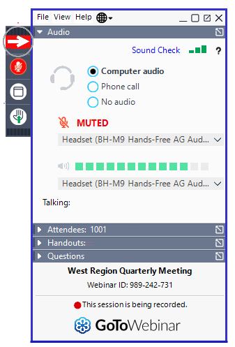
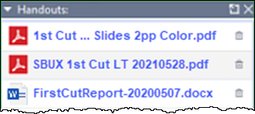
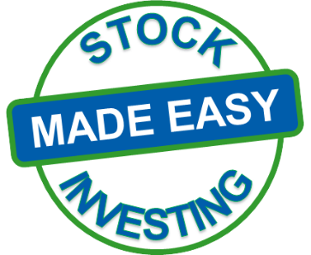
On the
Control Panel
Click Here to
Download Handouts
Click Here to Ask a Question
Notes:
An your first question may be, What Control Panel?
If all you can see is this, click on the red arrow.
It’s a little like magic, You can make the control panel appear or disappear at will with the red arrows
Click to download handouts
Click to ask a question
So, moving on to the First Cut Is the Deepest >>

Slide 5

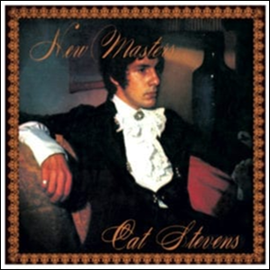
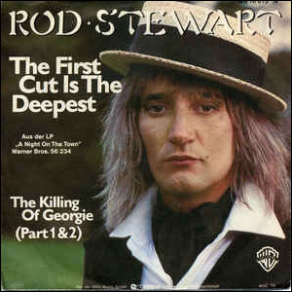



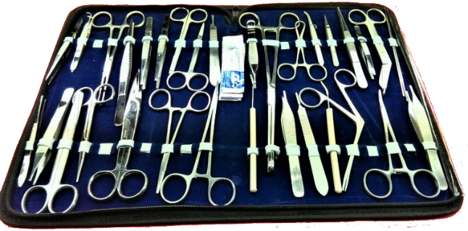

The First Cut Is the Deepest
Notes:
This Title is catchy and definitely grabs attention.
It takes me back to my young adulthood and the
Cat Stevens 1967 Hit of the same name.
It’s been Covered by others several times over the years
However that title also Conjures up some other alarming images
But, tonight we’re going to look at BI’s First Cut …
Diving a little deeper into the BetterInvesting First Cut>>

Slide 6
The First Cut Is the Deepest
The BI First Cut is NOT a deep cut.
It’s just a simple method to help BI Members
improve their stock studies.
Notes:
Clarifying the title a little bit …
Our First Cuts is not the deepest cut.
It’s a straightforward tool to help us enhance or improve our stock studies.
Let’s get a little deeper into it.
Moving on to today's objectives, takes us to the corner of First Cut & SSG Streets>>

Slide 7

Objective …
To show how the First Cut helps us improve SSG judgments.
What is a First Cut Report / Study?
Features & Benefits.
Preparing & submitting a study.
Finding and using reports done
by others.
Notes:
We want to show how First Cut Reports/Studies can be a valuable tool to enhance SSG judgments.
… Just a quick clarification I’ll be using the words report and study interchangeably.
We will show you what exactly a First Cut Report is
All its features & benefits
What needs to be done to prepare and submit your own First Cut
How to find and use First Cut done by others.
I just mentioned SSG … for those not familiar here’s a description >>

Slide 8
SSG?
The ‘Stock Selection Guide’ or ‘SSG.’ is BetterInvesting’s primary stock analysis tool. It organizes a company's historical financial data to help investors identify the characteristics of quality growth companies and enable plotting of potential future growth from historical trends.
Notes:
This is not an SSG class
A quick description is …
It’s BI’s tool that we use for initial fundamental stock analysis.
As mentioned before, It is our goal to show how The First Cut can help with your SSG
So, what is a First Cut

Slide 9
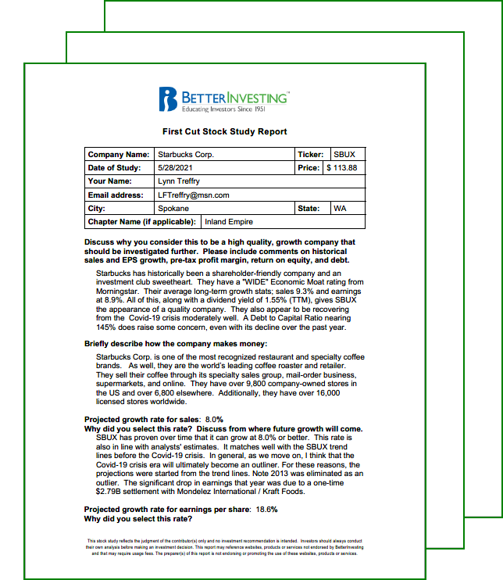

What Is a ?
A First Cut is simply
an SSG stock study with explanations.
It is a Learning Tool.
  That shares ideas to help improve SSG judgments.
Prepared by BI members.
Shared with BI members.
They are only shared ideas
NOT recommendations!
Notes:
It’s just a stock study, SSG, with explanations.
A learning tool
Which will help improve your SSG judgments
They’re prepared by BI members
And shared with BI members.
But, they are just shared ideas – NOT RECOMENDATIONS
It’s been suggested that all First Cuts should be stamped with “DO YOUR OWN RESEARCH”
I agree
Let’s take a look at its features >>

Slide 10
A Completed First Cut Study Features
An organized consistent format for SSG study details.
The answers to why a company is thought to be a ‘quality company.’
Description of how the company makes money.
The rationale, or the ‘whys’ behind all SSG judgments.
Details of SSG’s results.
Explanation of all conclusions.
Notes:
Handily, it provides a uniformly organized format for study details.
It shows “why this is a quality company?”
It also explains how a company makes money.
With this, Warren Buffett comes to mind. One of his cardinal rules is
“DON’T INVEST IN SOMETHING YOU DON’T UNDERSTAND.
These last two bullets could help UNDERSTANDING a company.
It answers a lot of “why” questions. Why or how did you arrive at these judgment conclusions.
It shows the explains thought process behind an SSG’s results.
Explains the author’s conclusions
So, how does this benefit the user >>

Slide 11
Benefits to the User
Helps find new stock ideas to study.
Shows new or different reference tools.
Gives examples of research methodology.
Explains conclusions about a company
It can even add some market, sector, or industry understanding.
Notes:
In this case I’m defining the “user” as anyone who downloads a First Cut prepared by someone else.
We’re always looking for new stock ideas to investigate. A First Cut can help and possibly give you some ideas along the way.
I find that I fall into a routine in studying stocks
New ideas could be helpful.
>
>
You may enlightened with some new technique OR
It may validate what your already doing OR
You may just say “that isn’t for me.”
All conclusions about the studied company are explained.
This could help better understand a market, sector, or industry conditions.
Moving on the thought benefits to the Preparer. >>

Slide 12

Benefits to the Preparer
The First Cut documents SSG judgments and explains the “whys” behind them.
  Provides an organized format for study details.
  Helps prevent future “what was I thinking?” moments.
  Promotes looking a bit harder at SSG research.
  Allows your SSG judgment ideas to be shared with others in the BetterInvesting
  community.
Notes:
We’ve established The First Cut documents SSG judgments and explains the “whys” behind them.
The first cut is useful for a number of reasons but at its core it gives us an organized format for our study details.
As memories can fade there are moments where I look at an SSG after year-end earnings and have to ask “what was I thinking” when I did this?
Doing a First Cut helps me avoid this quandary.
I also find that I work harder at my SSG research when I’m doing First Cut.
I suspect this is because I may well submit my study to BI
I want to be through in my research.
So, let’s prepare a First Cut. >>

Slide 13
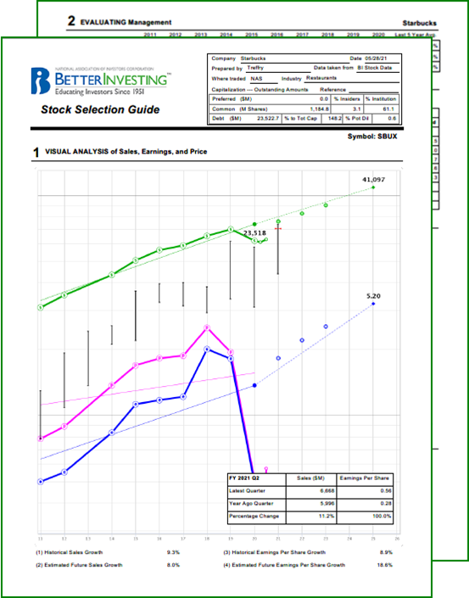
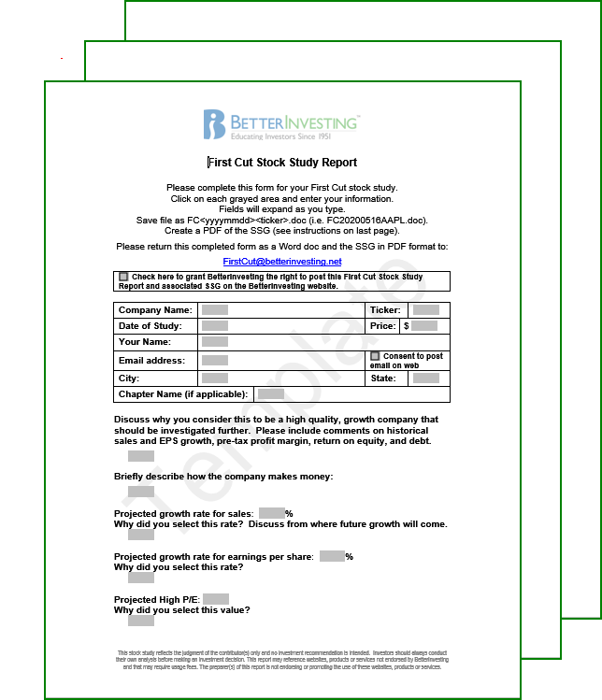
How to Prepare a First Cut Report
To start, you’ll need:
  Your final completed SSG.pdf, printed and at
  your side for reference.
  A blank template.
  ‘FirstCutReport.docx’
  A ‘DOCX’ word processor.
    MS Word
    LibreOffice Writer
Notes:
To prepare a First Cut Report or Study you’ll need three things
First, you’ll need to FINISH YOUR SSG,
Then on the SSG, click on both the Print Tab & Generate PDF Buttons.
Then print that generated SSG.pdf to paper …
this is important and we’ll talk a little more about this later.
But, be aware that you will need a copy of this when you submit your First Cut to BI.
Secondly, a blank form/template has to be downloaded.
And a .docx word processor like Microsoft Word or LibreOffice Writer
There are also several other free ones available out on the web.
Personally I’ve had no experience with anything beyond WORD …
… so I can’t speak to the viability on any others.
Let’s go download the template
Here’s how we locate and download a template>>

Slide 14
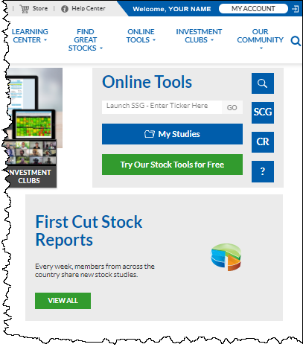

Getting a FirstCutReport.docx template
Start at the
BetterInvesting
Home Page
Click on →] Login
When logged in you’ll be Welcomed by name.
Click on the ‘View All’ button
Notes:
We’ll be starting at the BI home page
You’ll need to be Logged in
You’ll always know you’re properly logged in when it welcomes you by name
Clicking on the View All Button takes us to the First Cut Stock Reports Page
>>

Slide 15
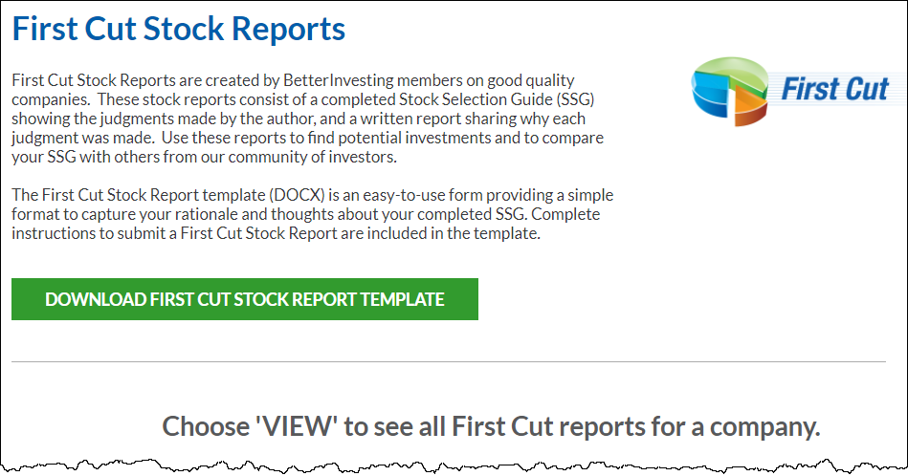
Download the First Cut Report.docx
Click Here
Notes:
While we’ll see more of this page later on all we need to do now is …
Click the DOWNLOAD … Button which sends the template to your computer.
About the template … >>

Slide 16
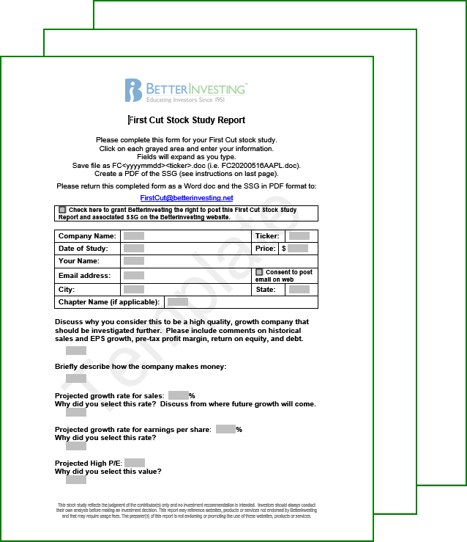

About the Template
FirstCutReport-ymd.docx is a protected ‘.docx’ file.
  Which means typing
  can only be done in the small gray fields
  |
As you type these fields expand to fit whatever needs to be included.
Notes:
Hey, it’s a protected .docx file
Simply put, you can only type in the little gray boxes.
One other word of caution, Spelling & Grammar checks don’t work! In MS Word anyway.
With that said, as you type the boxes will expand, allowing one to be as wordy or verbose as necessary.
A quick note, wordiness is not recommended or encouraged
To borrow a quote from Shakespeare's Hamlet,
“Intelligent speech and writing should aim at using few words.”
Moving On >>

Slide 17
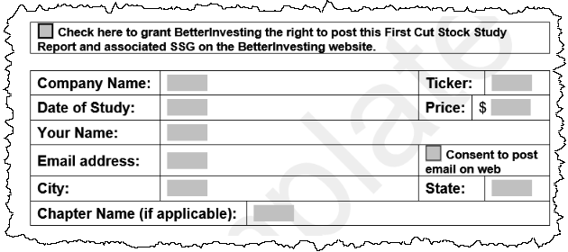
First Cut Report Header
Company name & ticker
Your name, email, etc.
Study date & stock price
from your printed SSG
Two consent check boxes may require attention.
Email is required
Notes:
Most of this is pretty straight forward.
More about the printed SSG ….
Speaking from experience, preparing your First Cut from the SSG on the screen can get disturbed by price updates or changes after the .pdf was created.
The SSG.pdf and First Cut must match … exactly.
There are two consent check boxes that you’ll need to address.
The upper one just grants your permission to post your First Cut to the BI Website.
The second, tells BI if you want your email address posted with the First Cut or not.
With that said, your email is required in the event BI needs to contact you re: your First Cut submission.
Again, Not Checking that second box will prevent your email from being posted.
>>

Slide 18
Research Data Resources
Remember, First Cut Reports are a Learning Tool to help us make better SSG judgments.
A few resource suggestions to help with this.
  ‘Fee Based’.
    Value Line
    Morningstar Premium Service
    Yahoo Finance Premium
    Manifest Investing
  Available from brokers.
    CFRA (formerly S&P Global Equity Research)
    Thompson Reuters
    Proprietary broker products
Notes:
There is an implication here that we may need to do some research
So, here are some data resources.
These are Fee Based subscriptions
More may be available from your broker(s).
A quick note here, Valueline and/or MorningStar may be available through your library or broker.
Now, let’s see what BetterInvesting has included in your BI membership >>

Slide 19
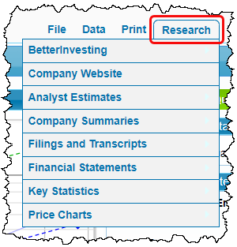
Research Data Resources (continued)
BetterInvesting provided resources.
  On the SSG^{Plus} or
  Core SSG
    Click on “Research” on
    the upper right corner.
    This provides a wealth of
    data to help make and/or
    validate SSG judgments.
Notes:
Starting with the BI online tools … SSG Plus and Core
A click on the Research Tab produces this pull down
This includes a wealth of data and tools to aid your research.
It is certainly worth exploring … So much so that might even warrant a class of its own.
And there’s more from BI >>

Slide 20
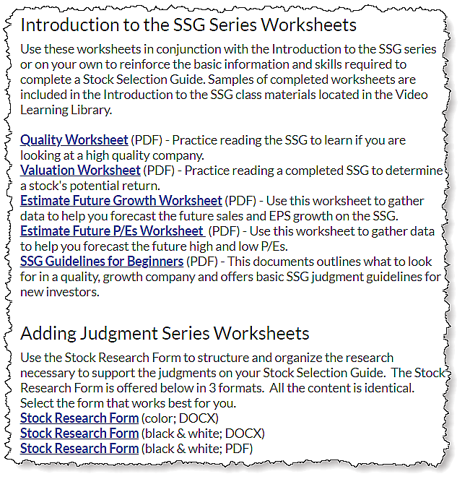
Research Data Resources (continued)
More BetterInvesting provided resources.
Go to the BI Home Page –
Learning Center/Worksheets.
  There are several SSG work-
  sheets that can contribute to
  successful First Cut Reports.
  Two that can work well with
  a First Cut.
    SSG Guidelines for
    Beginners
    Stock Research Form
Notes:
Go to the BI Home page. Near the top middle of the page is a Learning Center pulldown. Click on WORKSHEETS at the bottom.
This will takes you to the links for several useful worksheets.
Calling you attention to two of them …
The SSG Guidelines for Beginners, while aimed at those new to the SSG, it provides a good review of the basics, even for the more experienced.
I will be mentioning this one as we move on.
The Stock Research Form is for those with more experience.
Here is a quick look . >>

Slide 21
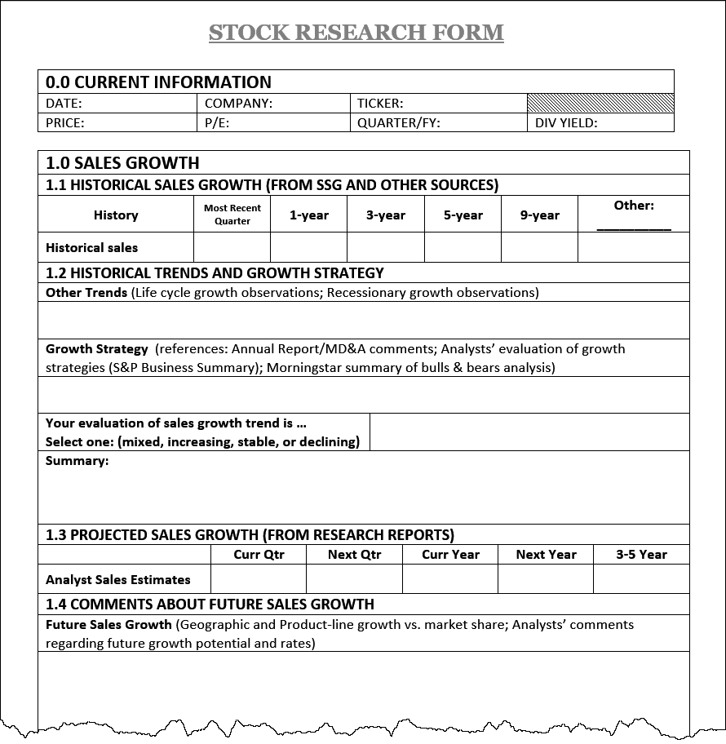
About the Stock Research Form
This form can help to structure and organize the research necessary to support the judgments on your SSG.
It can help track the detailed historical data and strategies used by you or your investment club on completed SSGs.
Notes:
This form will flesh out with detailed documentation of both numbers and rationale supporting your judgments.
Accommodates a lot of, in depth details & data.
Both of these WORKSHEETS MENTIONED can help prepare a First Cut.
Well, let’s get into the actual First Cut … >>

Slide 22

First Cut – First Question
“Discuss why you consider this to be a high quality, growth company that should be investigated further. Please include comments on historical sales and EPS growth, pre-tax profit margin, return on equity, and debt.”
OH! MY!
OH! NO!
It’s an essay question!
Don’t Panic –
There are no wrong answers!
Notes:
My apologies but I’m going to read this …
To quote Dorothy from the Wizard of Oz
OH! MY!
… and in the background I can hear
OH! NO! … it is an essay question!
Don’t Panic, as we’ll see in a few slides
There are no wrong answers.
Continuing with this question >>

Slide 23
First Question (continued)
All this question is asking for is your thoughts on future growth and management performance.
All of the factors that might need to be addressed are mentioned in this first question.
The SSG Guidelines for Beginners, Step 1 offers some help on this.
Your answer just needs to be a brief description of the rationale you used to determine that this company is a ‘quality company’ that merits
further study.
Notes:
What this question is really asking for is your “Analysis of Growth” and your “Evaluation of Management.”
The question tells everything to speak to in your answer.
Step 1 of the Beginners Guide provides some help on this concept as well.
This last bullet sums it up. What makes it a quality company worth more study.
The simplest answer for this question might be “lines are up, straight and parallel with no debt”.
The worst example might be “My uncle Barney told me about it at Thanks Giving.”
Just remember, to always DO YOUR OWN RESEARCH.
Moving on to the Second Question. >>

Slide 24
Second Question
“Briefly describe how the company makes money”
What a company does to make money is often under the heading ‘Profile or ‘Company Profile’ on several of the listed resources. (See slides 18~19)
Look at a few of these and enter your thoughts
on these company descriptions into the field.
Or, copy and paste the one that makes the
most sense to you.
  In this case crediting the source is
  recommended.
Notes:
“Briefly describe how the company makes money:”
Typically stock analysist’s Company Profile section that goes into detail about how a company makes money.
Read a few of them and enter your thoughts about what they are saying.
Or you can copy and paste the one that makes the most sense to you.
It’s probably a good idea to credit the source in this case.
OK, Let’s address the right or wrong answer dilemma. >>

Slide 25

Right / Wrong Answers
There are no ‘Wrong’ answers!
The First Cut is a Learning Tool that shares ideas.
These are the ideas that worked best for you on
a given SSG.
The key to this is explaining and sharing the thought processes behind your ideas.
Let others take away from that what they may
to influence their ideas and do their own study.
It’s a bit like long-distance “Brainstorming.”
Notes:
IN MY OPINION – There are no wrong answers
Some may be better than others but…
The First Cut is a Learning Tool that shares ideas.
This is what worked best for you on this SSG.
Now you need to explain and share your rationale behind those ideas.
This all reminds me of a college lit class I took a lot of years ago. We were charged with writing a paper about Franz Kafka short story.
After the paper was handed in the instructor presented the premise of the short story and I discovered that my interpretation was so far out in left field, it was on the warning track.
A few days later the papers were being handed back while I trying to figure out how I can retake the class and much to my surprise, my paper came back with an A on it! Oh, and a note to see the instructor
When I visited the instructor, she mentioned that while my take on the story was way off, I’d supported my theory well enough to earn the A.
She then took it one step further and ask for a copy of my paper to use, anonymously, as an example in future classes.
So as I see it, the moral story is there are no wrong answers as long as your supporting argument is factual and cogent.
Some may like your ideas and other may not agree.
Others may glean something that helps them with some aspect of their own SSG,
Remember everyone is encouraged to DO YOUR OWN RESEARCH.
Hey it is a little bit like Long Distance Brainstorming …
… just bouncing ideas off each other.
Still, some answers may better than others … it’s your choice
Maybe this slide helps put it in perspective >>

Slide 26
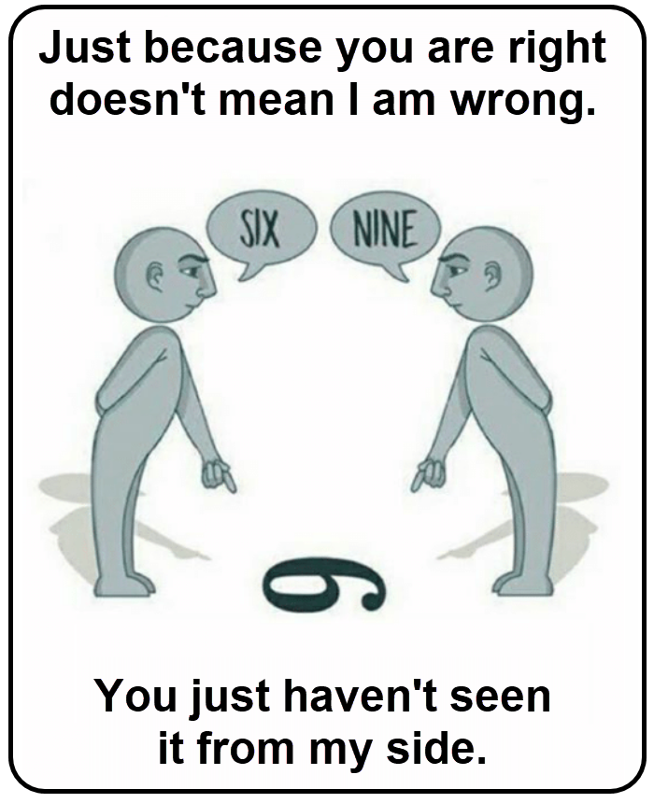
The First Cut allows ideas to be
shared from your perspective
Notes:
>
Moving on to more First Cut questions. >>

Slide 27
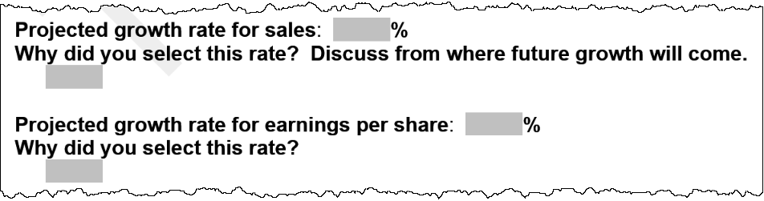
Projected Sales & EPS Growth Rates
The 2 growth rates can be copied from your printed SSG.
Followed by “Why did you select this rate?”
Step 2 of the ‘SSG Guidelines for Beginners’ offers
some basic fundamental thoughts on this topic.
Notes:
The next question starts by asking for Sales and Earnings projections.
This is an easy step as these judgments can be copied from your printed SSG.
But then, this is followed by the “WHY” question.
Step 2 of the Guidelines for Beginners can help on this.
The next question is a lot like this one >>

Slide 28
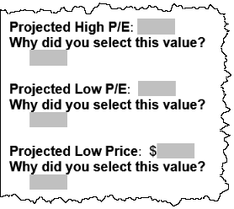
Projected High/Low P/Es & Low Price
These values can be copied directly from your printed SSG.
Each is followed by the “Why did you select this value question.”
For ‘Projected Low Price’
explain how it was calculated and your rationale for selecting this low price.
Notes:
Here it’s looking for Projected High & Low P/Es along with the projected low price.
Copy & Paste the values from the SSG
And answer the “Why” questions.
There are some different process to calculate the Projected Low Price.
Whatever process is used should be shared in the “WHY” question.
The next question is kinda a bonus >>

Slide 29
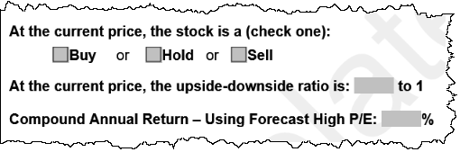
SSG End Results
The SSG results can be copied directly from your
printed SSG.pdf.
The current price referenced here is the price
on your printed SSG.pdf.
Notes:
No “why” questions!!!
Copy 3 items from the SSG
The second bullet again emphasizes the need to use the final complete original printed SSG.pdf for all copied judgments.
Now, we’re ready for YOUR conclusion >>

Slide 30
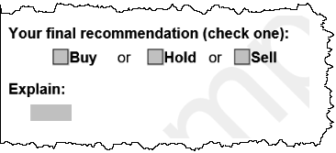

Your Final Conclusion
Your final conclusion does not have to agree with your SSG.
All that’s left is explaining how and why you reached your final conclusion.
If your conclusion differs from your SSG, address that in the explanation as well.
Again, remember this is NOT A RECOMMENDATION
Notes:
As this says your final conclusion does not have to agree with your SSG.
Now, all you need to do is explain your ideas about why your arrived at this conclusion.
As indicated, if your conclusion does not have to agree with the SSG. There may be something you’re seeing that isn’t apparent on the SSG.
Just be prepared to explain yourself.
Yes, the form shows this as a “RECOMMENDATION.”
I personally think that it should say “CONCLUSION” because we don’t make recommendations.
The form has been justified by stating that we should think of this “recommendation” as in a club stock presentation.
When you think about it, a First Cut is a great format for a club stock presentation.
I still stand by “CONCLUSION” and the rubber stamp.
OK, now it’s done … let’s share it with others.

Slide 31
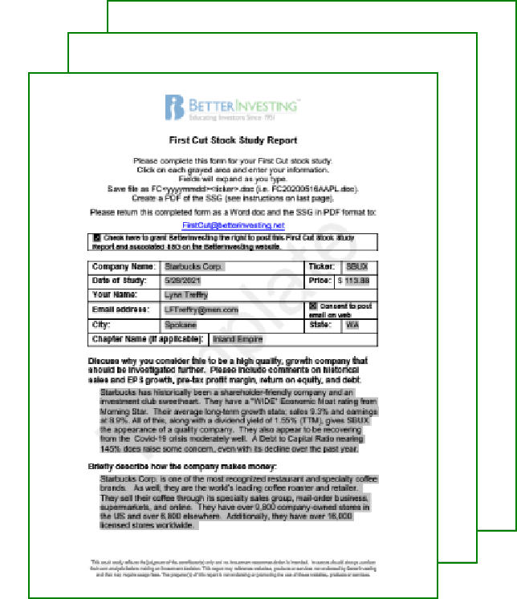
Submitting Your First Cut to BI
Submission instructions are at the top of page 1 of the First Cut template.
Follow the naming convention to save your completed First Cut Study
Email the study as a Word.doc & the SSG.pdf to: FirstCut@betterinvesting.net
Notes:
Submitting you First Cut is really pretty simple …
the instructions are at the top of the first page of the template.
Use the naming convention shown in the instructions
And email the two reports to BetterInvesting.
Quick note here … the gray background in the entry boxes and the TEMPLATE watermark will all be removed by BI before publication

Slide 32
Any Questions
? ? ?
Notes:
Q. Will my submitted First Cut be reviewed or edited before posting to the BI website?
A. Yes and No … Reviewed YES / Edited NO
Your First Cut will be reviewed for completeness and to see the it matches with the submitted SSG.pdf
If there’s anything awry or missing you’d be notified by email.
The reviewer doesn’t have to agree with your conclusions as long as you’ve supported them.
OK, let’s move on in search of completed First Cut Reports or Studies >>

Slide 33

How to Receive First Cuts
In Your
BetterInvesting
Weekly e-newsletter
Click on “MY ACCOUNT”
to go you to your ‘My Account’ page.
  You must be logged in
  to the BI Website.
Notes:
Yes you can receive them in your email.
BUT, you do have to be signed up for the BI Weekly e-newsletter.
And you’ll receive new First Cuts as they’re initially posted.
Here’s a quick review of how to make that happen.
You have to be logged into BI’s homepage.
Then click on “MY ACCOUNT” to the right of your name.
That will take you to your account. >>

Slide 34
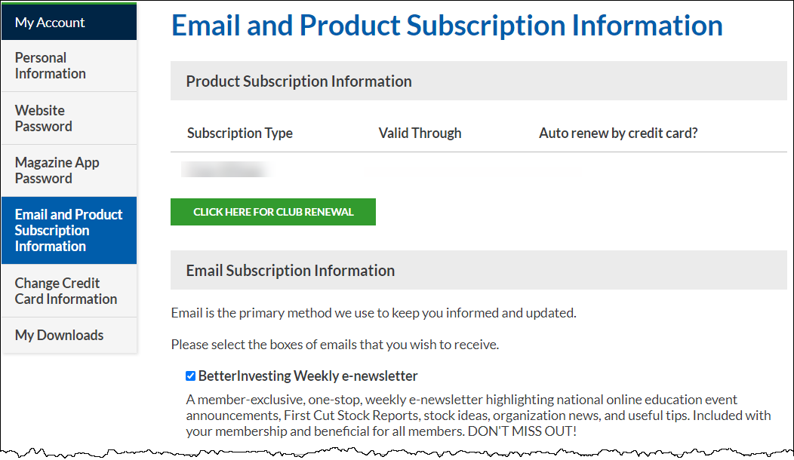

Notes:
Clicking on “Email and Product Subscription Information” will take you to this page
Make sure the “BetterInvesting Monthly e-newsletter” is checked.
I would also suggest that you scroll down the page and make sure that “Local Chapter News & Events” is checked.
That allows us to keep you informed about what the chapter is doing.
Now, we can go find ALL of the posted First Cuts. >>

Slide 35
How to Access All First Cut Reports
From the
BetterInvesting
Home Page
You must be logged in.
Clicking on the
‘View All’ button
takes you to the
First Cut Stock
Reports Page
Notes:
Once again we’re back to the BI Home page,
Logged in
And clicking on the “VIEW ALL” Button.
This will take us back to the page where we downloaded the First Cut Report Template …
just a little further down the page. >>

Slide 36
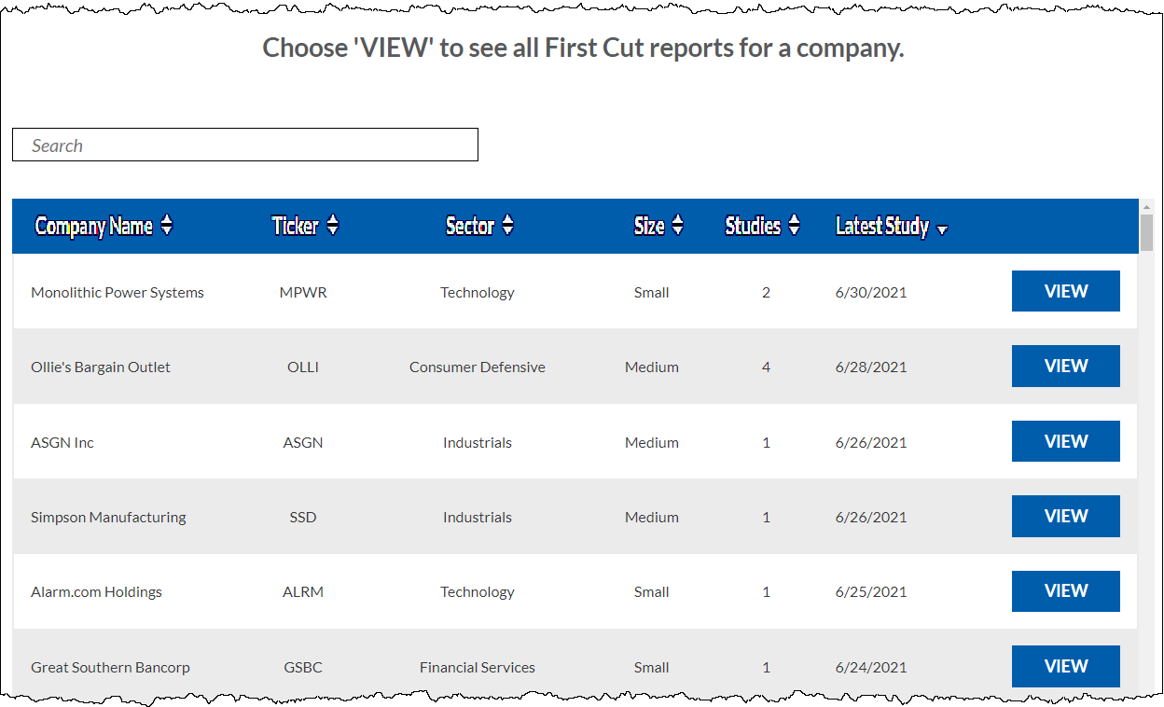
Sort Ribbon
Enter ‘SBUX’ or ‘Starbucks’
Notes:
This is a list of ALL the posted First Cut Reports with the most recent at the top.
The sort ribbon allows you to sort by company name, ticker, sector, size, # of studies and date.
So, if you’re looking for a small company or tech company you can sort, up or down by these headings.
This page’s second feature is the Search Field.
We’ll just enter SBUX or Starbucks, either will work.
This will filter the list down to Starbucks. >>

Slide 37
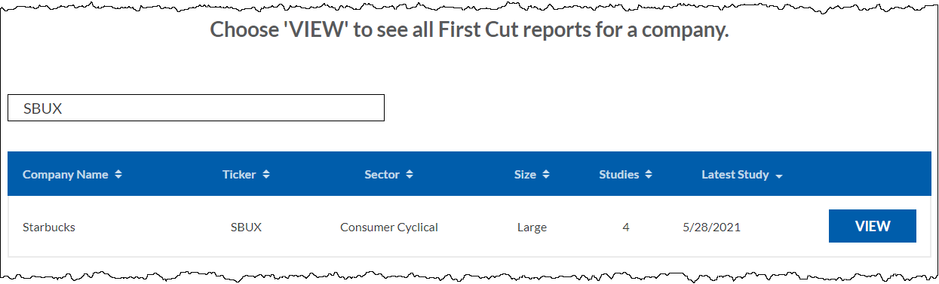
How To Access All First Cut Reports
Notes:
Following the directions here
A click on VIEW …
takes us to the STARBUCKS page >>

Slide 38
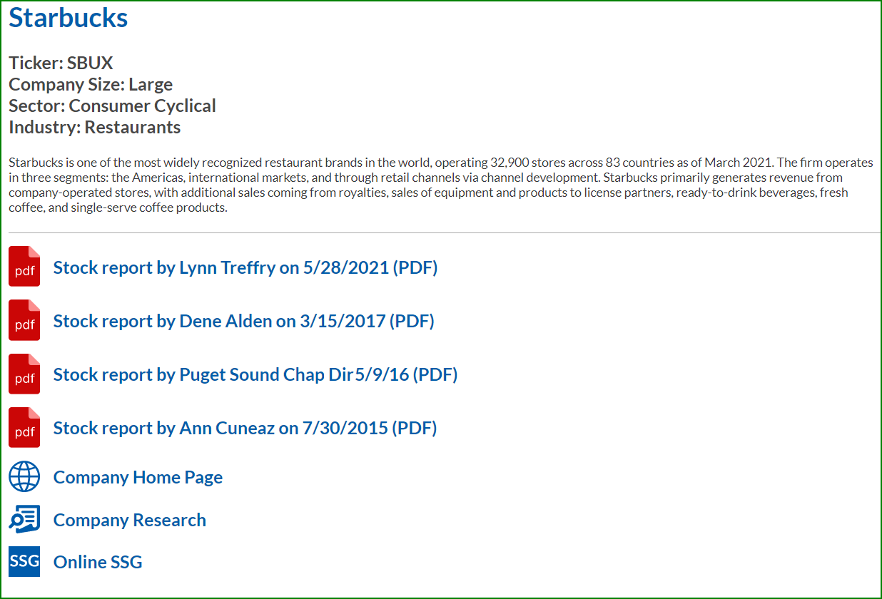
General Information
Click on these links to
download the First Cuts
Opens the Starbucks Home Page
Opens the BI SBUX Co Research Page
Opens a New SBUX SSG Study
Notes:
At the top of this page is a section of general information.
This is the same as the information show on the SSG when you hover over the COMPANY NAME & STOCK TICKER
AND, you might find this useful in answering in the second First Cut question.
Next on the page are the links all First Cut Reports for this company.
Depending on how your computer is setup it may download the .pdf directly …
… or open a page where you can download.
A click on the link down loads the report to your computer.
The next three links on this list are self-explanatory … with a twist.
Click on any of these will open the page in A NEW TAB ON YOUR BROWSER/.
So, we’ve found and downloaded a First Cut Study>>

Slide 39
Now What?
Read through the First Cut to see how others approach analyzing this company.
See if there are any new ideas that might help you in your stock analysis and judgments.
Do your own SSG for this stock and compare conclusions.
Notes:
First off, you can read through it to see how someone else looks at analyzing this company.
Investigate to see if there are analysis techniques that might be new to you.
A good exercise here mighty be to do your own SSG on the company. See how it differs from the First Cut version.
Then consider, if you owned this stock … which conclusions would allow you to sleep better.
After all is said and done, a major goal here is to buy stock that makes money AND allows us to sleep well at night.

Slide 40
Summary
In this session we’ve touched on:
What a First Cut study/report is all about.
  It’s a Learning Tool to help us improve our SSG skills.
  It organizes our judgment supporting thoughts & ideas.
  It shares those ideas with others in the BI Community.
How to prepare a First Cut study and submit it to BetterInvesting.
Where to find First Cut studies shared by others.
How to use First Cut studies/reports.
Notes:
We saw what a First Cut was about.
That it was a learning tool
Organizes judgment thoughts & ideas.
That it is ideas shared with others
We focused on how to prepare a First Cut Study and how that prep could help our judgments.
We explored a couple of ways to find archived reports, … on the website and by email.
And some ways to use a First Cut report to our advantage.
Here are some bonus slides, especially …
if you are looking for MORE instruction or education on improving your SSG judgments … >>

Slide 41
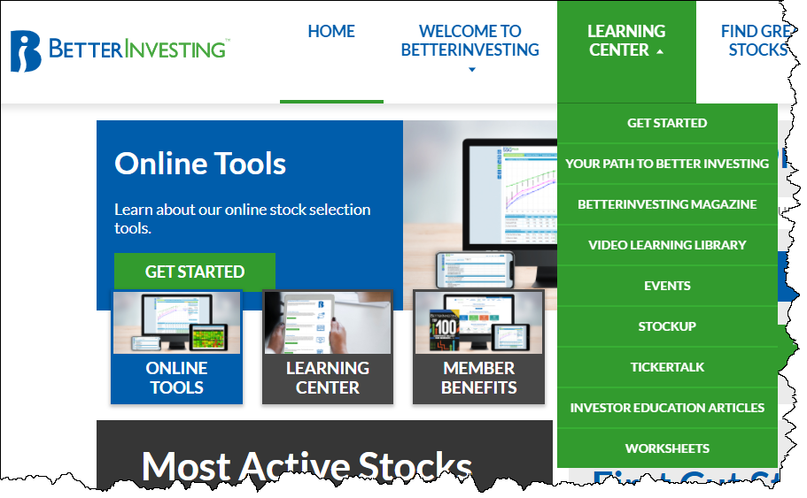
BetterInvesting
SSG Judgment Education
Notes:
The BetterInvesting Home page has a lot to offer under the Learning Center Tab.
We talked about a couple of the WORKSHEETS in that section …
But I’d call your attention to a source on this tab that can help you zero into some help with your SSG and judgments
The VIDEO LEARNING LIBRARY is all inclusive and lets you select or filter for almost any stock investing topic imaginable. >>

Slide 42
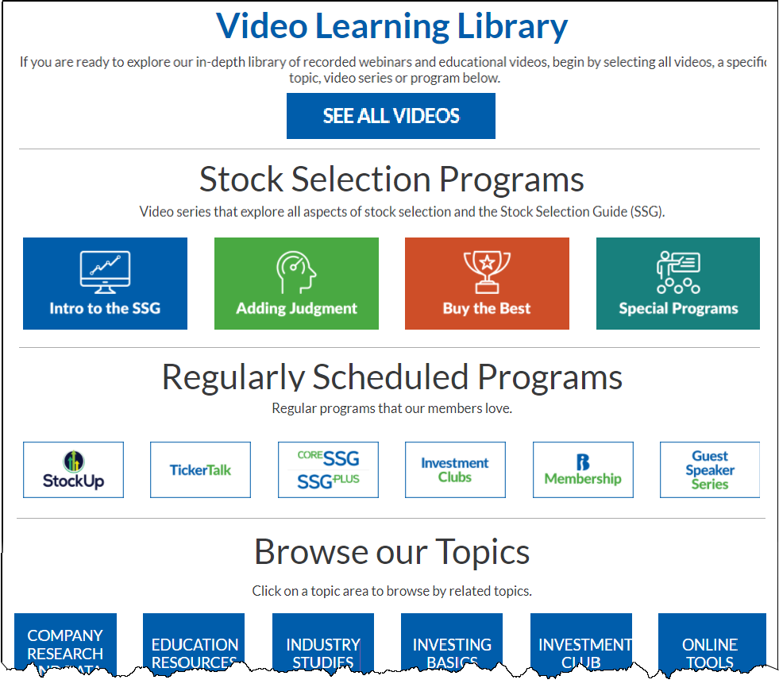
Notes:
The page was way too big to put it ALL on the slide
but You can still see a myriad of topics with educational videos.
Even ADDING JUDGMENT
Once you select any of these buttons …
You can additionally filter the programs by …
Program Type
Access Level … SSG Plus, Core or All
Skill Level … Novice, Intermediate, Experienced
Topics
On an earlier slide I mentioned the RESEARCH TAB on the online tools.

Slide 43


Online Tool Research Tab Information
Currently, my two favorite videos on this feature.
‘Analyst Consensus Estimates Made Easy’ by Suzi Artzberger
‘Using Historical P/E Charts from BigCharts.com’
by Mike Torbenson
Both can be found in the ‘Video Learning Library’
Notes:
I even suggested that it warrants a class of its own.
Others feel the same way.
and …
Here are my favorites.
> …
> …
and yes, They are both in the VIDEO LEARNING LIBRARY
One last thought …
I found this short, Anonymous PARABLE …
>>>

Slide 44

One Last Thought
Every teacher once was a student.
Every winner once was a loser.
Every expert once was a beginner.
But all of them crossed
the bridge called
“Learning.”
Anonymous
First Cuts help
us build our
“Learning Bridge”
Please share a First Cut
with us
Notes:
… I think it relates well to our First Cut Story.
Because …
I emphasize US here
And request that you share a First Cut with US when you do your next SSG

Slide 45



Make A Difference In
Someone’s Life
If you have benefited from
BETTERINVESTING,
please pick up some
BETTERINVESTING materials
and introduce others to this dynamic investment education opportunity!
Pay it forward !
Notes:
And on that note, I’ve been a member of BetterInvesting since 2006. I’ve been mentored and mentored others. I’ve watched and studied countless educational presentations. And, even taught some myself.
I’m a firm believer that when you teach another person, … two of you learn.
In general, BetterInvesting has been good to me.
I have learned a lot that helped put me in a much better financial position than I could have hoped for without BetterInvesting.
If it has made a difference in your life, pass it along, share BetterInvesting with anyone who wants a better future.
>>

Slide 46

Notes:
Thank You to all that attended.
And my thanks to everyone in the back room.
This couldn’t be done without you.
>>

Slide 47

Questions or Comments?
Lynn Treffry
LFTreffry@msn.com
Notes:
Any questions or comments?
Please feel free to email me with any questions, comments or concerns.
Thanks Again
Back to you Jane

