Slide 1

Notes:
Logo Slide
Show the logo slide before your show begins / while people are coming in.
Please use your chapter’s logo on this slide.

Slide 2
NEW RULES FOR 2022 CLUB TAXES
AVOID FILING K-2 and K-3s
02/09/2023
Presented By Russell Malley
Vice-President, BetterInvesting Silicon Valley Chapter
ICLUBcentral Consultant
vicepresident@silicon.betterinvesting.net
Notes:
Main Presentation Title Slide
Showcasing a logo/art

Slide 3
Notes:
General Disclaimer Slide.
Note: Please ensure to check the copyright and usage of any image that is used for your slides.

Slide 4
Agenda
What are the schedules K-2 and K-3
Why avoid filing these schedules
The rules for avoiding filing K-2 and K-3
Tool to help
Questions
Notes:
Title and Content Slide
The workhorse of the presentation

Slide 5
What are Schedules K-2 and K-3
Additional schedules added to IRS form 1065 in TY 2021
Expand foreign income information
  Formerly shown on line 16 of schedule K
Schedule K-2 gives whole club information
  Only 1 schedule K-2 is included with a club tax return
Schedule K-3 gives each partner’s share
  A K-3 for each partner must be filed with a club tax return

Slide 6
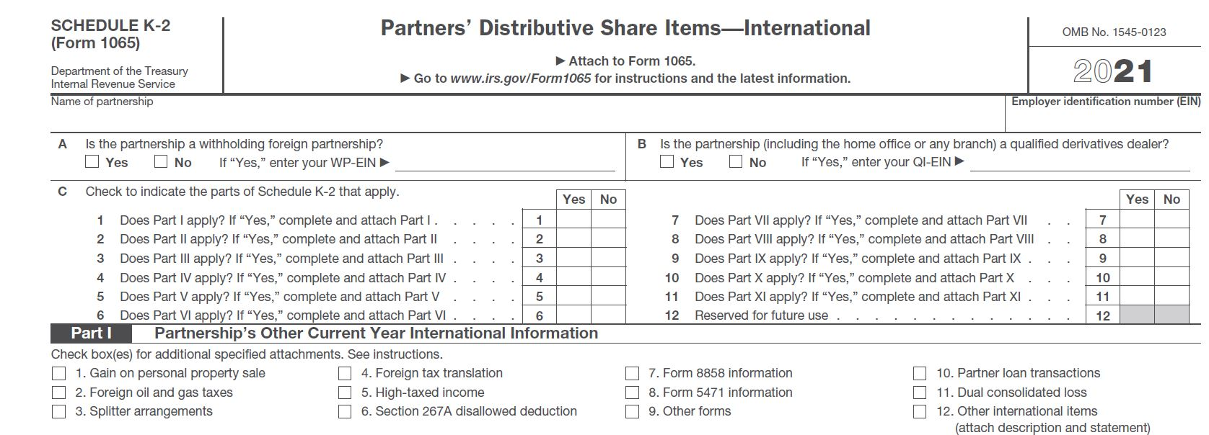
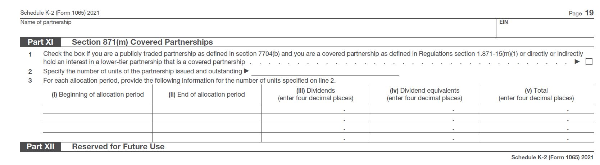

Slide 7
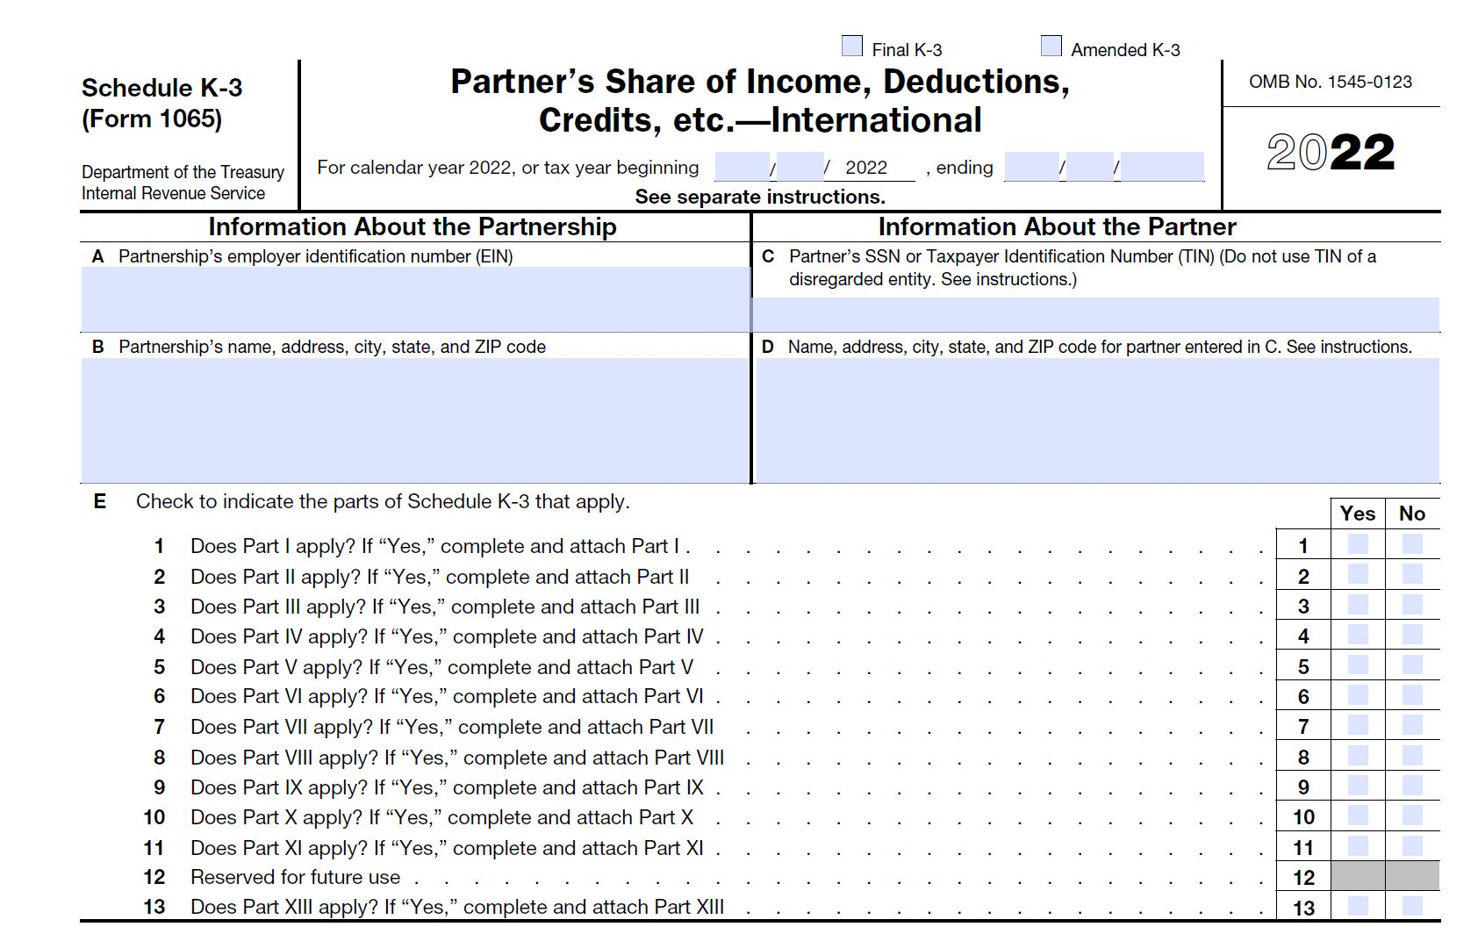

Slide 8
Why avoid filing these schedules
The schedules make club return very large
  Schedule K-2 is approximately 20 pages
  Each Schedule K-3 is approximately 20 pages
Clubs generally have little or no foreign income
Few parts of schedules apply to investment clubs

Slide 9
Rules to avoid filing K-2/K-3
Partnership has no/limited foreign activity:
  If there is activity, it must be passive (such as investment income).
  Taxes paid (or withheld) and/or accrued must be less than $300.
  A payee statement (such as a brokerage firm's Form 1099) must be received.
Partners are restricted to following:
  U.S or resident alien individuals.
  Domestic trusts (grantor or non-grantor).
  Domestic estates of deceased persons.
  Not a foreign estate or trust.
  Not a foreign individual (an individual who does not have resident alien status).
All partners are notified of opt-out no later than when club furnishes Schedule K-1 to partners.
No partner requests a Schedule K-3 before one month prior to Form 1065 filing.

Slide 10
Tool to Help
Tool in myICLUB to notify members to satisfy item 3
Click Taxes tab
Click link for K-2/K-3 information
Click Notify Members button
Select members to notify (can select all at once)

Slide 11
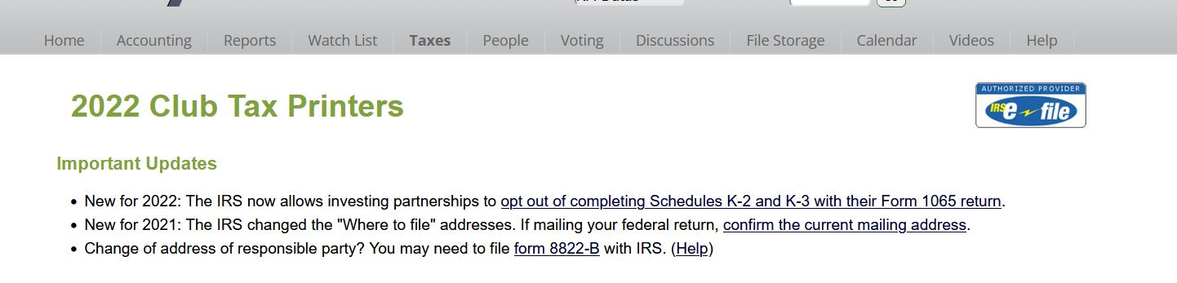

Slide 12
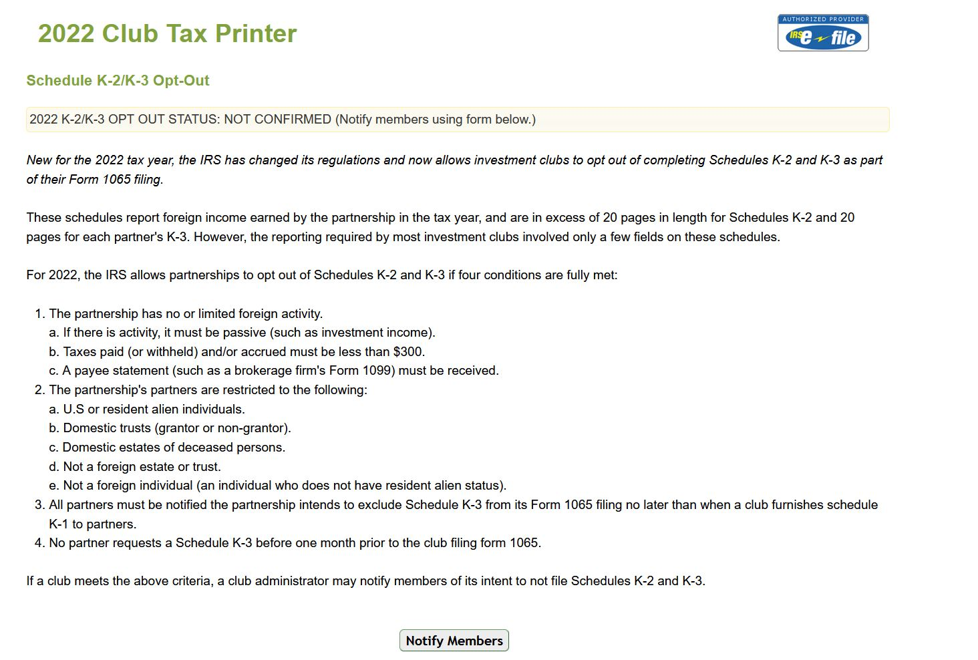

Slide 13
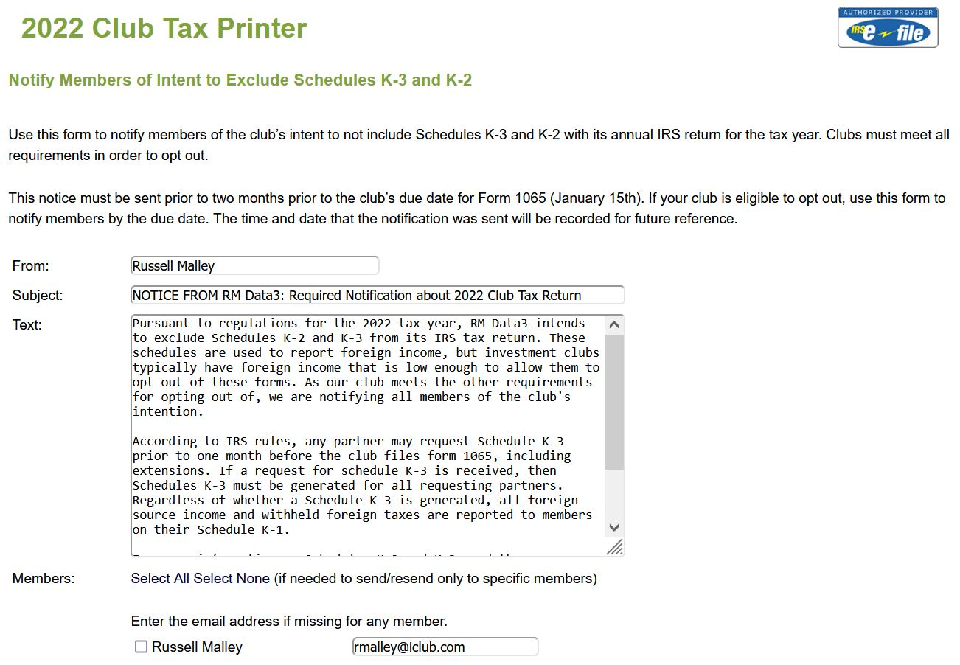
Text of message
List of all members who will receive a K-1

Slide 14
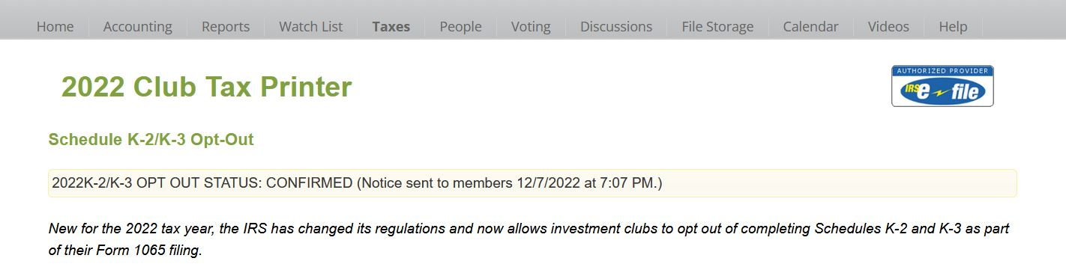
Proof of Notice
Confirmation notice was sent stored on myICLUB

Slide 15
Why Request a K-3?
Most club members will not need a schedule K-3
A K-3 will be needed if
member has significant foreign income
member includes form 1116 in personal tax return
Form 1116 - foreign tax credits
foreign tax paid > $300 for single filers
foreign tax paid > $600 for joint filers

Slide 16

Question and Comments
NEW RULES FOR 2022 CLUB TAXES
AVOID FILING K-2 and K-3s
Russell Malley
Vice-President, BetterInvesting Silicon Valley Chapter
ICLUBcentral Consultant
vicepresident@silicon.betterinvesting.net
Notes:
End Slide
Question and Comments

