Slide 1

New Jersey Chapter
Board of Directors Meeting
January 13, 2025

Slide 2
First Cut Mentoring
Robin Ware
January 13, 2025

Slide 3
Notes:
General Disclaimer Slide.
Note: Please ensure to check the copyright and usage of any image that is used for your slides.

Slide 4

Agenda
Kinsale Capital Group
The Five Judgments
Kinsale Capital Group Research
Complete the SSG
Complete a First Cut

Slide 5
Kinsale Capital Group
Specialty commercial insurance
Moved into personal insurance – auto, ‘high value” homeowners, high risk as a growth opportunity
Serve Excess & Surplus markets – other insurers consider high risk
Conservative astute underwriting
Technology
Diversified in many lines of insurance in 50 states

Slide 6
Five Judgments
Sales 5 Year Forecast
Earnings Per Share 5 Year Forecast
High Price Forecast
Low Price Forecast
Payout Ratio

Slide 7

Analyst Estimates
5 Year Estimates of Sales and Earnings Growth
At least 3 sources
  Morningstar
  Value Line
  Seeking Alpha
  Yahoo
  Zacks
  Member Sentiment
  Company History and Future

Slide 8

Research
 | RESEARCH AT LEAST 3 SOURCES
 | Morningstar |  | Value Line |  |  | CNN | Seek Alpha | Yahoo | Zacks | Company |  | Average
Stock | Sales | EPS | Sales | EPS | H$ | EPS |  |  |  | Sales | EPS | Sales | EPS
KNSL | NA | 15.0 | 16.0 | 15.0 | $ 730.00 | NA | 15.00 | NA | 15.00 |  |  | 16.0 | 15.0
Find at least 3 sources for Sales and EPS

Slide 9
Prepare Stock Selection Guide
 | PREPARE MY SSG
 | My SSG Judgments
Stock | Sales | EPS | HPE | H$ | L$ | CAR | U/D Ratio | Zone
KNSL
Complete your SSG based on your research

Slide 10
Compare Member Sentiment
 | COMPARE MY SSG TO MEMBER SENTIMENT
 | Member Sentiment
Stock | #SSGs | Sales | EPS | HPE | H$ | LPE | L$ | Pot Ret
KNSL | 385 | 19.0 | 15.0 | 33.00 | $ 1,058.40 | 21.00 | 342.00 | 17.6

Slide 11
Research, Prepare, Compare
 | RESEARCH AT LEAST 3 SOURCES
 | Morningstar |  | Value Line |  |  | CNN | Seek Alpha | Yahoo | Zacks | Company |  | Average
Stock | Sales | EPS | Sales | EPS | H$ | EPS |  |  |  | Sales | EPS | Sales | EPS
KNSL | NA | 15.0 | 16.0 | 15.0 | $ 730.00 | NA | 15.00 | NA | 15.00 |  |  | 16.0 | 15.0
 | PREPARE MY SSG
 | My SSG Judgments
Stock | Sales | EPS | HPE | H$ | L$ | CAR | U/D Ratio | Zone
KNSL
 | COMPARE MY SSG TO MEMBER SENTIMENT
 | Member Sentiment
Stock | #SSGs | Sales | EPS | HPE | H$ | LPE | L$ | Pot Ret
KNSL | 385 | 19.0 | 15.0 | 33.00 | $ 1,058.40 | 21.00 | 342.00 | 17.6

Slide 12
North Florida Chapter Events
Tuesday Training Workshop: Back to Basics for the Stock Selection Guide (SSG)
    Part 1 - Analyze Growth and Quality (January 7)
    Part 2 - Valuation and Return (February)
    Part 3 - Five Judgments (March)
Virtual Education Fair – Saturday, April 5th at 10AM
Find Great Stocks – join Dan Harter and Robin Ware as they navigate the BetterInvesting website, SSGPlus and a variety of other tools to find great stocks. Have your pen and paper ready to jot down the tickers because we will use these tickers for the 1-Minute Stock Selection Guide presentation.
The 1-Minute Stock Selection Guide - In session 2, Dan and Robin will prepare the 1-minute SSG which will allow you to quickly review these stocks and determine if they are worthy of further analysis, consideration and your hard earned $$$.

Slide 13
Questions?
Robin Ware | rwfincon@gmail.com
www.BetterInvesting.org/Contact-us

Slide 14
NJ Chapter’s 2025 First Cut Challenge
TO PARTICIPATE:
Download the First Cut Stock Study Report Template from the BI website
Complete and save as directed on the form. Submit your completed form as a Word doc and the SSG in PDF format to FirstCut@betterinvesting.net
Clubs or individuals can submit a First Cut, although if the First Cut is submitted by a club, only one prize will be awarded
First Cuts must be published on the BI website to be counted

Slide 15
NJ Chapter’s 2025 First Cut Challenge
    Prizes will be awarded to the top six clubs or individuals who submit and have published the most First Cut Reports
    1st, 2nd, and 3rd place winners will receive a one-year SSGPlus Membership or Membership Upgrade
    4th, 5th and 6th place winners will receive a book of choice from the BetterInvesting Book Series
        Mutual Fund e-book
        Using Portfolio Management Wisdom Handbook
        Investment Club Operations e-book
        Stock Selection Guide e-book

Slide 16
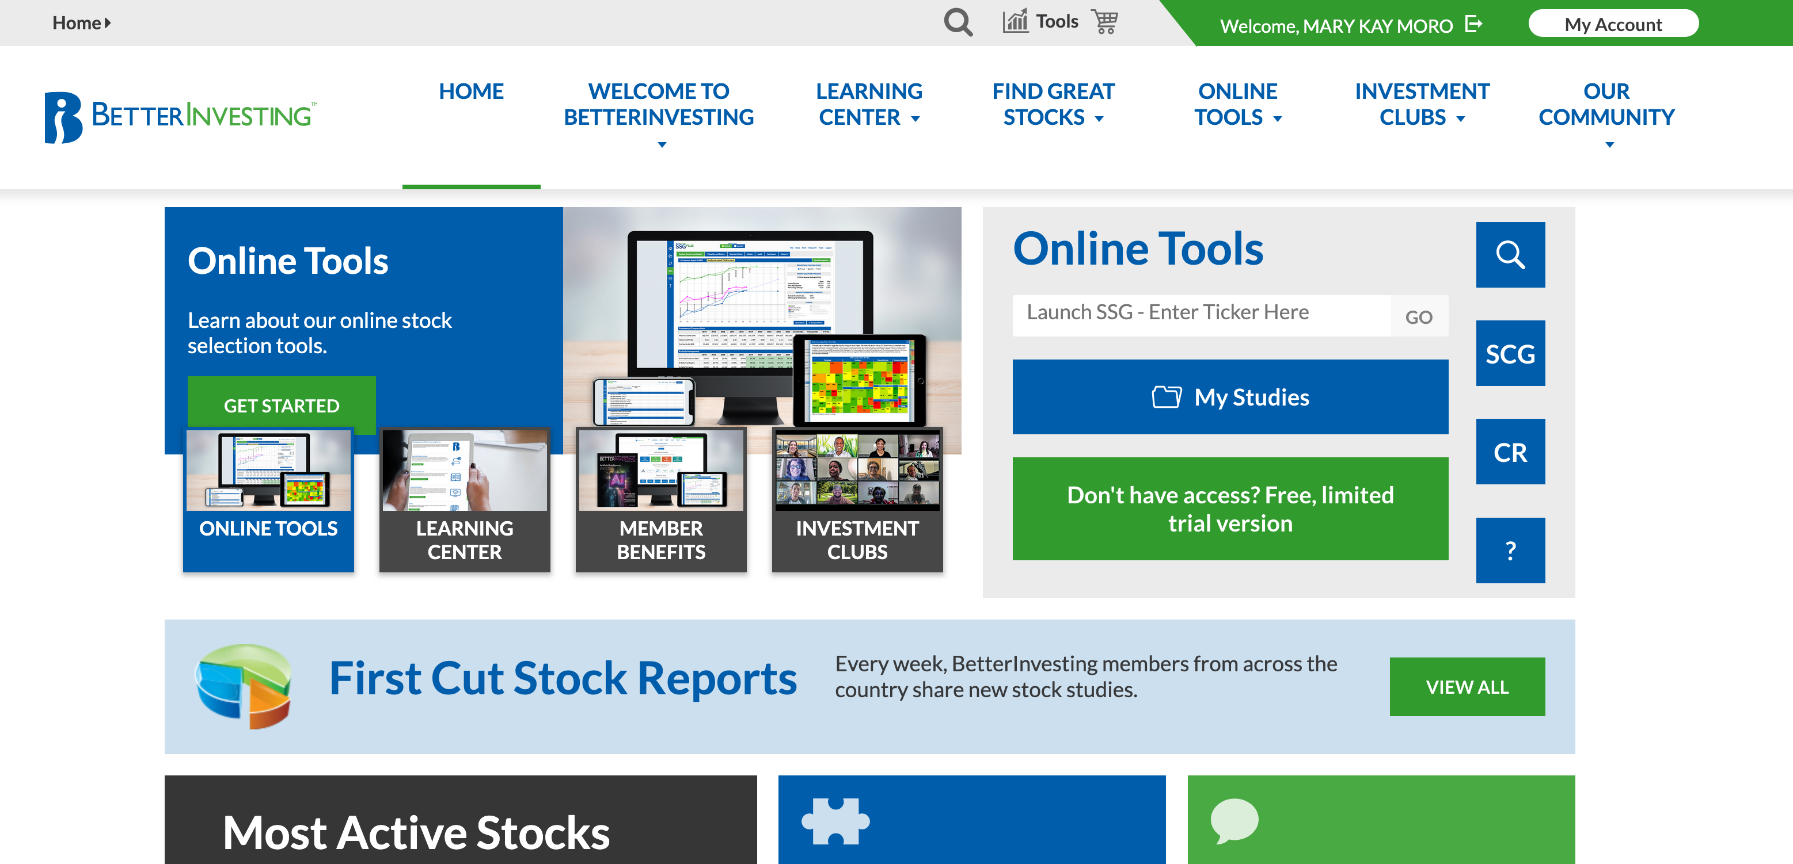

Slide 17
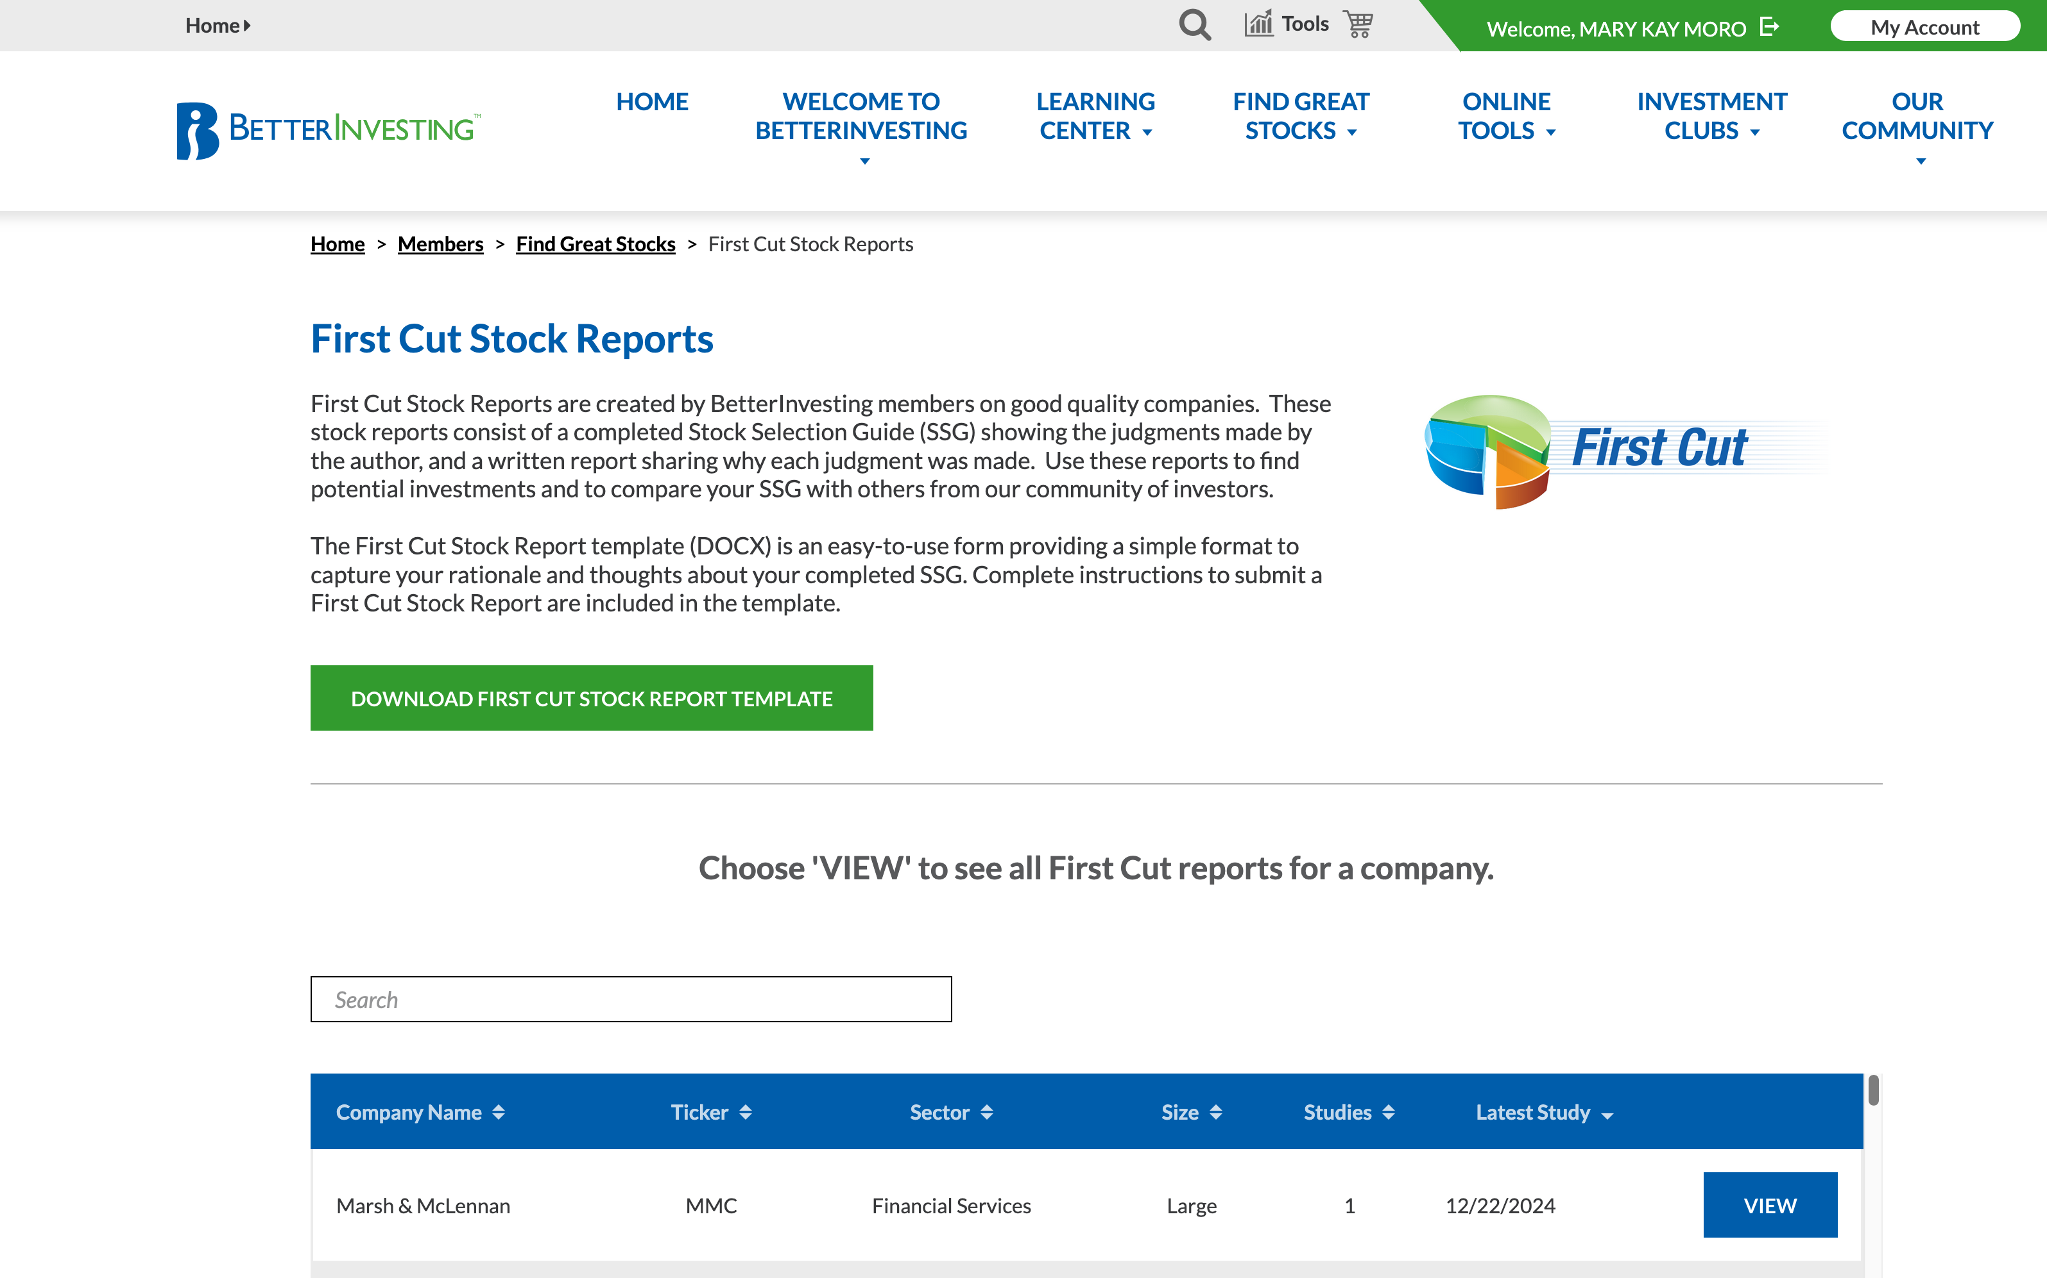

Slide 18
