Slide 1

Ch-Ch-Ch-Changes
Preferred Procedure Simplified:
Case Study – Part 1
Avi Horwitz
October 26, 2020
Notes:
Welcome to Ch-Ch-Ch Changes - Preferred Procedure Simplified, A Case Study, part of the “Stock Investing Made Easy” series.
I had been teaching Preferred Procedure in the traditional way. Over time, and with the help of Julie Werner from GA and Beth Hamm, who is George Nicholson’s daughter, I began to realize that we do a great job teaching people who are good with numbers, but we don’t do a very good job teaching those who learn visually through pictures.
I woke up one morning and decided to try to build what I called “Preferred Procedure Without A Net” because I didn’t know how it would work out and whether I would come crashing down to earth. The beauty of the Stock Selection Guide (SSG) is that you really can do a pretty good stock study by just looking at the pictures, because Every Picture Tells A Story.
Tonight is a bit of a refresher on Preferred Procedure in pictures, followed by the beginning of a multi-year case study applying what we learned using the pictures, and how to go about finding the information that will be meaningful to us.

Slide 2
Disclaimer
The information in this presentation is for educational purposes only and is not intended to be a recommendation to purchase or sell any of the stocks, mutual funds, or other securities that may be referenced. The securities of companies referenced or featured in the seminar materials are for illustrative purposes only and are not to be considered endorsed or recommended for purchase or sale by BetterInvestingTM National Association of Investors Corporation (“BI”). The views expressed are those of the instructors, commentators, guests and participants, as the case may be, and do not necessarily represent those of BetterInvestingTM. Investors should conduct their own review and analysis of any company of interest before making an investment decision.
Securities discussed may be held by the instructors in their own personal portfolios or in those of their clients. BI presenters and volunteers are held to a strict code of conduct that precludes benefiting financially from educational presentations or public activities via any BetterInvesting programs, events and/or educational sessions in which they participate. Any violation is strictly prohibited and should be reported to the CEO of BetterInvesting or the Director of Chapter Relations.
Notes:
Let’s start with our Standard Disclaimer. – As usual, there will be a quiz at the end of the session on it.
Any stock mentioned is being used as a teaching example, not as an investment recommendation. It offers my own perspective, and before investing in any company, do your own homework.
I may hold shares in some of the companies mentioned. BetterInvesting (BI)’s code of conduct prohibits me from benefiting financially from any BI education programs I teach.

Slide 3

Disclaimer
This presentation may contain images of websites and products or services not endorsed by BetterInvesting. The presenter is not endorsing or promoting the use of these websites, products or services.
This presentation uses older examples prepared using various software. Older examples are used in order to prevent the examples from being used for current investment decisions without proper updating and study. The instructors makes no representation that the software used for the examples is still being used for their own stock studies.
This session is being recorded for future use.
Notes:
I may mention products or services not endorsed by BI and although I may mention them, I am not endorsing them.
This is a new paragraph for the disclaimer: I almost always use old examples when I teach classes. The purpose is so that they are so far out of date that no one would make an investment in them without updating them and doing their homework. The older examples will provide as good an illustration of what is being taught as a current example would.
Accordingly, there may be examples using software other than BetterInvesting’s online Stock Selection Guide (SSG). I make no representation as to whether I am still using any of the software. However, BetterInvesting’s SSG plus will produce results very similar to the other software programs that I may use.
And finally, this class is being recorded.

Slide 4
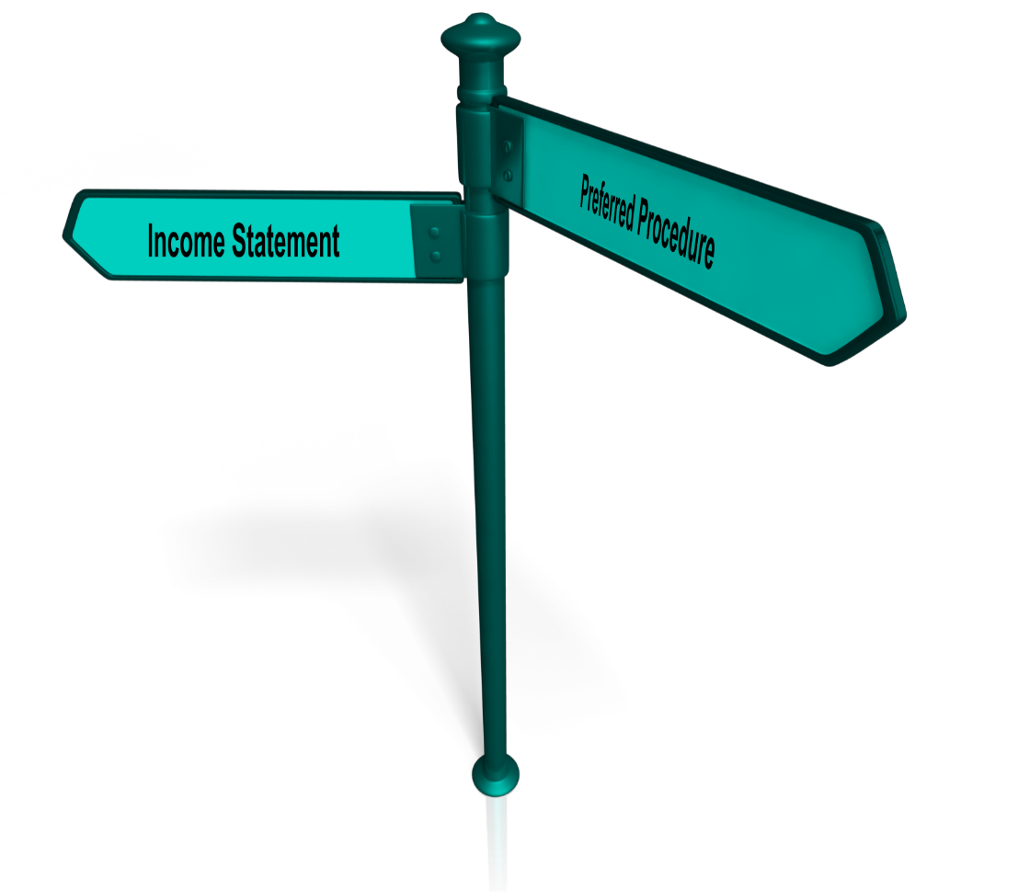
Objectives
Review the relationship between the Income Statement, Preferred Procedure, and the Stock Selection Guide (SSG)
Understand the relationships on the SSG and what you need to research
Case Study applying what we learned
4
Notes:
We have a road map for today.
We will refresh ourselves on the relationship between the Income Statement and the Stock Selection Guide (SSG). The piece that really connects how we use the Income Statement on our Stock Selection Guide is Preferred Procedure.
After that we will begin a multi-year case study applying what we have learned about Preferred Procedure and find out how to determine what we need to know about a company.
I will say that this session will run more than the normal one hour. It will probably run about an hour and fifteen minutes as there is a lot of interesting material to cover.

Slide 5

Preferred Procedure
Preferred Procedure is also known as:
“The Business Model”
It is based on a
“simplified” Income Statement.
5
Notes:
Sometimes you may hear Preferred Procedure referred to as “The Business Model”, but in any case, it is based on a simplified version of the company’s Income Statement.

Slide 6
The Income Statement
Provides information on:
  How a company performed, where it is heading, and what future cash flow or profitability might be.
  Ability of managers to make Sales, control expenses, and thereby earn a profit.
  Growth trends in Sales and Net Income, which are particularly important to watch.
6
Notes:
So we start off by talking about what the income statement means to us.
The statement shows how the company has done. Is it profitable?
We can use a series of income statements to see a trend over time. Hopefully, profitability will result in cash flow allowing the company to pay bills. We also base our future expected price partly on growth in earnings of the company, more specifically Earnings Per Share.
We can look at the ability of management to generate Sales and control their expenses, hopefully resulting in a profit.
We are concerned about trends, certainly the trend in Sales and the trends in Net Income or Earnings Per Share.
I would like to remind everyone that when we use a term that is normally plotted on our standard SSG, we will highlight it in a color that matches the color it appears on the SSG, for example, Sales on this slide. I will confess Net Income is a little more brown than it should be, but its standard color makes it hard to read on the slides (so I took a little liberty with that one)

Slide 7
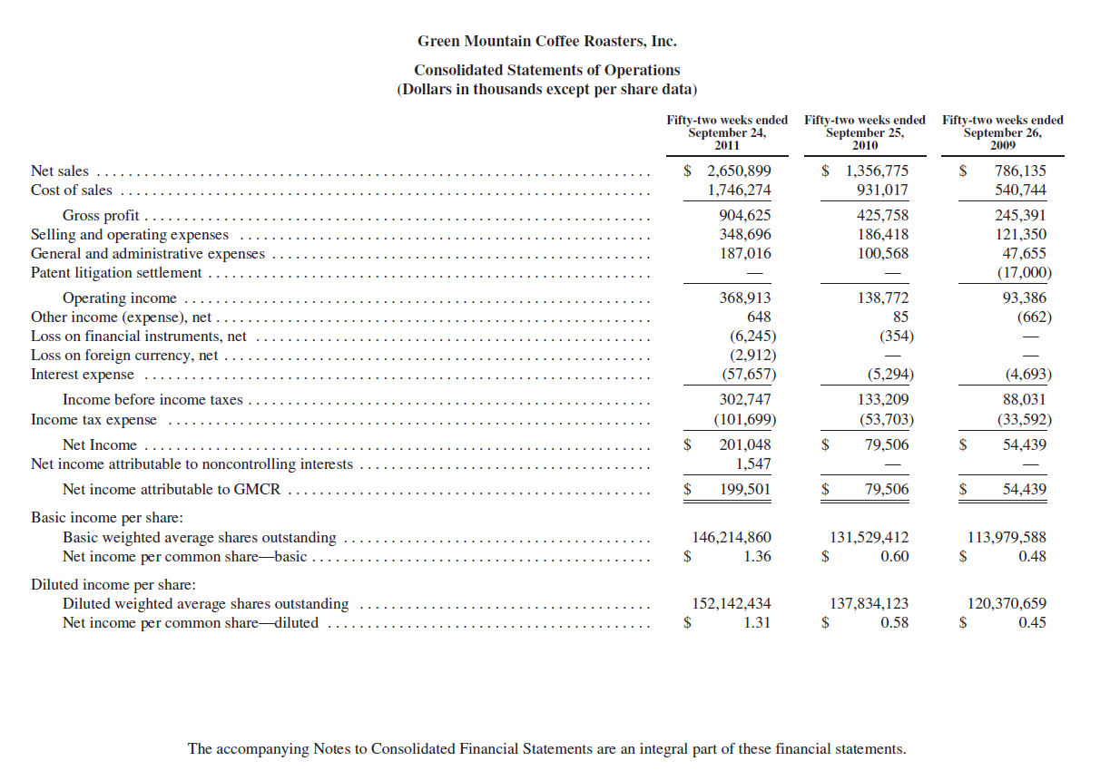

7
Notes:
Over time we can look at Income Statements year after year. How do we analyze the Income Statement? What do we do with all this information? What is the best way to use it?

Slide 8
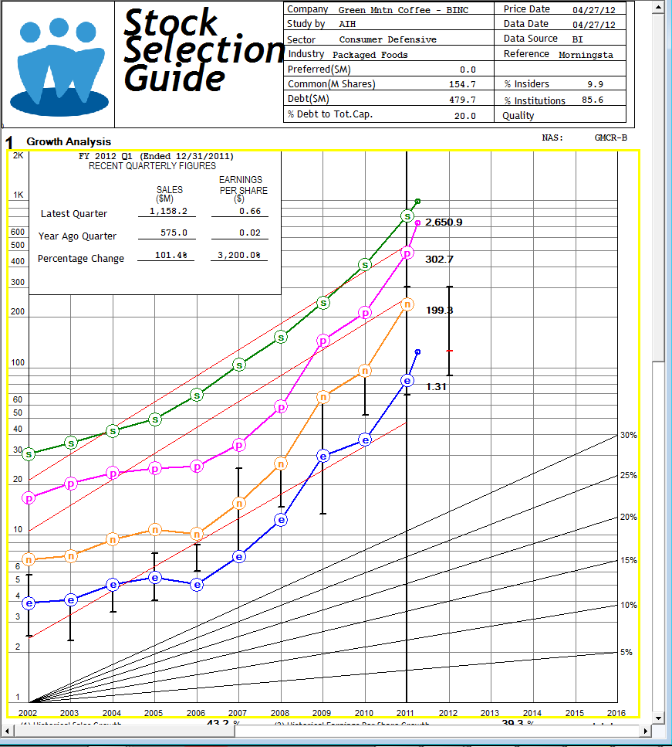

8
Notes:
We are dataholics, we collect data. What do we do with the data? ©
We use our Stock Selection Guide and plot information on it in a specific order – for a reason. It aligns with our income statement!
Our SSG is a simplified representation of our company’s income statement over a 10-year period. ©

Slide 9
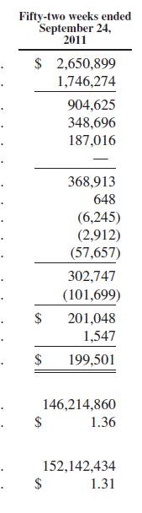
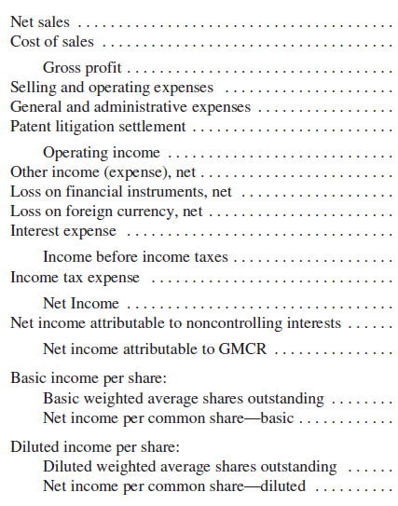
1
2
3
4
5
Co
6
7
9
Notes:
Let’s take a brief look at our income statement.
We are going to break it down into 7 items.
Number 1, 3, 5 and 7 are the financial numbers that we plot on our SSG and are shown using the colors we use on the SSG. We will be consistent through this presentation in using green for Sales, pink for Pre-Tax Profit, yellow (well, brown really) for Net Income, and blue for Earnings Per Share.
The other three items, 2, 4 and 6, which we show in purple, represent the spaces between the lines that we plot on our SSG.
This is how we “simplify” our income statement.
Let’s take a look at our Simplified Income Statement.

Slide 10
The Simplified Income Statement
1
Net Sales
2
- Expenses
3
Earnings Before Provision for Income Taxes
4
- Taxes
5
Net Earnings
6
÷ Diluted Weighted Average Common Shares
7
Diluted Earnings Per Share (EPS)
10
Notes:
You will see 3 of the lines are purple. The purple items are the things that are happening between the lines on our SSG that, in addition to Sales, we must look at to see what is going on with our company.
We start with Sales and from that we subtract expenses. That brings us to Earnings Before Provision for Income Taxes or as we know it Pre-Tax Profit.
If we subtract Taxes from Pre-Tax Profit, it brings us to Net Earnings or Net Income for the entire company.
If we divide Net Earnings by our Shares Outstanding, that brings us to Earnings Per Share.
Each of the items in between the lines is shown in Purple and represent a space on our SSG. If those spaces get bigger or smaller, the lines around them will either move further apart or closer together. If this is happening, we know we must read between the lines to see what is happening in that space and why.

Slide 11

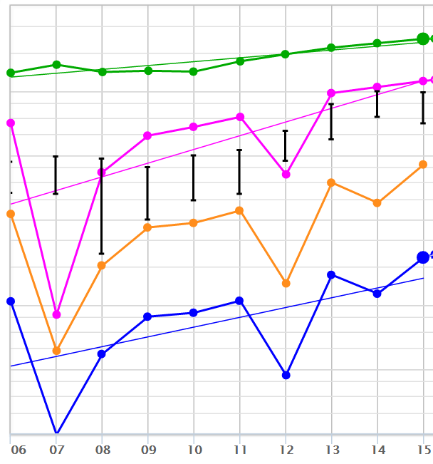
The Simplified Income Statement
Sales (1)
Minus Expenses (2)
= Pre-tax
Profits (3)
Minus taxes (4)
= Net Income (5)
Divided by shrs.(6)
= EPS (7)
Note: Earlier versions of Toolkit did not show Net Income (5)
11
Notes:
And here is that simplified income statement for 10 years shown on our SSG.
We start with the green line, Sales, and we subtract expenses (represented by the space between the green and pink lines) and that brings us to the pink line, Pre-Tax Profit.
From there, we begin with the pink line, Pre-Tax Profit, and we subtract taxes (represented by the space between the pink and yellow lines) and that brings us to the yellow line, Net Income.
Finally we start with our yellow line, Net Income, and we divide it by Shares Outstanding (represented by the space between the yellow and blue lines) and that brings us to the blue line, Earnings Per Share.
You may want to note that if by some chance you are still using a version of Toolkit prior to version 6, the earlier versions of Toolkit didn’t have ability to plot Net Income. We can imagine where it is (in the space between line 3 & line 7 dividing up that space), but we can’t really separate the change between Pre-Tax Profit and Net Income from the change between Net Income and Earnings Per Share. In other words, without line #5 Net Income, you can’t tell how much of the space between line 3 Pre-Tax Profit and Line 7 EPS is taxes #4 or shares outstanding #6
If you are still using the earlier versions, you must look at the taxes and shares outstanding as one combined item. In later versions, and in the SSG Plus, we can isolate them individually.

Slide 12

Why Use Preferred Procedure?
Often EPS is not as well behaved as Sales
EPS is affected by:
  Sales
  Profit Margins,
  Tax Rates, and
  Shares Outstanding
12
Notes:
Why are we concerned about all of this?
One of the things we try to do on our SSG is project Earnings Per Share growth over the next 5 years.
We start with Sales growth which is simply the cash register ringing. It isn’t affected by other financial numbers.
If we think back to our simplified income statement that we just saw, how do we get to Earnings Per Share?
We start with Sales. It is affected by expenses. Using Pre-Tax Profit Margins we look at the profit left from each dollar of Sales, after our expenses are paid , but before taxes are paid.
This helps us determine how much our Pre-Tax Profit grew. So our bottom line starts with Sales and is affected by Profit Margins.
It is then affected by Tax Rates in order to determine how much Net Income the company had after paying taxes. And finally, it is affected by Shares Outstanding to determine how much our Earnings Per Share grew.
Think of Sales as a boat on a calm ocean. Think of Earnings Per Share as a boat starting on that same ocean but pushed around by waves of Expenses (reflected in Profit Margins), waves of Tax Rates and waves of Shares Outstanding. It certainly won’t be as smooth a ride. We must look at the direction and strength of each of those waves to determine how our boat is going to move.

Slide 13

Let’s Take A closer Look
13
Notes:
Let’s take a closer look.
For our closer look, we are going to look at a company called Green Mountain Coffee Roasters. As I explained earlier, we are going to use very old information. We have provided you with the Income Statement for GMCR as well as, for those of us who go back far enough, what we called the front page of our Stock Selection Guide (SSG). It is Additional Handout #1.
Because of going private and some mergers, at this point the closest you will find to Green Mountain Coffee Roasters (ticker symbol: GMCR) is Keurig Dr Pepper (ticker symbol: KDP)

Slide 14
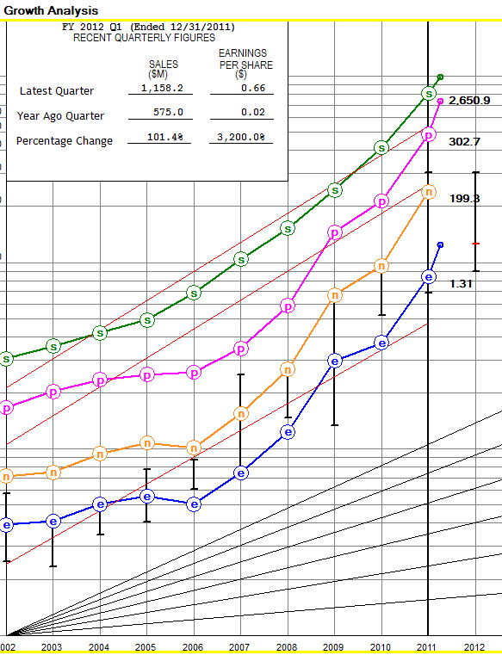
What is our first (top) line?
14
Notes:
Remember our Income Statement? What’s is our first line? Correct, it is Sales!
That is the reason we plot the lines on the Stock Selection Guide the way we do. Our first line at the top of our Stock Selection Guide is also Sales. © We want our Stock Selection Guide to reflect our Income Statement for each of the past 10 years. Our SSG is a picture of the company’s Income Statement for the past 10 years.

Slide 15
1st step down the Income Statement
Gross Profit.
Cost of Sales
15
Notes:
Let’s start stepping down our Income Statement. Let’s look at what happens next, our first step down.
We start with Sales on the top line and the first thing we do is subtract Cost of Sales. © When a company sells a product, Cost of Sales is the cost incurred to produce or obtain the product that it sells.
It is exactly what it sounds like, the costs of obtaining or manufacturing the items that are sold to produce the company’s Sales.
When we subtract the Cost of Sales, we arrive at something called Gross Profit. © Gross Profit simply is the difference between what the products were sold for and what it cost to obtain the products.
It is the profit on the product before anything else, such as costs of running the business, are subtracted.

Slide 16
Next step down the Income Statement
Operating Income.
Expenses to operate the business – Operating Expenses.
16
Notes:
Speaking of our costs of running the business, our next step down is to subtract all of the expenses necessary to operate the business. We call these Operating Expenses. ©
The most well-known format is Selling, General and Administrative (often referred to as S,G and A), but as we see in our example company, it can be shown categorized slightly differently. It all means the same thing.
These are general costs related to running the company. It would include selling costs, marketing costs and administrative costs. For example: salaries, officers’ salaries, advertising, insurance, utilities, etc.
Sometimes for companies such as tech companies you will also see R&D Expense, Research and Development.
The net after we subtract our Operating Expenses from our Gross Profit is Operating Income. © That is the profitability from the normal operations (ongoing regular activities) of the business.

Slide 17
It’s Simple
Net Sales
- Cost of Sales
= Gross Profit
- Selling Expenses
- General and Administrative Exp.
= Operating Income
===============
17
Notes:
Let’s review how we get to the income from the normal operations of a business on our Simplified Income Statement.
We start with net Sales © and subtract Cost of Sales, © and that brings us to © our Gross Profit.
From that we subtract our © SG&A, Selling, General and Administrative Expenses, and that brings us to our © Operating Income, the income from the normal operations of the business.

Slide 18
The Non-Operating Section
This section frequently consists primarily of Interest (or Other) Income and Interest Expense.
  Interest and investment income is earned and reported when a company invests in certificates of deposits, treasury bills or notes, or the stocks and bonds of other companies.
  Interest Expense is a payment that the company makes for the use of another company’s money (for example: notes, mortgages, and bonds).
18
Notes:
The next section we are going to look at is the section that includes things that are not part of the core operations of the main business. The most common things we see are the costs of financing business operations, interest expense, and the amounts generated by parking excess dollars when they are not needed, interest income.

Slide 19
Next step down the Income Statement
Results in Income before income taxes.
Non-Operating Items (May be income or expense items).
19
Notes:
As you can see, there are several other things that can appear in this section.
In this case we do see one item that is an addition, rather than a subtraction, as we walk down our income statement, Other Income.
We also see Loss on Financial Instruments and Loss on Foreign Currency.
As you can see, the largest item in this section by far is Interest Expense.
We will lump this all together as © non-operating items and when we subtract non-operating items from our Operating Income, we arrive at © Income Before Income Taxes.

Slide 20
We are going to call this entire section “Expenses”
20
Notes:
We are going to lump together everything between Sales and Income Before Income Taxes and call it Expenses. ©

Slide 21
What is the second line?
Pre-tax Profit
21
Notes:
As you can see, we are at the second line that we plot on our SSG, © Pre-Tax Profit.
And once again, as we look at our SSG from top down to bottom, we can see that we plot the lines in the order that they appear on the company’s income statement.
We can look at the income statement on our SSG and see everything that happens to the company from Sales down to Pre-Tax Profit. For example, are Sales and Pre-Tax Profit moving closer together, staying the same distance, or moving apart?
We will see that we can focus in on what is happening in each step, between each pair of lines.

Slide 22
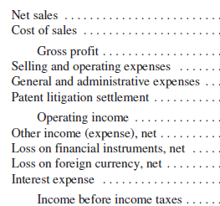
What is Happening?
The distance between the Sales line and the Pre-tax Profit line is changing. What might be the cause?
1
2
3
One or more of the items in the box is changing!
Expenses !
22
Notes:
We can focus in on what is happening in each step as we move through our SSG – We have plotted two lines on our SSG so far, Sales and Pre-Tax Profit. If the space between the two lines is changing something is happening between them. ©
What is between Sales and Pre-Tax Profit? We can look on the income statement and see everything that happens to get the company from Sales down to Pre-Tax Profit. Remember we lump together everything in that section of the income statement and call it “Expenses”.
If the space between Sales and Pre-Tax Profit is changing, © Then what is happening between the two lines, Sales and Pre-Tax Profit. © The amount of expenses out of every dollar of Sales is changing. Remember, Pre-Tax Profit Margin (% Pre-Tax Profit on Sales)? That tells us out of every dollar of Sales how much is left after the company pays all its expenses but before paying taxes..
We have just shown on our SSG the part of our Simplified Income Statement that is © (1) Sales minus (2)Expenses equals (3) Pre-Tax Profit.
When Sales and Pre-Tax Profit are getting closer, the space in between the two lines, our expenses, is getting smaller. Remember that space represents our expenses. Out of each dollar of Sales the expenses are getting smaller and we see that in an increasing Pre-Tax Profit Margin. If the company’s Pre-Tax Profit Margins have been growing, part of our Earnings Per Share growth is coming from improved profitability. The Pre-Tax Profit line moving up closer to the Sales line because the Pre-Tax Profit Margin is increasing, also pulls up the lines below it, including our bottom line, Earnings Per Share. This is one reason Earnings Per Share could have grown faster in the past.
What might happen to our future Earnings Per Share growth rate if Pre-Tax Profit Margins stop growing, or decline over the next five years? Will Earnings Per Share still grow as fast?
The converse is true as well. If Pre-Tax Profit margin has been declining over the last ten years, that could drag our Earnings Per Share growth down. If it stops declining or it starts to increase, our Earnings Per Share might be able to grow faster over the next five years.

Slide 23
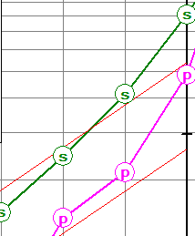

Let’s Look a Little Closer
2011
From 2010 to 2011 Sales and Pre-tax Profit moved closer!
The space between the lines – Expenses
– got smaller
2010
23
Notes:
How do we decide if our Pre-Tax Profit Margin has grown?
We can draw an imaginary line on our SSG. Here are the two most recent years from our example company. The two headed arrow drawn in for each of the two years is exactly that same size.
Note that in 2010, our 2nd to last year, the line fits nicely between our plotted Sales and our plotted Pre-Tax Profit . If we move to 2011, the same size arrow now goes from Sales , but it extends into our plotted Pre-Tax Profit . That means the lines got closer.
That means Pre-Tax Profit grew faster than Sales . This means expenses out of each dollar of Sales got smaller and we will see a higher Pre-Tax Profit Margin in 2011 versus 2010.
This is one way of doing it. If you are a pretty visual person, you can usually eyeball it and tell if the lines are getting closer or further apart. If not, there are alternative ways of doing this. In the interest of time, we won’t go over the other two ways that we have, but we did include as a handout slides showing the options for doing it. That is additional handout #2.
We have made available a prior session that I taught where this was covered in some detail. We are going to put the links for the recording, handouts, and follow up Q&A for that class into the chat box.

Slide 24

Questions?
24
Notes:
Let us stop here for a minute and see if there are any questions.

Slide 25
Next step down the Income Statement
Income taxes
Results in Net Income.
25
Notes:
Okay, let’s continue with our next step down the Income Statement.
At this point the company pays Taxes on the Pre-Tax Profit. ©
When we subtract those taxes from our Pre-Tax Profit, we arrive at Net Income. ©
This is the total Net Profit for the company as a whole. It can also be shown as Net Earnings.

Slide 26
26
Notes:
As you can see, we are at the third line that we plot on our Stock Selection Guide, © Net Income, the total income for the company. This is the line we plot in yellow.
This is often referred to as the bottom line. We tend to think on a per share basis, so we will consider Earnings Per Share the bottom line.
Net Income remains after the company deducts operating and non-operating items as well as taxes from the Sales.
And once again, as we look at our SSG from top down and we can see that we plot the lines in the order that they appear on the company’s income statement.

Slide 27

What is Happening?
The distance between the Pre-tax Profit line and the Net Income line is changing. What might be the cause?
3
4
5
Only one thing is happening in between!
Taxes !
27
Notes:
We have plotted one more line on our SSG and we now have three. At this point we have focused on the Sales and Pre-Tax Profit lines and what is happening in between. We are now going to focus on our second set of lines © , Pre-Tax Profit and Net Income, and the space in between this set of lines.
What does it mean if the distance between the Pre-Tax Profit line and the Net Income line changes? What happens between Pre-Tax Profit and Net Income? © We can look on the income statement and see everything that happens to get the company from Pre-Tax Profit down to Net Income. © In this case it is only one item, © Taxes.
What we have just done is shown on our SSG the part of our Simplified Income Statement that is © (3) Pre-Tax Profit minus (4)Taxes equals (5) Net Income.
If the space has gotten smaller, our tax rate has dropped allowing Net Income to grow faster than Pre-Tax Profit. It pulls up the Net Income line and the Earnings Per Share line below it. This could be a reason why Earnings Per Share might grow faster than Sales.
If this has been the case, what will happen to our Earnings Per Share growth rate over the next five years if tax rates don’t continue to drop? We won’t have declining tax rates pulling the Earnings Per Share line up. It likely won’t grow as fast. If tax rates continue going down, perhaps our Earnings Per Share can grow faster than Sales?
If we find out why it happened and know that it is something that is not going to happen in the future, when we do our projections of what things will look like 5 years in the future, isn’t that wonderful information to have? You can see it right here on the SSG. Are those lines getting closer or further apart? This is visual analysis. We are analyzing the income statement visually.

Slide 28
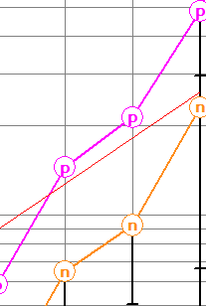
Let’s Look a Little Closer
2011
From 2010 to 2011 Pre-tax Profit and net income moved closer!
2010
28
Notes:
Let’s focus in on the change from 2010 to 2011. Both pink two-way arrows are the same size. In 2010, the arrow only extends to the top of the circle with the “n” in it. For 2011, the arrow extends into the middle of the circle. So we can see that the two lines have gotten closer.
What is the only difference between Pre-Tax Profit (the pink line) and Net Income(the yellow line)?
That’s right ! Taxes - If the lines have gotten closer together, the space between them is smaller. That space reflects tax rates. From 2010 to 2011 the tax rate declined, pulling up our Net Income line. In the last year our bottom line, Earnings Per Share, got help growing from a decrease in tax rate and the pulling up of the Net Income line helped pull up everything below it, our Earnings Per Share line.

Slide 29
Final step down the Income Statement
Shares Outstanding
Results in Net Income Per Share.
Notes:
Let’s move down our final step.
Before we do, in the interest of avoiding confusion, our example company has an item that we almost never see. It is truly irrelevant for our purposes, but we didn’t want to pretend it isn’t there and not say anything. ©
The example company had a “non-controlling interest” and part of the Net Income is attributable to that interest. Therefore the Net Income attributable to the company shareholders is slightly lower. We can say with confidence you will probably never see this and for us it is largely irrelevant. Basically there is another entity which owns a piece of the earnings and they don’t belong to the company’s shareholders.
So for our final step down our income statement, we take our Net Income for the company and © divide it by the Shares Outstanding which brings us to © our bottom line, Earnings Per Share, which for this particular company is called Net Income Per Common Share.

Slide 30
What is our final line?
Co
30
Notes:
As you can see, we are at the final line that we plot on our Stock Selection Guide, which is our bottom line, © Earnings Per Share, and this is the line we plot in Blue.
Once again, as we look at our SSG from top down to bottom, we can see that we plot the lines in the order that they appear on the company’s income statement.

Slide 31

What is Happening?
The distance between the Net Income line and the Earnings Per Share line is changing. What might be the cause?
6
5
Only one thing is happening in between!
7
Shares Outstanding !
31
Notes:
We have plotted our fourth and final line on our SSG.
We can focus in on what is happening in each step. If the space between the two lines is changing something is happening between them. We have focused on the Sales and Pre-Tax Profit line and what is happening in between. We have focused on the Pre-Tax Profit line and the Net Income line and what is happening in between.
We are now going to focus on our final pair of lines, © Net Income and Earnings Per Share, and the space in between this set of lines. If the space is changing something is happening between them. What is between Net Income and Earnings Per Share? © We can look on the income statement and see everything that happens to get the company from Net Income down to Earnings Per Share. © Again, in this case it is only one item, © Shares Outstanding.
So, if the space between Net Income and Earnings Per Share is changing, it is Shares Outstanding that is changing!
What we have just done is shown on our SSG the part of our Simplified Income Statement that is © (5) Net Income divided by (6)Shares Outstanding, resulting in (7) Earnings Per Share.
If the space has gotten larger, our Shares Outstanding have increased causing Earnings Per Share to grow slower than Net Income . The larger space is pushing down on our Earnings Per Share line. This could be a reason why Earnings Per Share might grow slower than Sales.
If this has been the case, what will happen to our Earnings Per Share growth rate over the next five years if shares outstanding don’t continue to increase? We won’t have the same push down on our Earnings Per Share line. That might allow Earnings Per Share to grow faster.
We can focus in on what is happening in each step. With this information we can look on the income statement and see everything that happens to get the company from Sales all the way down to Earnings Per Share .

Slide 32
Shares Outstanding
Which Shares Outstanding should we use?
  Basic Weighted Average Shares Outstanding
  Diluted Weighted Average Shares Outstanding
32
Notes:
You may have noticed that there are two different numbers for shares outstanding and for Earnings Per Share. One is “Basic” and the other is “Diluted”. What is the difference?
Diluted includes certain other financial instruments, such as convertible stock or bonds, that can be turned into Common Shares. Effectively using Diluted Shares treats the Earnings Per Share as divided over not only actual shares, but things that could be converted into actual shares. This is more conservative and therefore it is what we use for our purposes.

Slide 33

Questions?
33
Notes:
Let’s pause for a moment and see if we have any questions we need to address.

Slide 34
How Do We Use This?
We try to understand how the company has grown historically.
We try to understand where things have changed over time:
  Sales
  Expenses
  Pre-Tax Profit
We use this information to help us project how the Income Statement might change over the next 5 years.
Taxes Paid
Net Income
Shares Outstanding
Earnings Per share
34
Notes:
We look at the pictures to tell us how the company has grown its Earnings Per Share over the past 10 years.
Is it all from Sales, or have changes in Expenses, Tax Rates or Shares Outstanding helped or hurt our past growth, and what do we think will happen with those going forward?
There they are! The 7 things we see on the Visual Analysis graph of our SSG.

Slide 35
Reality Check
We easily see what to focus on using Part 1 of the SSG, “Growth Analysis”.
  The SSG tells you which items on the Income Statement to focus on.
  We can isolate what is changing by looking at each set of lines.
  This points us to the items we need to study and understand and consider in projecting the future.
    Try looking in the Annual Report at Management’s Discussion and Analysis (MD&A).
  We can then project our future EPS by evaluating each component of the preferred procedure.
35
Notes:
The beauty of the Visual Analysis section of the SSG is that it tells us where we should focus. We can very simply see what is changing.
If the space in between the lines is getting smaller, whatever we know is in there, whether it is expenses, taxes, or shares, has gotten smaller. We also know that if it has gotten smaller, it has pulled up, or given a lift to the line immediately below it, and all the lines below that. That helped our Earnings Per Share grow faster than it would have in the past without the help from the space getting smaller.
The opposite is true. If the space got larger, it pushed all the lines below it down, dragging down our growth, all the way down to Earnings Per Share .
We can easily spot what has contributed to our Earnings Per Share growth rate in the past besides the growth in Sales, and then we can decide if it will continue, stabilize or go in the opposite direction.
For those who know me well, I am a bit of a radical. I am not making a recommendation, but I do believe that people who aren’t good with numbers can do a really good stock study just using the visual analysis graph. You can see in pictures how Sales has grown, how Pre-Tax Profit margins have grown, how Net Income has grown and how Earnings Per Share has grown. You can also see whether PE ratios are too high by looking at the graph. There is a picture of everything we need when we look at visual analysis.
Despite what many will tell you, people who are better visually than they are with numbers can still do a pretty good SSG.

Slide 36

Where Do We Go From Here ?
Notes:
So, we have been through a lot of information? Where do we go from here?

Slide 37
Management Discussion and Analysis (MD&A)
Where do we find out why things are changing?
  MD&A!
MD&A
  Part of a company’s annual report.
  Management provides an overview of what has happened and why?
37
Notes:
One of the things we have to do is begin to search for answers. On our Stock Selection Guide we can look at each pair of lines and what the form tells us about what is changing. In fact, the beauty of the Stock Selection Guide is that it tells us exactly what we need to go look at.
A great place to start your search is by grabbing the Annual Report from the company and looking at the section called Management Discussion and Analysis, which we will refer to as MD&A.
I am going to digress here for a moment and get up on my soap box.
MD&A is provided by management in mostly an essay form, with not too many numbers. In it management discusses what is happening with things like profit margins, tax rates, etc. in English. Isn’t that exactly what we need to find out? And the nice part, it is written in almost understandable English.
My personal opinion is that you can’t really do a thorough stock study without at least reading management’s essay explaining what is happening with the company, MD&A.
This is my personal opinion, but I strongly believe it.
Now I will dismount my soapbox and simply state that in our case study tonight we will use MD&A as our primary source for information about what is changing with our company.

Slide 38








RPM International Inc
Case Study
38
Notes:
We are going to use RPM International Inc as our Case Study. RPM International Inc. was founded in 1947. It is a multinational company with subsidiaries that are world leaders in specialty coatings, sealants, building materials and related services.
You may know of, or have used, some of their products… Rust-Oleum, DayGlo, DAP, Carboline, or one that I know of because of my secret nerdy past. As a kid I used to build model rockets and the paint that was most widely used was Testors.
I will admit that I also have a personal affinity for RPM as they have been a big supporter of BI and of BINC, appearing in our exhibit hall pretty often for at least 20 years and probably longer.
What we are going to do is try to read the lines on our Stock Selection Guide to see what the Stock Selection Guide tells us we have to investigate.

Slide 39
Expenses
39
Notes:
Our first space on our SSG is between Sales and Pre-Tax Profit. We know that space represents expenses, so we are going to start there.

Slide 40
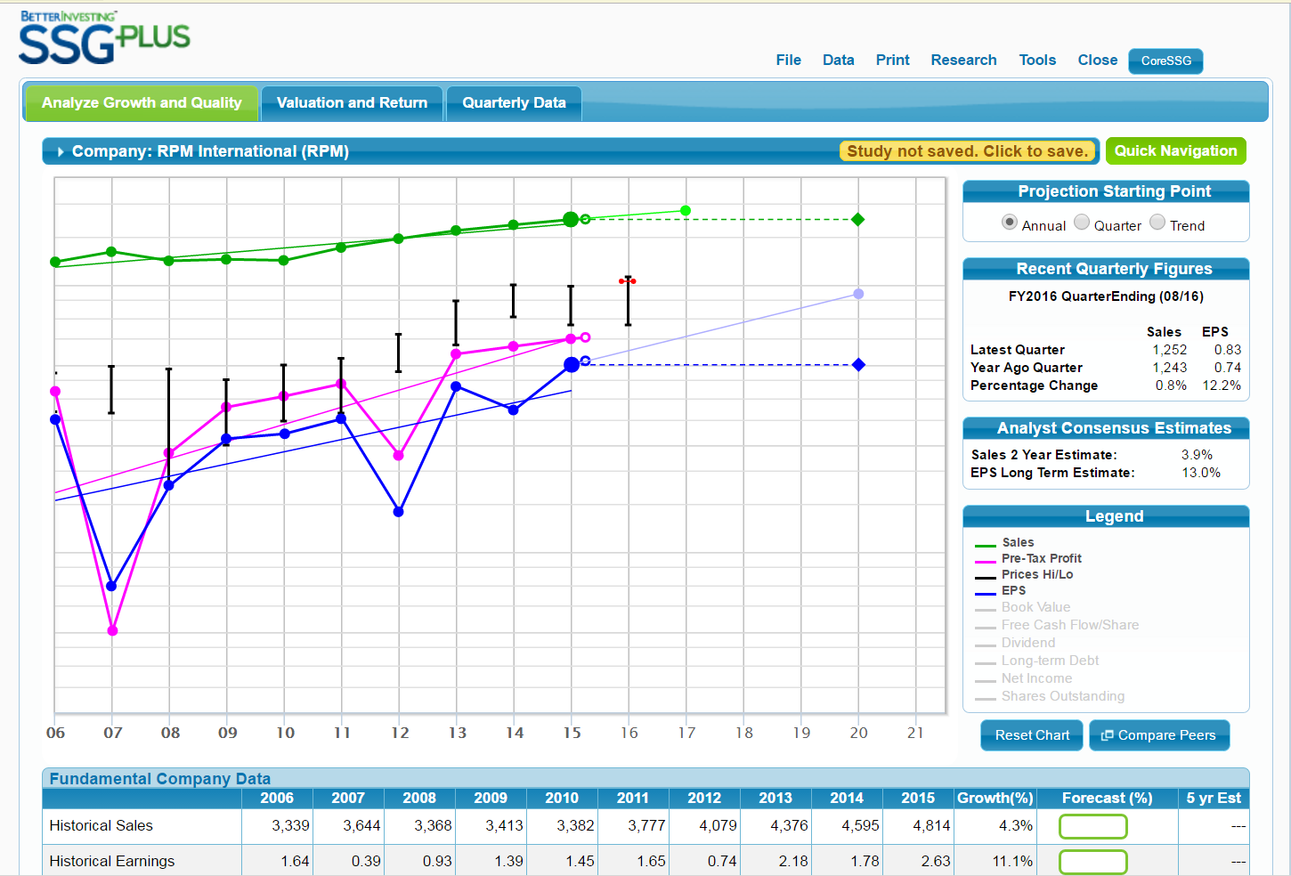
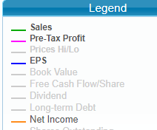
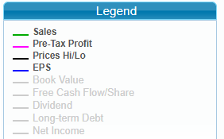

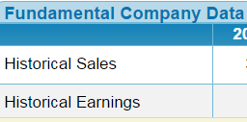
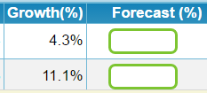
40
Notes:
The first thing we need to look at is in the red circle. Those are our historical growth rates, © 4.3% for Sales, but Earnings Per Share was able to grow at 11.1% on that 4.3% increase in Sales.
How can Earnings Per Share grow so much faster than Sales? We are going to need to dig in and see what is going on. Something pulled the Earning Per Share growth up!
The first thing we will need to do is bring our SSG into focus by setting up the graph to look the way we want it to so that we can read our SSG like our Income Statement.
In the green circle you can see that in the Legend box © Sales, Pre-Tax Profits, Prices Hi/Lo and EPS are turned on.
We aren’t really using Prices on our SSG and as we mentioned, we want to look at Net Income.
Step 1 is turn Prices off and Net Income on. © This is done by clicking on them in the Legends box. ©

Slide 41
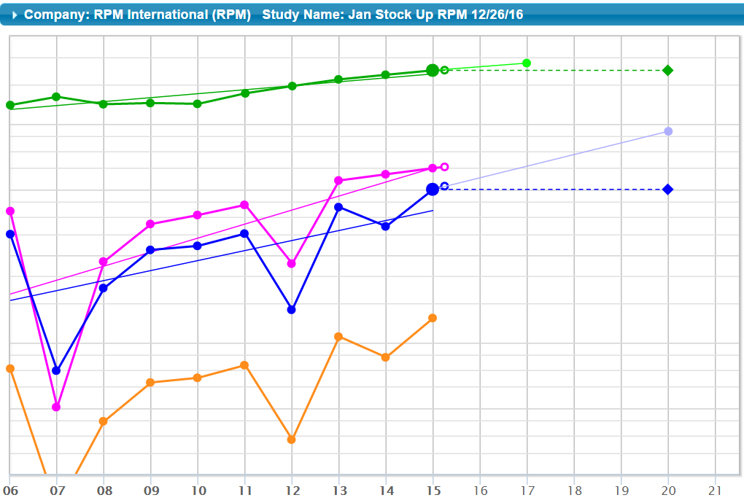
41
Notes:
Once we do that, this is what we see.
We do have one remaining issue. Do you know what that is?
Yup, the yellow line – Net Income isn’t in the right place. It should be below our pink Pre-Tax Profit line, but it should be above our blue EPS line.
So lets move our yellow line up, also we don’t want it dropping off the bottom of our graph as it does in 2007, and let’s move our blue line down below it.
You simply click and drag the lines.
Well that is true in SSG Plus and in Toolkit. In Core SSG you can’t move the lines and in actuality, you can’t get the Pre-Tax Profit or Net Income lines, only Sales and Earnings Per Share. Core SSG is a simpler tool to begin with. If you really want to do better studies and work with preferred procedure you probably should upgrade from the Core SSG to SSG Plus.

Slide 42
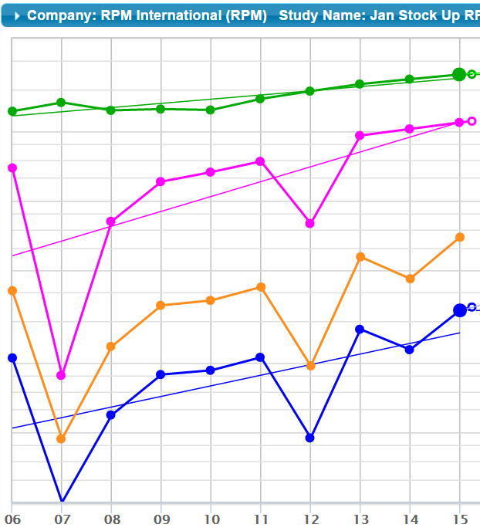
42
Notes:
Once we move our lines, this is what we see. Doesn’t it look just like our Income Statement?
So let’s begin our study and dig in.
What is the first step down our simplified income statement? That’s right: Sales – Expenses = Pre-Tax Profit.
We start by looking at our Green and Pink lines and the space in between them.
If we look at the Green Trend Line and the Pink Trend Line ©, the first thing we notice is that the slope of the Pink line is steeper. Pre-Tax Profit is growing at a faster rate than Sales. Profit Margins are rising!
We can see that clearly …. The space between the Green line and the Pink line is getting smaller. What does that space represent? You got it! Expenses.
What we are seeing is a smaller amount of each dollar being used for expenses and therefore our profitability is rising. We are left with more out of each dollar of sales.

Slide 43




Percentage Increase
43
Notes:
Here it is in numbers. If we look at % Pre-Tax Profit on Sales, our Pre-Tax Profit Margin, we see that over the 10-year period it has grown. It started at 9.2% in 2006 © and climbed to 10% in 2015. That is an 8.7% increase from 9.2 to 10. How do you get the 8.7% increase??
For those of you who remember calculating the most recent quarter by hand on the pencil and paper SSG, here is how it goes… ©
We subtract the original old value, 9.2, from the new value, 10, to get the amount of change which is .8. We then divide the amount of change, the .8, by the original old value, 9.2, and that will give you the percentage that it has increased, just about 8.7%.
Going back to our Profit Margin numbers, we can see it hasn’t been a straight smooth climb, but nonetheless we know that part of our higher bottom line Earnings Per Share growth for the 10-year period is as a result of the company becoming more profitable.
One downward year in the recent past is 2012. © I definitely am going to want to go in and figure out what happened. I also want to see if I can figure out why the Pre-Tax Profit Margin has been climbing over time, so after we look at 2012, I think we will start with 2015, the current year, and see whether we can get some information there.

Slide 44


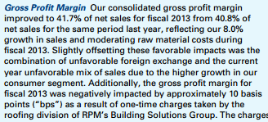
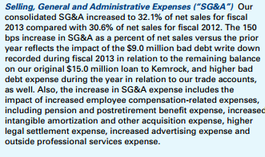
44
44
Notes:
AVI [Note to self: BI SSG Year 2012 is FYE 5/31/13]
We are going to look in RPM’s 2013 Annual Report and take a look at Management’s Discussion and Analysis (MD&A).
We decided to look at 2012’s Pre-Tax Profit Margin, so why are we looking in RPM’s 2013 Annual Report?
RPM’s year ends on May 31. In the SSG data if the year end is May, it is referred to as the prior year because the majority of the fiscal year fell into the prior year. So, 2012 in the SSG Plus is the fiscal year ended May 31, 2013.
On the other hand, RPM refers to it as 2013, based on that being the year in which the fiscal year ended. So, we have to look at RPM’s 2013 Annual Report to find information about our 2012 data points. We will refer to it as 2012 for consistency with our SSG. We have included RPM’s 2013 Annual Report as additional handout #3.
Where should we start looking? What is the first force that acts on Sales as they move their way down to Earnings Per Share? That’s right! Expenses
The two main areas of expenses we talked about were Gross Profit, the profit after subtracting the Cost of Goods Sold, and Operating Profit, after Operating Expenses, primarily Selling, General and Administrative (SG&A) Expenses are deducted. So let’s search for some of those terms.
As you can see on the slide, whether you used a “find” or “search” feature or simply scan the headings we easily find the two main sections we need.
Let’s start at Gross Profit Margin. The Gross Profit Margin actually increased from 40.8% in 2011 to 41.7% in 2012. They actually grew sales at 8% and were able to moderate raw material costs. They do talk about the gains being slightly offset by “current year unfavorable mix of sales due to higher growth in our consumer segment”. What does this mean?
More of the Sales are coming from consumer products which either sell for less or cost more to produce. That makes them less profitable.
That is what they are telling us here. Although sales are increasing, they are somewhat offset by the fact that the faster growth is coming in the consumer area which is less profitable.
If we look further by digging into SG&A, the big thing we see there is an “increase in SG&A as a percent of net sales versus the prior year reflects the impact of the $9.0 million-dollar bad debt write down”. This is likely not a regular occurrence, but it is what pulled down our Profit Margins and consequently pulled down our Earnings Per Share in 2012.
As a side note, they go on to talk about higher bad debt expense on trade accounts, increased employee compensation costs, increased advertising expense and outside professional services expense. It looks like they are experiencing some upward pressure on expenses, besides the $9 million dollar write off. It gives us something we need to keep an eye on.

Slide 45
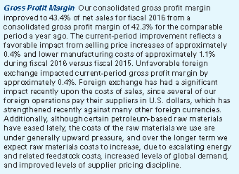

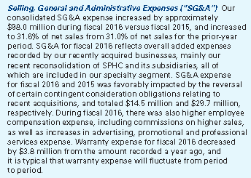
45
Notes:
Moving ahead to 2015, the fiscal year ended May 31, 2016, which is 2016 for RPM’s annual report, we will again look at the same two sections, and we have attached RPM’s 2016 Annual Report as additional handout #4.
If we look at Gross Profit Margin again, we see an increase from 42.3% to 43.4%. It goes on to tell us “The current-period improvement reflects a favorable impact from selling price increases….and lower manufacturing costs.” Lower costs resulted in an increase in Profit Margin.
They also go on to tell us “although certain petroleum-based raw materials have eased lately, the costs of the raw materials we use are under generally upward pressure, and over the longer term we expect raw materials costs to increase…”
What is RPM telling us about Profit Margins? Well at least about Gross Profit Margins. Their cost to produce the products they sell is expected to go up. To us, that means that Profit Margins will go down!
When we look at SG&A, we are told they increased from 31.0% of sales to 31.6% of sales. Isn’t that what we saw three years earlier, signs of increasing SG&A costs? They go on to tell us that they were favorably impacted by “the reversal of certain consideration obligations relating to recent acquisitions”. So, the numbers got worse even though they were helped by a one-time thing. What does that tell us about Profit Margins? Without the one-time reversal the numbers would have been even more negatively impacted.
They then also go on to tell us again about increases in the same things they talked about as increasing three years ago. What we are seeing is continuing upward pressure on expenses as a percentage of Sales. More expenses equals lower Profit and lower Profit Margins.

Slide 46
To Recap
If Taxes and Shares Outstanding remain the same going forward, what will happen if Profit Margins decrease?
  Sales will grow faster than Earnings Per Share
46
Notes:
So, if the only thing that changes is Profit Margins and they decrease, that means Expenses are increasing out of every dollar of Sales. When this happens, Pre-Tax Profit is dragged down, which in turn causes Earnings Per Share growth to be dragged down and it will grow slower.
Therefore, Sales can be expected to grow at a faster rate than Earnings Per Share if Pre-Tax Profit margin declines and everything else, taxes and shares outstanding, remain constant.

Slide 47
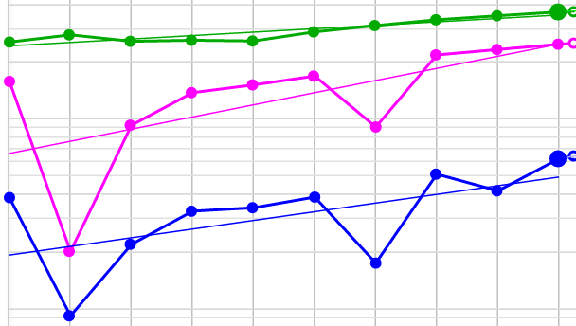
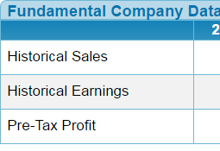
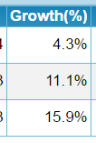
2012
2007
47
Notes:
I think we should look at one more thing related to our expenses and Pre-Tax Profit Margins.
If you look at the graph, which for the moment just shows Sales, Pre-Tax Profit and Earnings Per Share, you can see that the pattern for Earnings Per Share looks fairly similar to Pre-Tax Profit. The big change in relationship of the lines is between Sales and Pre-Tax Profit.
While there is some change between Pre-Tax Profit and Earnings Per Share, it is clearly not as significant. We will take a look at what else is happening, but our EPS growth rate seems to be very much affected by our Pre-Tax Profit growth.
Lets take one more look at our lines. We decided that our Pre-Tax Profit drop in 2012 was not a “normal” reflection of what is happening with Pre-Tax Profit. Remember our $9.0 million dollar write-off? Because it isn’t a normal thing that happens, we could assume it won’t happen again in the next five years.
In the interest of time, let’s make an assumption that the drop in 2007, 9 years ago, is something similar and also not relevant to what normally happens with the company’s operations. So lets think of those two years as outliers or irrelevant information in terms of projecting what will happen in the future.
Now let’s look at the fundamental company data at the bottom of the screen ©. Remember we calculated that Pre-Tax profit grew at 8.7% over the 10-year period? Why does the data show a Growth rate of 15.9% for Pre-Tax Profit?
[PAUSE]
Take a look at 2007, it is much steeper a drop right near the back end of our trend line. That pulls the back end down. If the back end is pulled lower and the front end isn’t pulled down as much, what happens to the slope of the line, or our growth rate?
The slope becomes steeper and that shows up as a faster growth rate. This is one of the reasons to be very careful to make sure data is relevant!

Slide 48
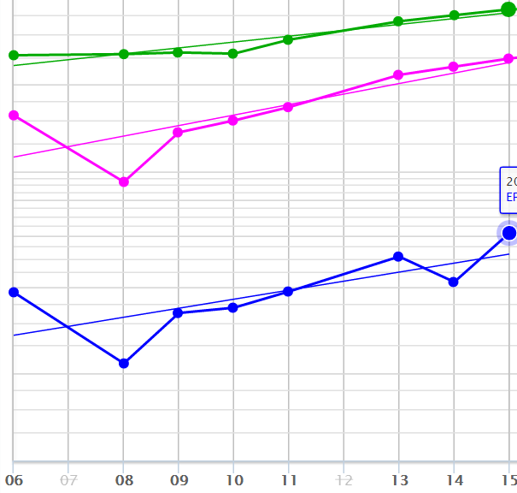
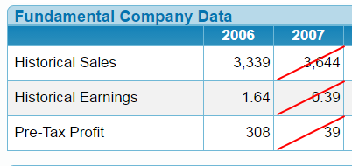
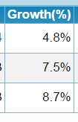
48
Notes:
So, let’s see what happens if we eliminate 2012 and 2007 as invalid data points in terms of our projecting the future.
The way we do this in SSG Plus is to click on the year. As you can see in the pink circles 2007 and 2012 are grayed out. They have been eliminated from our SSG calculations. If you look up those year’s line, you will see there are no dots for Sales, Pre-Tax Profit and EPS. That information is excluded from our SSG.
If we just eliminate 2007 as an outlier, it drops our Pre-Tax Profit growth rate to 7.5% and our Earnings Per Share growth drops from 11.1% all the way down to 5.9%.
We have done the same with 2012. We know 2012 is also an outlier and we had to eliminate it to get a truer picture of the company operating “normally”
So when we are all said and done eliminating the two years of irrelevant data, here is where we stand: ©
The Sales trend changed slightly. Because it was a fairly consistent Sales pattern, eliminating years didn’t change the trend very much. We went from 4.3% Sales growth to 4.8% Sales Growth.
Here is where the changes get interesting and show us what really evaluating the past properly does.
Remember we showed a Pre-Tax Profit growth of 15.9% on the last slide. Well, it really didn’t grow quite that fast if you only look at what is normal for the company. In fact, eliminating those two years drops the 15.9% we showed originally to 8.7%. Anyone remember the 8.7%? Yes, that is the growth in Pre-Tax Profit we manually calculated by starting with 9.2% in our earliest year and ending with 10% in our most current year.
Remember, we talked a few minutes ago about how it is the Pre-Tax Profit that is predominantly affecting our Sales as we move down our Income Statement to Earnings Per Share?
Notice that after eliminating the two years, our Earnings Per Share growth line still looks pretty much similar to the Pre-Tax Profit growth, although we notice something happening below Pre-Tax Profit in our 2nd to last year.
So, if Pre-Tax Profit growth slows, what follows?
When our 10-year Pre-Tax Profit growth rate dropped from 15.9% to 8.7%, what happened to our 10-year Earnings Per Share growth rate? It dropped from 11.1% when we leave in the irrelevant data to 7.5% when we only use data that is relevant. This is the kind of effect an outlier in the wrong place can have.
One thing we do know going forward is that we can’t base our judgment on historical Earnings Per Share growth of 11.1%, we only can use 7.5% as our starting point.
That still brings us back to the earlier question of whether PTP% will continue to grow at even 8.7%, but either way, I have to bring my future EPS growth rate down from the 11.1% historic growth rate, at this point to no more than 7.5% unless we know of something else that will help it in the future.

Slide 49

Questions?
49
Notes:
Ok! Let’s stop for a minute, catch our breath, and see if we have any questions that need to be answered.
Seeded question: How do you know if they are using 52-53 week accounting?
Answer: You will see it. Most financial statements are shown with more than one year so that you can compare numbers. Even if one of the periods ends at a month end, the other won’t. You will see a period shown that doesn’t end at the end of a month. That is the biggest clue.

Slide 50
TAXES
50
Notes:
Our next step down the Income Statement is from our Pre-Tax Profit line to our Net Income line. What is happening between those two lines? Taxes!

Slide 51
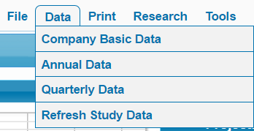


51
Notes:
So let’s go back to our SSG and try to figure out what is happening to our taxes, or tax rates.
Where do we begin? We look at the space between the Pink line and the Yellow line. We have drawn in two equal sized arrows ©, one for our most recent year, 2015, and one for our earliest year 2006.
In 2015, our arrow touches both the Pre-Tax Profit and the Net Income. If we look back to 2006, we can see that it doesn’t. Take a look at the blue arrow ©. It points to where we can see that there is space. Our Pink arrow no longer touches both lines because the space was bigger, and it got smaller over the 10 years because we can see that the arrow touches both lines in our latest year.
So, what do we know? Over our ten-year history, our lines have moved closer together. The space in between them is smaller which means that our tax rate is lower in 2015 than it was in 2006.
You can actually see this in the numbers. In SSG Plus © if you click on the data tab © you will see a drop-down menu. Selecting Annual Data © will bring up a table showing the 10 years of data. We copied the Tax Rate column ©.
As you can see in 2015 © our tax rate is 26.1, back in 2006 © it was 32.3. That is what our arrows showed, that our space between Pre-Tax Profit and Net Income got smaller from the 32.3% tax rate in 2006 to our 2015 tax rate of 26.1%
The tax rates got lower meaning the space between Pre-Tax Profit and Net Income, which we know represents taxes, got smaller over the 10 years……That another part of why our EPS was able to grow faster than sales and grew at 11.1% while Sales only grew at 4.3%. The company was paying less taxes out of every dollar of sales in 2015 than it was in 2006. Less Taxes pulled up the yellow Net Income line, which in turn pulled up our Blue Earnings per share line.
One other thing you might notice. Remember in the discussion about expenses we indicated that although most of the changes between Sales and Earnings Per Share were as the result of changes in expenses, something happen in the 2nd to last year.
Let’s take a look at 2014. Notice how big the space between Pre-Tax Profit, our pink line, and Net Income, our yellow line, got? Bigger space equals bigger expenses. If you look at the table in 2014 the tax rate hit 49.6%. Notice the effect it had. It dragged down our yellow Net Income line and as a result also dragged our blue Earnings Per Share line down. In 2014, the big change was in taxes, Pre-Tax Profit and Sales stayed in Sync! In 2014 our EPS grew slower than sales because there was a very high tax rate.

Slide 52
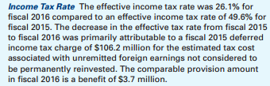

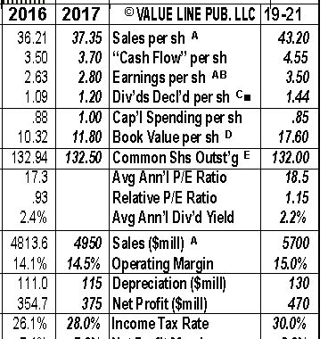
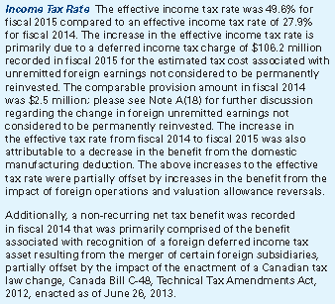
2015
2014
52
Notes:
We did a little digging. We went to MD&A for 2015 in RPM’s 2016 annual report. What we found was that the rate dropped significantly because the prior year was affected by a “deferred income tax charge”. Didn’t we see a very high tax rate in 2014?
So we dug into 2014 and they talk about a $106.2 million dollar tax charge related to the change in foreign unremitted earnings not considered to be permanently reinvested.
My feeling is that figuring out multi-national tax rates and the effect of deferred taxes etc. is largely beyond what most people can figure out. I generally don’t make my own judgment on future tax rates. It is just easier to go see what the “experts” at Value Line or some other source think.
So we pulled up Value Line and they are expecting the rate to climb from our most recent 26.1% rate up to 30%. If that happens, taxes will grow, which means the space between Pre-Tax Profit and Net Income will get bigger, which pushes the Net Income line downward. Net Income will grow slower than Sales. If this happens, it will also push down everything below it, meaning Earnings Per Share, and so Earnings Per Share will be expected to grow slower than Sales.
In the last 10 years, the tax rate got smaller, going from 32.3% to 26.1%. This pulled up the Net Income and Earnings Per Share lines and is part of what allowed EPS to grow at 11.1% which was faster than Sales growth of 4.3%.
Going forward, we are expecting the opposite. Not only won’t we get a bottom-line boost because tax rates go down, but there will be a drag on the bottom line because tax rates are expected to increase.

Slide 53
To Recap
If Pre-Tax Profit Margins and Shares Outstanding remain the same going forward, what will happen if Tax Rates increase?
  Sales will grow faster than Earnings Per Share
53
Notes:
For the moment lets assume that expenses and shares are not changing. Again, if we assume that the only thing that changes is Tax Rates and they increase, that means Taxes expense is increasing out of every dollar of Sales.
When this happens, the Net Income line is pushed down and the Earnings Per Share line below it is dragged down and will grow slower. Therefore, Sales can be expected to grow at a faster rate than Earnings Per Share.

Slide 54
Shares outstanding
54
Notes:
Our last step down the Income Statement as we move down from our Net Income line to our Earnings Per Share line. What is happening between those two lines? Shares Outstanding!

Slide 55
55
Notes:
If we go back to our SSG we can see that our lines for Net Income and for Earnings Per Share are moving much more in unison than any of the other sets of lines. That tells us there aren’t major fluctuations in what happens between those two lines, Shares Outstanding.
If we look a little closer, we can see that the space has gotten larger over time, which indicates our Shares Outstanding has been increasing. This effectively dragged the Earnings Per Share line down a bit and caused our Earnings Per Share growth rate to be a little lower.

Slide 56
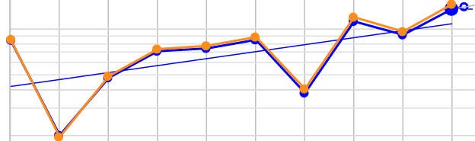
56
Notes:
If we drag the lines so that the Net Income line and the Earnings Per Share line begin at the same point, we can see that over time Net Income grew slightly faster than Earnings Per Share. The space between them, Shares Outstanding, widened.
Don’t ever be afraid to drag the lines on the SSG around to see what you need to see. You can’t break it

Slide 57
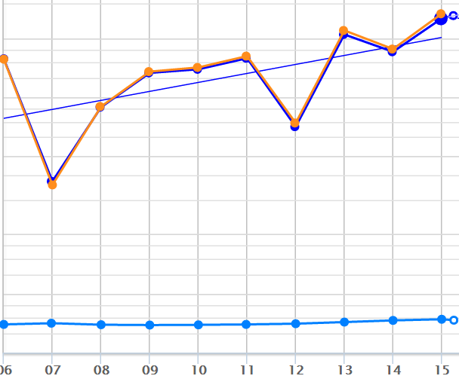
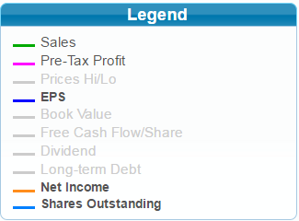
57
Notes:
What we are seeing is that an increase in shares dragged the Earnings Per Share line down causing it to grow slower than Net Income.
While our other two spaces, Expenses and Taxes, worked in our favor over the past 10 years by pulling up the lines below them as the space got smaller, Shares Outstanding was the one thing that tempered the difference in growth rates between Sales and Earnings Per Share over the last 10 years. This very minutely counteracted the two other forces that caused Earnings Per Share to grow at 11.1%, so much faster than Sales which only grew at 4.3%.
One last thing here, if you look at the very bottom, you will see a light blue line. If you look in the legends box, you will see that we turned on Shares Outstanding. We can plot shares outstanding so that we can see the trend, and when we plot the shares, we can notice a slight up trend since 2011.

Slide 58



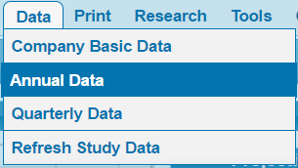
58
Notes:
Just as we could with tax rates, we can go to the top and click on data and then annual data, and we can find the column called “Diluted Shares”. If you look at the numbers, you can see what we just saw on the graph, shares have climbed from 128.7 to 136.7 over our 10-year period.

Slide 59
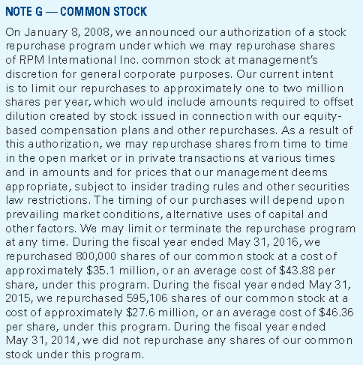
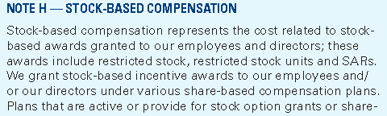
59
Notes:
To learn about Shares Outstanding we had to dig a little further than our usual MD&A, we had to go to the footnotes to the financial statements.
If we dig into our note about Common Stock we find out that they have a stock repurchase program authorized in 2008. If we look at the Shares Outstanding graph we saw a slight dip in shares in 2008 before they started climbing again.
They talk about the repurchase plan as including attempting to offset the dilutive effects of their equity-based compensation plan. If we dig a little further, we find that they do it based on “prevailing market conditions and alternative uses of capital” and we find out they did repurchase in 2015 and 2014, but not in 2013.
If we look at the Stock Based Compensation, we find that they give stock based awards to employees and directors.
In looking at the plot we see that there is some upward trend in shares outstanding, but we now know the forces that are keeping it in check. Shares are going out as compensation, but shares are coming in as they repurchase them under the repurchase plan. It doesn’t appear to have a major effect as the changes and increase are relatively small.

Slide 60
To Recap
If Pre-Tax Profit Margins and Taxes remain the same going forward, what will happen if Shares Outstanding continues to increase?
  Sales will grow faster than Earnings Per Share
60
Notes:
So, if taxes and expenses remain the same and the only thing that changes is Shares Outstanding and they increase, that means Net Income is divided over more shares making the portion allocated to each share smaller.
When this happens, Earnings Per Share growth is dragged down because of the additional shares and will grow slower. Therefore, Sales can be expected to grow at a faster rate than Earnings Per Share, if the only change that is happening is that Shares Outstanding is increasing.

Slide 61
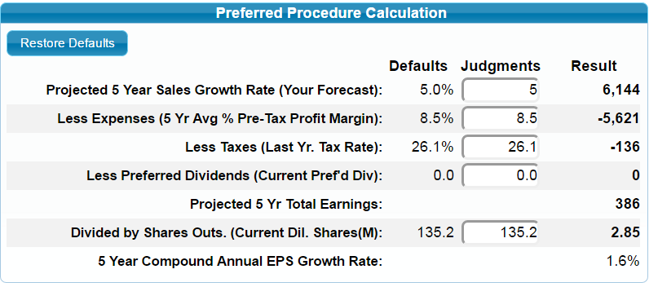
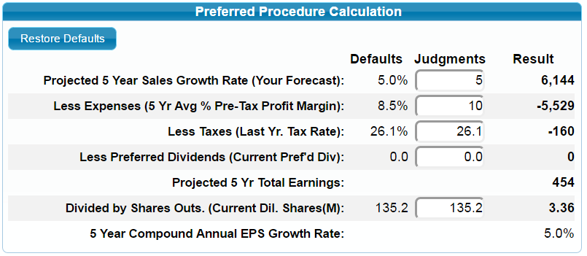
How we use this
61
Notes:
Let’s take a look at how this all begins to play out on our SSG.
Let’s start with the top. What we have is what we call our “Preferred Procedure Calculation”. And what we do with this is take a look at what we expect to happen with each of the pairs of lines over the next 5 years.
We do this by looking at the areas in between our lines: Expenses (as reflected by what is left after them, Pre-Tax Profit, which we do by looking at the Pre-Tax Profit Margins), Taxes (by looking at Tax Rates), and Shares Outstanding.
If you remember, we have a company growing Earnings Per Share at over 11% a year, starting with a 4.3% Sales growth. Things look pretty rosy!
To start with I decided to be a little aggressive and round up and project Sales will grow at 5%. I wanted a round number for our purposes. It may be a little aggressive.
On our top preferred procedure I left shares outstanding at 135.2 as they presently are although we know they have been climbing slightly and working against us. I also left tax rates at their low 26.1 even though we pretty much know they are going to go higher and work against us. The only thing I changed was where we started.
We talked about how there are raw material pressures and other rising costs coming. I made an assumption that we would drop back to our average Pre-Tax Profit Margin from our current 10%. If we assume it will be 8.5%, our average, at the very bottom we can see that the decline in profit margins, even if everything else stays the same and won’t work against us, is going to drag our Earnings Per Share growth rate down so that it grows at less than the 5% Sales Growth.
In fact, only taking into account that one negative, we see that our company that grew Earnings Per Share at 11.1% is only expected to grow Earnings Per Share at 1.6% moving forward.
We talked a lot about changing rates pulling lines up or dragging them down, so for illustration purposes, in the bottom half of the screen ©, I left all three of our items as they were, with no change. And as you can see if Sales grow at 5% and everything else stays the same, in other words we left our Pre-Tax Profit Margin at the current 10% rather than dropping it to 8.5%, how fast can we expect Earnings Per Share to grow when nothing changes going forward from where it stands today? 5%! The same as sales!
As we can see it is the movement or change in one of the three things that happens as we move down our Income Statement, Expense, Taxes or Shares, that causes the difference in growth rates between Sales and Earnings Per Share. If we can figure out which way those forces are expected to move, we can determine whether our Earnings Per Share will grow faster or slower than Sales.

Slide 62
What Do You Do with
Preferred Dividends ?
Preferred dividends must be paid to preferred shareholders before common shareholders get paid.
To common shareholders, it is the equivalent of an expense.
Estimate the preferred dividends five years in the future and subtract them from earnings before dividing by shares outstanding.
62
Notes:
We have to take into account one more item. We haven’t talked about Preferred Dividends tonight. This is because it is not a very frequent item and we didn’t want to muddy the picture.
The long and short of it is that because we as common shareholders only get our share of the profits after the preferred shareholders get theirs, the preferred dividends are like any other expense for us and we take them off of our Net Income before we divide what is left to arrive at our Earnings Per Common share.
In RPM’s case, there are none anyway.

Slide 63

Questions?
63
Notes:
How about we stop here and see if there are any questions?
Seeded question: How do you know if they are using 52-53 week accounting?
Answer: You will see it. Most financial statements are shown with more than one year so that you can compare numbers. Even if one of the periods ends at a month end, the other won’t. You will see a period shown that doesn’t end at the end of a month. That is the biggest clue.

Slide 64
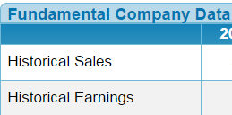
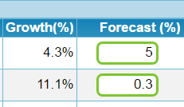
How We Use This
64
Notes:
We have talked a lot about moving lines, what is happening between the lines and how we understand what is going on with a company. How do we use this?
In our Fundamental Company Data area if you look immediately to the right of our Historical Growth Rates you will see two boxes for Forecast %. If you click in the lower box on the Historical Earnings line it will open our Preferred Procedure calculation screen.

Slide 65
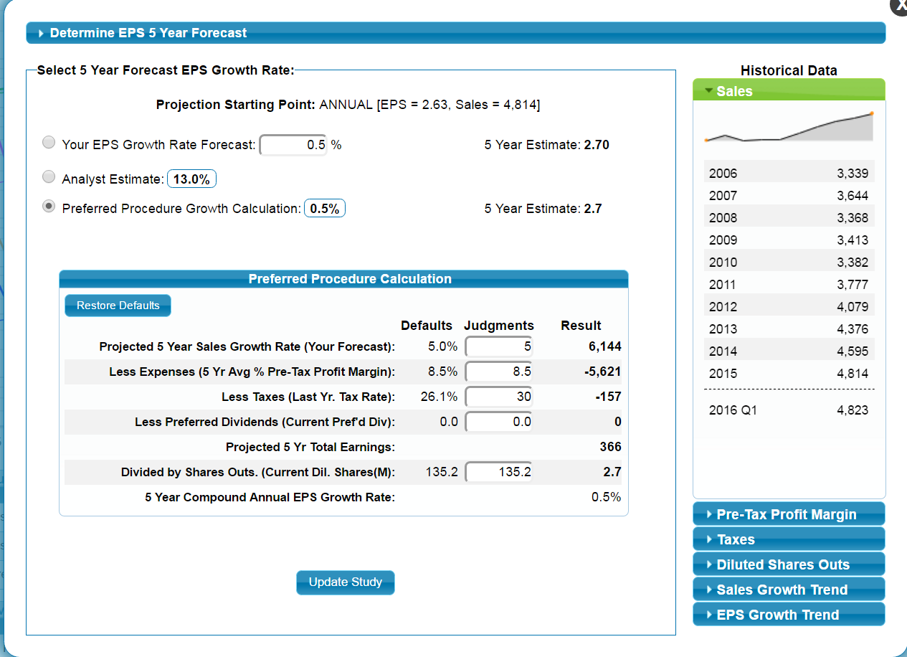
How We Use This
65
Notes:
A few things to note on this screen…
On the right side if you look right below the arrow, there are tabs. If you look above, you will see that we have 10 years of Sales information. We also have the ability, by clicking on the other tabs, to see 10 years of Pre-Tax Profit Margins, Taxes and Diluted Shares Outstanding.
The bottom two will allow you to see the growth rate over various periods, from 1 to 9 years, for Sales and EPS. We can’t really cover that tonight, but you should know it is there. And, we will talk about it in our November 30th session.

Slide 66
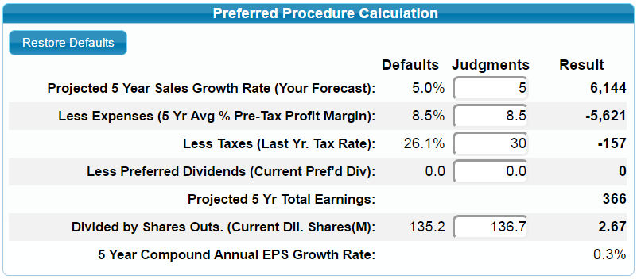
How We Use This
66
Notes:
If you remember we started with a company with that looked pretty good. Although it only grew Sales at 4.3%, it was growing Earnings Per Share at 11.1%
Here is our Preferred Procedure:
We showed Sales expected to grow at 5% over the next 5 years. Yes, we know that might be slightly aggressive.
We know there will be pressure on costs and so rather than go with the current 10% Pre-Tax Profit Margin from our most recent year, we rolled our expectation back to the average of the last five years.
We also discovered that tax rates are particularly low right now and that they are expected to rise from our most recent year’s 26.1% to 30%
And finally, We know shares outstanding have been inching up and although we are down at 135.2 currently, I rolled it back to 136.7 which is our actual 2015 number to be more conservative.
When we make all the assumptions, we find that a company that had been growing Earnings Per Share at 11.1% is expected to only grow Earnings Per Share at .3% over the next 5 years, even with the slightly higher 5% Sales growth, because we expect Profit Margins to go down, Taxes to go up and Shares Outstanding to go up.
I was pretty comfortable with the first two assumptions, so after I got all said and done, I went back to my Value Line and took a look at their projection of Shares Outstanding.
They actually project the buybacks to help bring the number down and they project 132. To check myself and see if it made much of a difference, I plugged in 132 for the Shares Outstanding and even with changing it so that Shares Outstanding actually works in favor of growth, I still end up with only a 1% Earnings Per Share projected growth rate.
I am pretty comfortable that at least as far as Earnings Per Share goes, we don’t have anywhere enough growth over the next five years, starting from now, to warrant considering buying this company at this point.

Slide 67
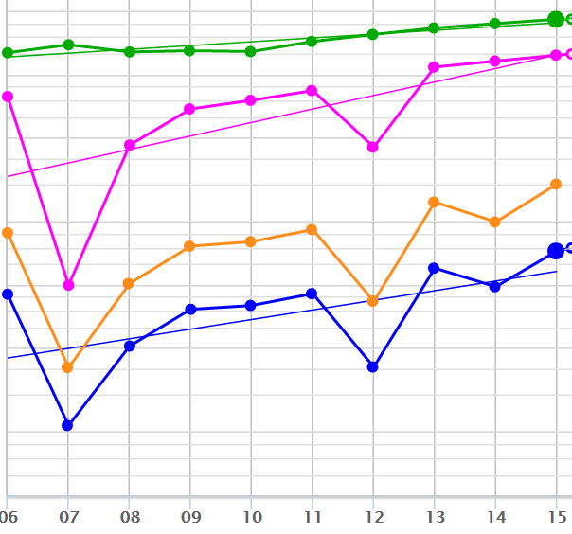
How We Use This
What are we trying to accomplish by using the SSG?
67
Notes:
When it all comes down to the bottom line, what is it that we are trying to accomplish by using our Stock Selection Guide?

Slide 68
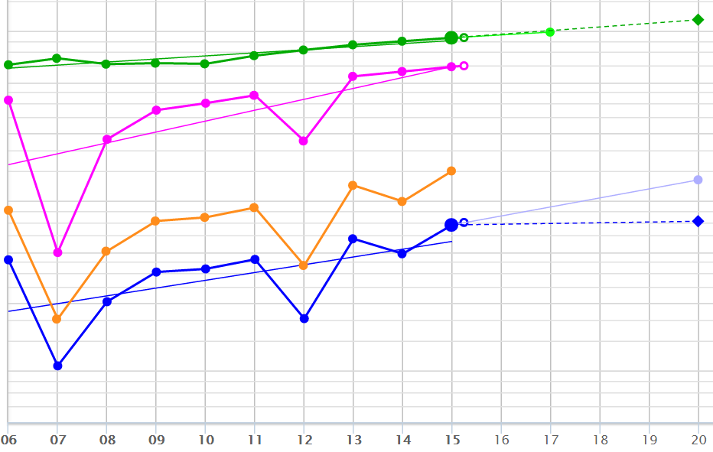
How We Use This
We are projecting Sales and Earnings Per Share 5 years into the future!
The top of our Income Statement (Sales) and the bottom (Earnings Per Share)
68
Notes:
What we use the SSG to do is project what our Sales will be and what our Earnings Per Share will be 5 years in the future. This is the top line and the bottom line of our Income Statement.

Slide 69
We want to determine what we expect our Income Statement to look like 5 years from now!!
USING PREFERRED PROCEDURE – WE CAN !
69
Notes:
We are trying to see what we expect our Income Statement will look like 5 years from now. That is what we are doing on the Stock Selection Guide.
If we use Preferred Procedure, we can help fine tune what we expect that our future Income Statement will look like.

Slide 70
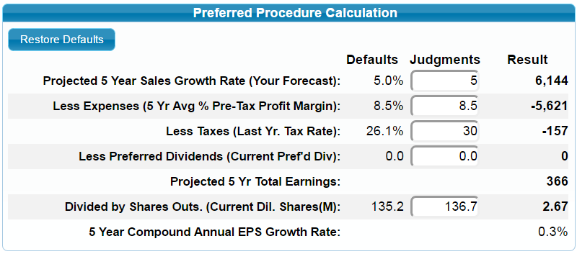
How We Use This
Our expected Income Statement
5 years from now !
-
-
=
÷
=
70
Notes:
Here we have it! This is our expected Income Statement 5 years from now.
We expect Sales of $6,144, and with Pre-Tax Profit margins of 8.5% we expect there to be $5,621 in expenses.
With Tax Rates of 30% we expect to pay $157 in taxes.
And when we subtract the Expenses and Taxes from the Sales, we end up with a Net Income for the company of $366.
When we divide our $366 Net Income by our Expected Shares Outstanding of 136.7, we arrive at our expected Earnings Per Share 5 years in the future of $2.67 per share.

Slide 71

Why Use Preferred Procedure
By looking at each component we get a better picture of what future EPS might reasonably be.
For a less consistent EPS history, Preferred Procedure can help focus a future EPS estimate.
71
Notes:
So why should we use Preferred Procedure?
Because by looking at each component, or wave that makes our boat move, we can then factor them in to where our boat ends up. In other words we can look at the factors that affect Sales as they work their way down to become Earnings Per Share.
This becomes even more important where Earnings Per Share growth has been inconsistent or unsteady. It helps us focus where Earnings Per Share might be heading at this point in time, and it helps us turn and face the strange and look at ch-ch-ch changes.

Slide 72




www.betterinvesting.org/
1
2
3
Notes:
Before we wrap up and take final questions….
If you are a BI member, the chapter wants to be able to let you know about upcoming events. © Once you log in to the BI website, please click on “My Account” ©
On the menu on the left, click on “Email and Product Subscription Information” ©
Finally, scroll down until you see “Local Chapter News and Events” © and make sure you check the box ©
The chapter doesn’t send a lot of emails so it won’t flood your in box, but this way you can know when the chapter has a class or an event.

Slide 73



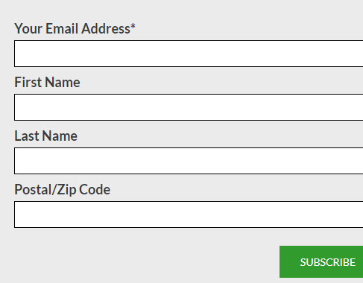
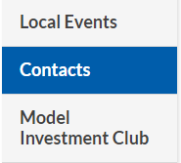
www.betterinvesting.org/
1
Not Logged in /
Non-Member
3
2
4
Notes:
If you are not a member, or not logged in, when you go to the BetterInvesting website, it will show “Login” where your name would be if you were logged in ©
Go to “Meet Our Community” © and click on “Our Local Chapters”. You will find a list of chapters by state and you can click on your nearest chapter.
When you click on your local chapter, you will be taken to the chapter’s page. On the bottom of the page, you will see a section called “Learn More” © which allows you to sign up as a guest for chapter emails. If you want to hear about upcoming chapter events, sign up for the emails.
Finally on the chapter page on the left side, even though we are showing it on the right side of this screen, there are some links. The chapter would like to hear from you and find out what we can do to help you and or your club. Look for the link called “Contacts” © and it will take you to contact emails addresses for the chapter.

Slide 74

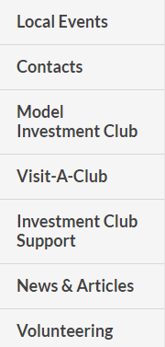
www.betterinvesting.org/
Logged in ➔
1
3
2
4
Notes:
If you are a member, you can also contact the chapter. Once you are logged in ©, go to “Our Community” and click on “My Chapter” © which will take you to your chapter’s page. And when you get to your chapter’s page, on the left, you can find © the contact box for chapter contact email addresses that you see here on the right on this slide.
One last thing on this. The chapters are staffed completely by volunteers who provide club support and all kinds of programs. Local classes are taught, when we can, by local volunteers.
There is always the need for extra hands. Help us bring more events to the members. To paraphrase, ask not what your chapter can do for you, ask what you can do for your chapter and other investors in your area.
Click on the Volunteering link © to find out more, or email one of the chapter contacts.
When I started, I learned so much by volunteering and being around and listening to people who were already experienced at investing. Volunteering is a great way to speed up your learning curve.

Slide 75
Summary
In this session we’ve touched on:
What preferred procedure is.
The relationship of the Income Statement, the SSG and preferred procedure.
Why we should use preferred procedure.
Understanding the relationship between the lines on the SSG graph.
Working with preferred dividends.
75
Notes:
I don’t want to forget at the end.
Wherever you heard about this “Stock Investing Made Easy” series of classes, keep watching there. We are hoping to continue the series beyond the two sessions this fall. I am not making promises, but it is in discussion.
Tonight we have talked about what Preferred Procedure is, and how the Income Statement, the SSG and our calculation of Preferred Procedure are intertwined. And we have tried to apply what we learned about the Income Statement from seeing between the lines on our SSG to our projections of future growth.
Next time, we will roll our RPM study forward and look at additional years and see what is changing and how our expectation might change. We will also touch on a few other items related to stock studies and preferred procedure.

Slide 76


Special Thanks
Ron Bruyn, Director, Orange County Chapter
Linda Glein, Director, Puget Sound Chapter
Claire Struthers, Director, Heartland Chapter
Joe Smith, New Jersey
These are all special people whose work contributed to this session and who passed their knowledge of BetterInvesting methodology to me.
76
Notes:
A lot of people at BetterInvesting pay it forward. They share what they know.
There are people who taught me, there are people who taught some of this material with me, and there are some people who put together pieces of this material for other classes we worked on together. Without them, this class wouldn’t exist.
I want to particularly mention and thank Ron Bruyn who brainstormed with me when we came up with the idea of the first financial statement track that was ever taught at BINC, and who helped me develop that 7-class series.
I also want to mention and remember, the late Joe Smith, who built the original Preferred Procedure class for that Financial Statement series, but more than that, Joe was the epitome of the BetterInvesting volunteer.
Joe was a big believer in Paying it Forward, he was a great teacher and more than that, any time I ever asked him anything, including to go somewhere to teach in an event I was involved in, Joe never said no. I really miss Joe.

Slide 77



Make A Difference In
Someone’s Life
If you have benefited from
BETTERINVESTING,
please pick up some
BETTERINVESTING
materials
and introduce others to this dynamic investment education opportunity!
Pay it forward !
77
Notes:
And on that note, when I ran BINC in 2006 in Columbus, I put a slide very similar to this in every presentation that was taught at the event.
BetterInvesting has been good to me. I have learned a lot and I am in a much better financial position than I would be if I had not found BetterInvesting.
If it has made a difference in your life, pick up some materials and share BetterInvesting with your loved ones, family, friends and anyone else who wants a better future.
The nice thing about investing is that everyone can do well. If someone else does well, it doesn’t diminish your ability to do well. There is plenty for everyone.

Slide 78

Questions or Comments?
ah cpabe.com
ah@cpabe.com
Avi Horwitz
78
Notes:
With that, if you want to reach me, or have questions, my email address is up on the screen.
If you do email me, please put “preferred procedure” in the subject so that I know where I know you from.
With that I will turn things back over to Bob to see if there are any more questions and to wrap things up.
Remember to join us for our next session, The Years Keep Rolling By, on November 30th, and keep a look out for more sessions in the spring. See you on November 30th..

