Slide 1



Online Chapter (OLC)
5th Annual Membership Meeting
August 5, 2024
Notes:
GOOD EVENING - I am Susanne Koster and together with the BOARD OF DIRECTORS of the Online Chapter – YOUR CHAPTER - Welcome to our 5th ANNUAL MEMBERSHIP MEETING.
We’ll share what we’ve been up to this past year and our plans for next year. <NEXT>

Slide 2
Notes:
As always, OUR STANDARD DISCLAIMER Information is presented for educational purposes only - always do your own research
This session is being recorded.

Slide 3
Agenda
8:00 PM EDT
Annual Meeting
Chapter overview, accomplishments, goals, election of Directors, and portfolio contests
8:30 PM
EDT
National Education Program
Craig Braemer CFP® CFA®
Director, San Francisco Chapter
A Quick Review of Trim or Sell - Which is Better?
Notes:
This evening’s agenda will be informative and educational – ·
including a chapter overview – ·
our accomplishments this year,
goals for next year,
election of directors and results of the 2024 portfolio contest.
Following our meeting at 8:30 join us for an engaging presentation from Craig Braemer on “Trim or Sell - which is Better”

Slide 4
Online Chapter Overview
Notes:
Let’s begin with our Chapter Overview <NEXT>

Slide 5





 | 3,000 members, largest chapter
 | 200+ clubs
 | 2 online model clubs
 | Includes 35 states and territories
 | 29 volunteers + 3 BIVAB Directors
Notes:
THe Online Chapter of BetterInvesting is the largest, most diverse chapter in BetterInvesting comprising of
More than 3,000 members
200+ Clubs
2 Online Model Clubs
Our Chapter includes 35 states and territories
We have 29 volunteers and 3 BIVAB directors
<NEXT>

Slide 6
This Year’s Accomplishments
Notes:
So – what has the Online Chapter Accomplished this year?
<next>

Slide 7
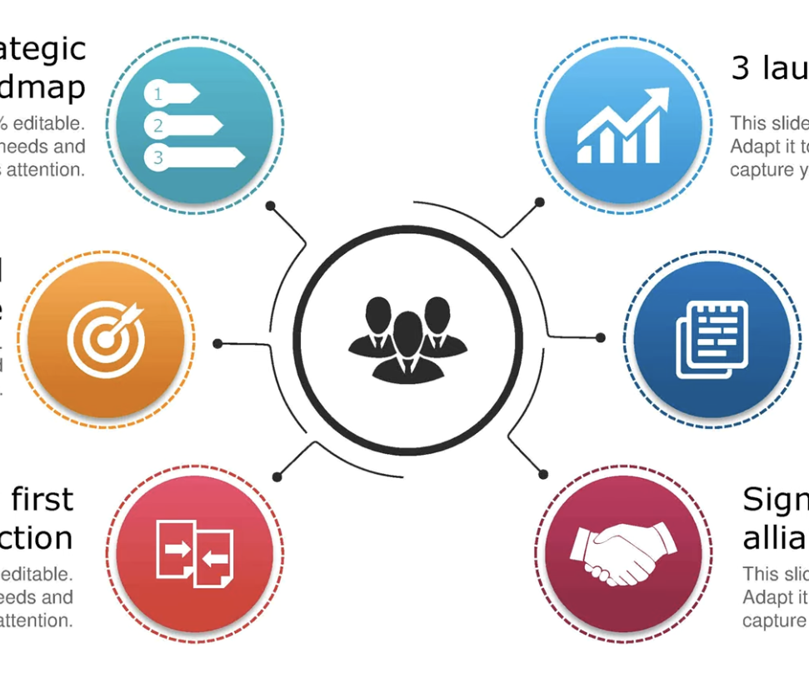


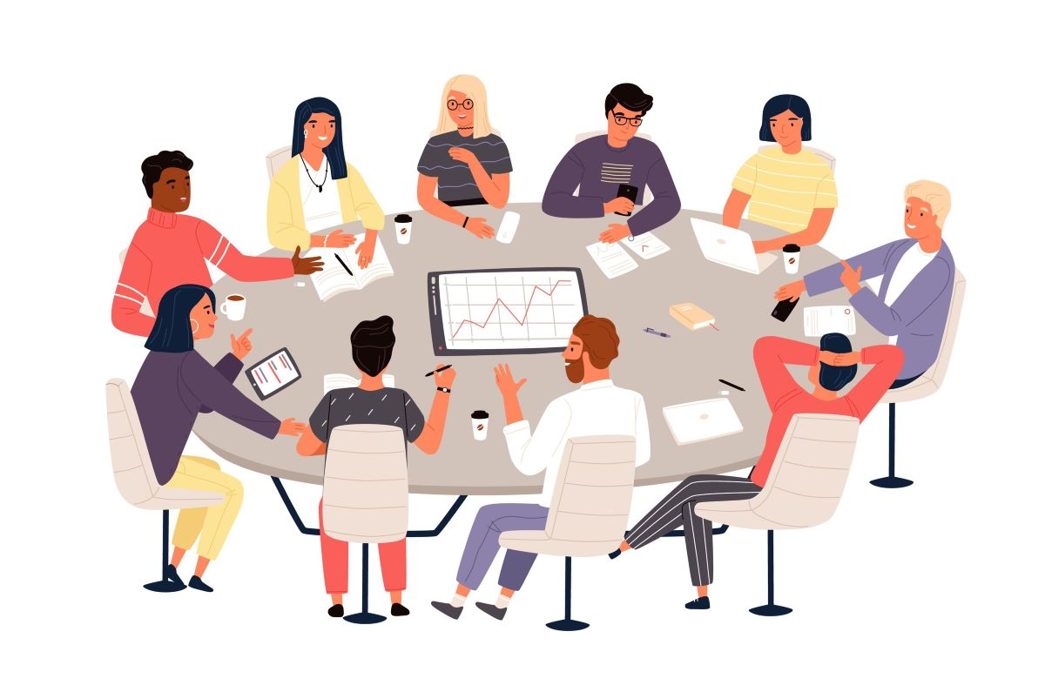


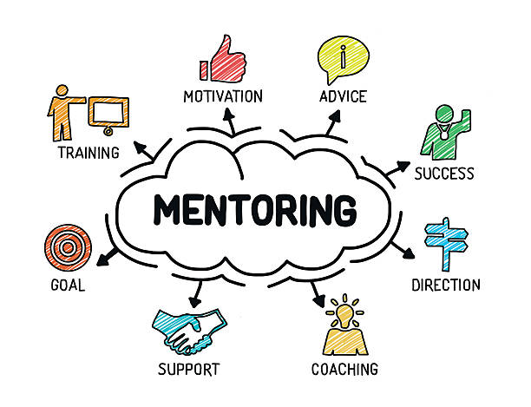
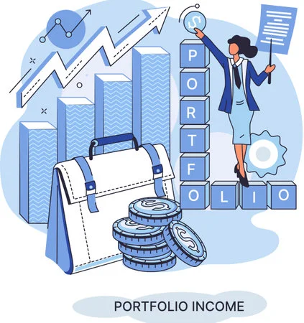
Communication
Open Forum hosted on Zoom simultaneously livestream on Facebook.
Recordings are on YouTube.
Monthly newsletters sent to all members and guests
Education Programs Open Forum every odd month with guest speakers
Online Model Clubs
Sponsor model clubs which are open to public and learn best practices
Partnership
Joined consortium webinar
Stock Investing Made Easy
Support Membership
Celebrate milestone clubs and tailor educational programs to clubs at their request
Portfolio Contest
Clubs and individuals compete with best portfolio to build interest and share best practices
Notes:
·Our education webinars are open forum which are virtual on ZOOM and livestreamed on Facebook. These webinars are recorded and available on demand on our YouTube channel.
We publish a monthly newsletter to all members and guest.
We sponsor two model investment clubs – clubs that are open to the public to watch and open to members looking to join and contribute.
We Celebrate and support our clubs with Anniversary Certificate Presentations and Club visits
We sponsor a Portfolio Contest that is FREE to enter
We are an active member of the Consortium - a collaboration of chapters presenting interesting and informative education topics.

Slide 8

Anniversary Clubs
1-3 Years
10
30 Years
6
5 Years
3
35 Years
4
10 Years
2
40 Years
5
20 Years
2
55 Years
2
25 Years
14
60 Years
3
Notes:
We have 51 clubs celebrating milestone anniversaries including 10 newer clubs

Slide 9

Club Visits
Notes:
Let’s chat for a moment about Club Visits
This is a benefit available to all Investment Clubs - at no cost - by one of our volunteers
We Celebrate and toast Milestone Anniversaries
We provide club training like:
Club Portfolio Discussion
• Discovering Stocks Worth Studying
• SSG Stock Study Tips
• First Cut Tips for Investment Analysis
• In-depth Company Research Techniques
• Streamlining Club Operations
• Conducting Effective and Engaging Meetings
• An Open Q&A on BetterInvesting Practices

Slide 10
Clubs we have visited
Collective Securities Group
Generational Wealth Investment Club
MMM Investment Club
Jones girls
Newbury Fund
Massaco Investment Club
Dozen Divas
Shamrock Investment Club
Profits Associated
Rochester Women’s Investment Group
Seaside Investment Group
Group 21
LOHI Investment Club
Upcoming Club Visits
Yankee Model Club
Money Tree Investment Club
Women's Investment Group of Pierre
The Profiteers
Northern Indiana Model Investment Club (NIMIC)
Notes:
Congratulations to the 13 clubs we have already had the privilege to visit
and we look forward to visiting with the 5 clubs already scheduled.

Slide 11
Club Visits
Interested in a visit by one of our volunteers?
Contact us:contact@online.betterinvesting.net
Notes:
Is your club interested in a visit?
Contact Us!

Slide 12
Next Year’s Goals
Notes:
The Current Board has outlined several goals and initiatives for next year.
<next>

Slide 13
Mission
Goals
Strategies
Education programs
Communication
Consortium Partnership
Online model clubs
Portfolio contests
Club Visits
Mentor young clubs
Club networking
Recruit and train volunteers
Align with BetterInvesting mission, provide support to members and clubs located in areas not served by a local on-the-ground chapter
Engage and support our clubs and members
Notes:
Our Mission is to align with the Betterinvesting mission and provide support to members and clubs in areas not served by local on the ground chapters
Our Goal is to engage and support our members and clubs
And we plan to achieve our goals
Education programs
Communication
Video library
Online model clubs
Portfolio contests
Visit-a-club
Mentor young clubs
Club networking
Recruit and train volunteers

Slide 14

Join us for the Planning Meeting in September
Notes:
WE’d love to hear from you – our members and clubs on how we can support you.
On September 23 at 8:30 PM we will be holding a Planning Workshop for the upcoming year – all members are invited to attend.
if you can’t attend - contribute your suggestion in advance.

Slide 15
Our Volunteers
Notes:
How will we achieve and support our goals for next year? with our Volunteers!

Slide 16

Board of Directors |  |  | Volunteer Members
Ila Barnes | Avi Horwitz | JoAnne Obata | Phil Crandall | Thomas Martinka
Janet Blaser* | Susanne Koster | Dan Perlman | Jack Finn | Terry Monasterio
Jie Eagleson | Sriram Madabhushi |  | Patricia Leonard | Philip Sudore
Ernie Felzani | Chris McCarron |  | Barney Lyons
*Associate Director
Notes:
.And a big Thank you to the many Active volunteers this past year. We need you to continue the success of the Online Chapter.
<CLICK>

Slide 17
Becoming a Volunteer
01
A BetterInvesting member who wishes to contribute to the chapter education mission
Volunteer
02
A volunteer who wants to take on additional responsibility for programs and activities to gain experience to serve on the Chapter Board
Associate Director
03
A volunteer who wants to be involved in the leadership and management of the Chapter Board
Director
Submit your volunteer application to apply
Notes:
.If you are interested in volunteering - please download the handout - it contains our contact information and an application.
We offer support and training to all our volunteers - and your commitment may be and hour or two per month or more significant if you chose.
<CLICK>

Slide 18

Volunteering with the Online Chapter
If you would like to nominate someone or yourself for a volunteer position, please enter it in the Question box or email us at contact@online.betterinvesting.net
Notes:
WE WOULD LIKE TO OPEN THE FLOOR TO NOMINATIONS FROM THE CHAPTER’S MEMBERSHIP TO CONSIDER VOLUNTEERING IN THE CHAPTER.
PLEASE USE THE QUESTION BOX ON YOUR CONTROL PANEL TO INDICATE THAT YOU’D LIKE TO BE CONTACTED TO FIND OUT MORE ABOUT BECOMING A BI VOLUNTEER.

Slide 19
Election of Directors
Notes:
It is now time for our Election of DIrectors.
THe Online Chapter currently has 14 directors elected for 3 year terms.
The terms are staggered - and about ⅓ of the director seats will be up election each year.
This year we have 4 chapter seats and 1 BIVAB seat up for election.
<CLICK>

Slide 20
BIVAB Directors
Jane Chatterjee
Howard Johnson
Bob Houle
BI member since 1992
Volunteer since 1992
BIVAB director, Chapter Support Region Liaison
BI member and volunteer since 2000
BIVAB director, Chapter Support Committee Chair
George A. Nicholson Distinguished Service Award in Investment Education
BI member since 2007
Volunteer since 2013
BIVAB director, Club Support Committee Chair
George A. Nicholson Distinguished Service Award in Investment Education
Class of 2025
Class of 2026
Class of 2027
Notes:
Here are our current BIVAB directors. Bob Houles seat is up for election this year.
The Online Chapter is unique - we are fortunate to include in our 14 directors THREE BIVAB - BetterInvesting Volunteer Advisory Board Directors.
These directors incubated the Online Chapter and continue to contribute to our success.
Jane Chatterjee
Howard Johnson
Bob Houle
This evening - Bob Houle has been nominated to continue his role as a director for the Online Chapter.
<CLICK>

Slide 21
Continuing Current Directors
Avi Horwitz
Ernie Felzani
Susanne Koster
BI member and volunteer since 1997
A board member of six chapters
George A. Nicholson Distinguished Service Award in Investment Education
BI member since 1982
BI volunteer since 1982
President, Massachusetts Investment Club
BI member since 1996
Founder of Emanon Investment Club
Served New York Chapter for 6 years
Online Chapter Satellite Coordinator since 2020
BINC 2022 Inst
Class of 2026
Class of 2026
Class of 2026
Jie Eagleson
Phil Sudore
Jack Finn
Dan Perlman
BI member since 2013
BI volunteer since 2015
Co-Founder of International Model Investment Club
BI member since 1992
BI volunteer since 1999
Volunteer, Rochester Satellite
Member, Online Chapter Education Committee
BI member since 2001
BI volunteer since 2020
Leader, Yankee Satellite
BI member since 1997
Served as President North Carolina Chapter & Online Chapter
National Volunteer since 2020
Class of 2025
Class of 2025
Class of 2025
Class of 2026
Notes:
Chapter boards members are unpaid volunteers with a passion for assisting and educating local clubs and individuals members.
Our current continuing directors are: <READ LIST>
<CLICK>

Slide 22
Elections of Directors
Ila Barnes
JoAnne Obata
Sriram Madabhushi
Chris McCarron
BI member since 2000
BI volunteer since 2002
Online Chapter Secretary
Leader, NYC Satellite
BI member since 2010
BI volunteer since 2014
Co-Founder of International Model Investment Club
Online Chapter Technology chair
BI member since 2000
BI volunteer since 2005
Editor, Online Chapter Monthly Bulletin
Leader, South Central Texas Satellite
BI member since 2017
BI volunteer since 2020
Online Chapter Education Committee Chair
Class of 2027
Class of 2027
Class of 2027
Class of 2027
Notes:
We have 4 directors seats up for election this year.
Our current continuing directors are: <READ LIST>
<CLICK>

Slide 23
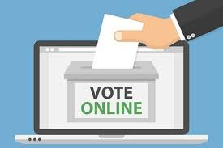
Vote By Poll
Online Chapter members are eligible to vote
Notes:
OK, NOW, IT’S TIME FOR YOU TO VOTE - Honor System Please - Only vote if you are a member of the Online Chapter.
Chris - PLEASE OPEN THE POLL.
Chris - ANNOUNCE THE RESULTS OF THE POLL PLEASE
Thanks for voting.
<CLICK>

Slide 24
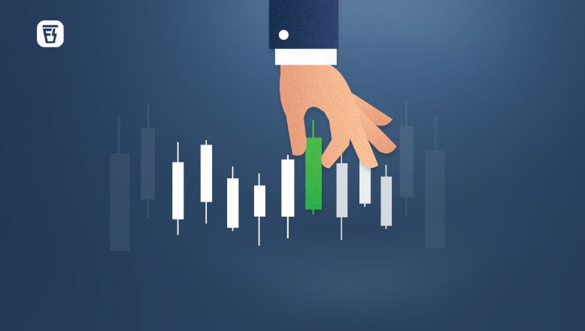
Chapter Portfolio Contest
Chapter Portfolio Contest
Notes:
Drum Roll Please as we reveal the results of our 2nd Portfolio Contest

Slide 25




2023-2024 Portfolio Contest
INITIAL INVESTMENT $100,000 IMAGINARY MONEY
4 TO 7 STOCKS
SEPTEMBER 1, 2023 TO JULY 31, 2024
ONE OPPORTUNITY IN FEBRUARY 2024 TO MAKE PORTFOLIO CHANGES
Notes:
This years contest began with an initial investment of $100k
Each entrant selected a minimum of 4 stocks to a maximum of 7 stocks
The contest ran from September 1, 2023 through the closing bell on July 31, 2024.
Entrants had one opportunity in February 2024 to make changes to the Portfolio

Slide 26
2023-2024 Portfolio Contest Results
Entrant | Initial Investment | Ending Value | Percent Return
Let It Ride Investors of Carson Valley | $100,000 | $140,276 | 40.3%
Financial Escape Investment Club | $100,000 | $129,061 | 29.1%
Notes:
Congratulations to the winner: Let it Ride Investors of Carson Valley with an ending value of $ 140,276 – an over 40 % return over the last 11 months.
And to our runner up – Financial Escape Investment Club with an ending value of $129,061 – an over 29 % return over the last 11 months.

Slide 27
2024-2025
Portfolio
Contest
Each club or individual member allocates $100,000 imaginary money
Choose 4 to 7 stocks
Contest runs from 9/1/24 to 7/31/25
Submission Deadline: 08/31/2024
Notes:
Our NEW Portfolio contest will again began with an initial investment of $100k
Each entrant selected a minimum of 4 stocks to a maximum of 7 stocks
The contest will run from September 1, 2024 through the closing bell on July 31, 2025.
Entrants had one opportunity in February 2025 to make changes to the Portfolio

Slide 28
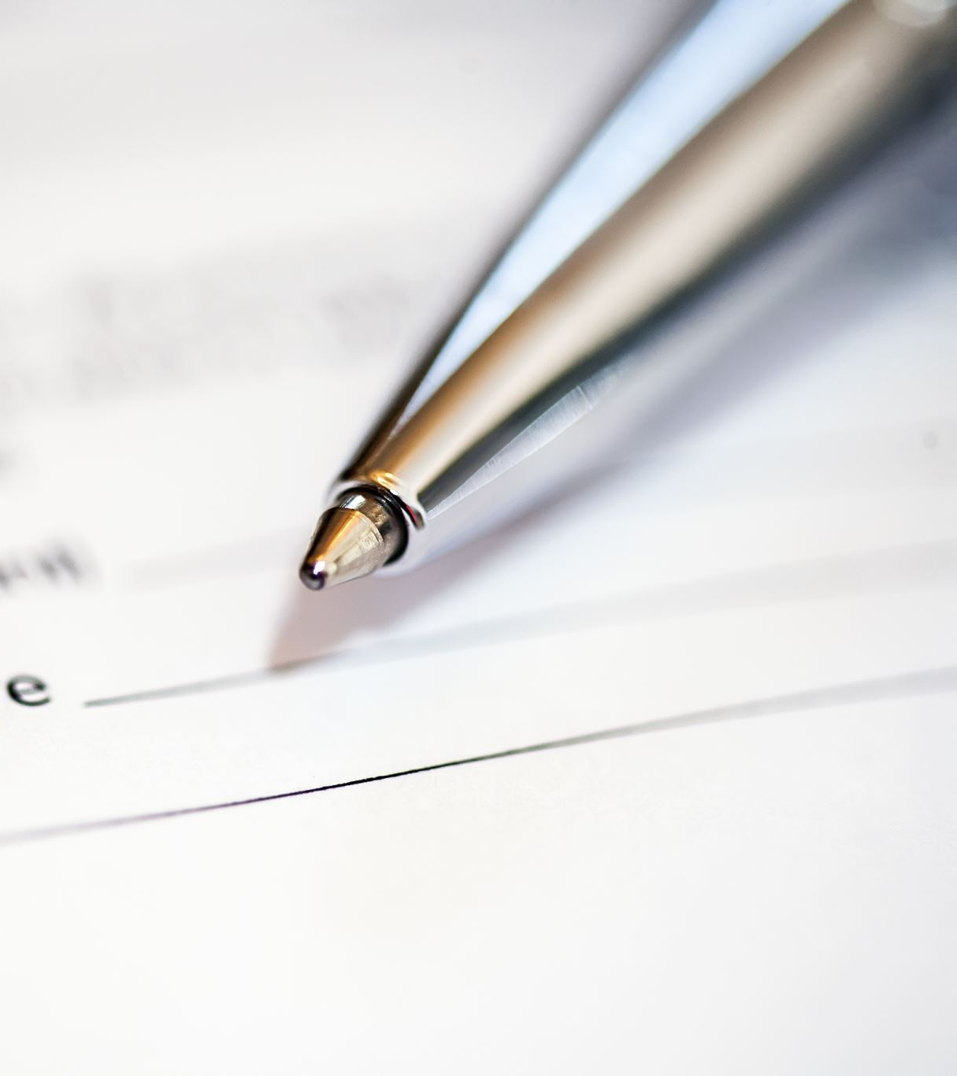
How to enter?
Submit: Online Contest Form
OR
Email to: contact@online.betterinvesting.net
Subject: Portfolio Contest
Submission deadline: August 31, 2024
Notes:
How can you or your club enter? That’s right - we accept individual entries too - so long as your club is not entering
Email us or use the link to submit the online contest form.

Slide 29
Online Chapter Resources
Facebook @onlinechapterbi
YouTube Channel @biolc
Chapter website: betterinvesting.org/online
  Volunteers
  Events
  Monthly Newsletters
  Video library
Email: contact@online.betterinvesting.net
Notes:
Here is a consolidated look at our Chapter resources - This information is available on our handout.

Slide 30

Notes:
WE’d love to hear your COMMENTS AND ANSWER ANY QUESTIONS YOU MAY HAVE. PLEASE USE THE QUESTION BOX ON YOUR CONTROL PANEL TO ASK YOUR QUESTION.
Tell me about the Model club and How join the Model Club? Check out the handout for a link on how to register for one of our two model clubs. You can observe and get more information at the meeting.
What is Club Connect? How do I use it as a club? How do I use it as an individual? This is like investment club dating. It’s a free service for members that matches clubs interested in adding new member with members looking to join an existing club. Once a match is made, clubs decided if they’d like to connect with a prospective new member and reach out directly. See forms and information on the BetterInvesting Website.
WHat happens during a club visit by a volunteer? The visit may be in person if we have a local volunteer or virtually through our software or yours. Each club has the flexibility to design the meeting to fit their needs. It may be a simple anniversary certificate presentation, educational session or a discussion on club operations and BetterInvesting benefits. It’s done by volunteers, complimentary without any obligation
I do I become a volunteer? What’s Involved? Follow the volunteer application on the handout. We will train all volunteers and are looking for any help you can offer - from one hour a month to a volunteer director.
Please stay tuned as we take a brief intermission and transition to our Guest Speaker.
Thank you for joining us!
<CLICK>

Slide 31
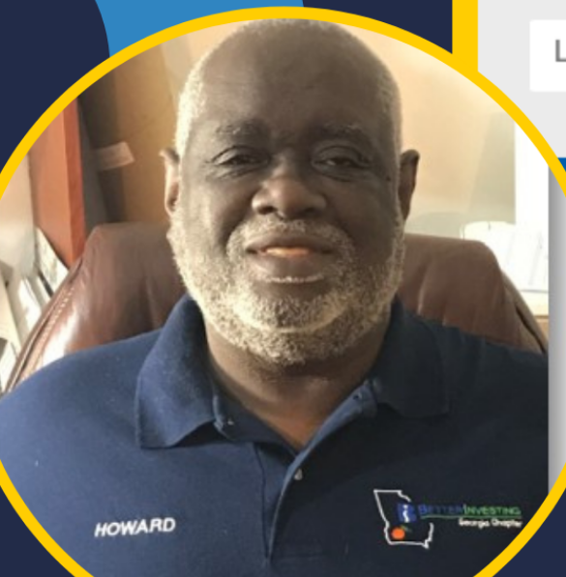
BetterInvesting
National Education Event
BIVAB Chapter Support Chair & Event Host
Howard Johnson
Notes:
It is my Pleasure to conclude The business portion of the Online Chapters Annual Meeting and introduce Howard Johnson BIVAB Chapter Support Chair our event host for our education portion of the meeting.
MANY OF YOU KNOW Howard FROM His YEARS OF SERVICE IN VARIOUS AREAS AND LEVELS WITHIN THE BI COMMUNITY. THANK YOU Howard FOR AGREEING TO BE WITH US TONIGHT AND BEING OUR HOST.
WE’LL NOW TURN OVER THE PROGRAM TO YOU
<CLICK>

Slide 32
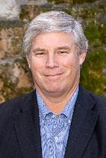
BetterInvesting National
Education Event
Craig Braemer CFP® CFA®
Director of San Francisco Chapter, BetterInvesting
Notes:
Howard to introduce and Craig will host his own presentation.

