Slide 1


Why the Tortoise Sometimes Wins
ACME
Notes:
Welcome to Why the Tortoise Sometimes Wins
This is a class originally developed by Brian Lewis. It looks at typical BetterInvesting stock selection in a bit of an unorthodox way. I felt it was something that we don’t focus on very often and isn’t taught around BetterInvesting very much, so with Brian’s permission I adopted the class, changed the title and reworked it a little.

Slide 2
Disclaimer
The information in this presentation is for educational purposes only and is not intended to be a recommendation to purchase or sell any of the stocks, mutual funds, or other securities that may be referenced. The securities of companies referenced or featured in the seminar materials are for illustrative purposes only and are not to be considered endorsed or recommended for purchase or sale by BetterInvestingTM National Association of Investors Corporation (“BI”). The views expressed are those of the instructors, commentators, guests and participants, as the case may be, and do not necessarily represent those of BetterInvestingTM. Investors should conduct their own review and analysis of any company of interest before making an investment decision.
Securities discussed may be held by the instructors in their own personal portfolios or in those of their clients. BI presenters and volunteers are held to a strict code of conduct that precludes benefiting financially from educational presentations or public activities via any BetterInvesting programs, events and/or educational sessions in which they participate. Any violation is strictly prohibited and should be reported to the CEO of BetterInvesting or the Director of Chapter Relations.
Notes:
Standard Disclaimer – there will be a quiz at the end of the session on it.
Any stock mentioned is being used as a teaching example, not as an investment recommendation. It offers my own perspective and before investing in any company, do your own homework.
I may hold shares in some of the companies mentioned. BI’s code of conduct prohibits me from benefiting financially from any BI education programs I teach.

Slide 3

Disclaimer
This presentation may contain images of websites and products or services not endorsed by BetterInvesting. The presenter is not endorsing or promoting the use of these websites, products or services.
This presentation uses older examples prepared using various software. Older examples are used in order to prevent the examples from being used for current investment decisions without proper updating and study. The instructors makes no representation that the software used for the examples is still being used for their own stock studies.
This session is being recorded for future use.
Notes:
I may mention products or services not endorsed by BI and although I may mention them, I am not endorsing them.
The new paragraph for this session: I use old examples when I teach classes. The purpose is so that they are so far out of date that no one would make an investment without updating them and doing their homework.
Accordingly, there are examples using software other than BetterInvesting’s online Stock Selection Guide (SSG). I make no representation as to whether I am still using any of the software.
And finally, this class is being recorded.

Slide 4

What We Will Talk About
What we are looking for in a stock
Where Total Return comes from
The importance of Portfolio
Management
Notes:
In this session we will talk about what we are looking for in a stock we invest in, where Total Return on our investment comes from, and the importance of portfolio management (at all times) but more so when we invest in so called “Tortoises”

Slide 5

What We Are Looking For?
Why would you invest in any stock?
  High Quality
  Good Value
Notes:
BetterInvesting suggest that you invest in a stock because the company is of high Quality and the stock offers a good Value.
We are really looking for two things – Is the company of sufficient quality for us to invest in it for our portfolio, and Can we purchase it at a price where we can make a sufficient return on our investment.
Ultimately, we want quality companies at a reasonable price.

Slide 6


The Tortoise and The Hare
We often think of fast-growing companies as being the best prospects
  Stronger Growth
  High Quality?
Notes:
Most of us think in terms of the Hare, the fast growing companies.
We often focus on the growth of the hare and forget about the higher risk, and about volatility.
Some fast growing hares simply aren’t of sufficient quality, but we are so focused on the growth rate that we don’t pay sufficient attention to whether it is a good, strong company.

Slide 7
Tortoises: Why?
Can a company with only moderate growth prospects offer both high quality and good value?
  Absolutely!
Notes:
So what about the Tortoises, the larger slower growing companies. Can they be what we are looking for in a company to invest in?
Absolutely, a slower growing company is often a larger, stronger company that hopefully is better quality than some of the Hares and as we will see there are times when they can be a good value and be on sale.
ORIGINAL NOTES
Why invest in a slower growing companies? Because it’s possible for a company with slower growth prospects to meet the investment standards suggested by BetterInvesting.
BetterInvesting suggest that you invest in a stock because the company is of high Quality and the stock offers a good Value. A company with only moderate growth prospects can offer both of these.

Slide 8
Tortoises: Why?
You shouldn’t expect larger companies to grow rapidly
  BetterInvesting Stock Selection Handbook suggests 7% to 10% growth as reasonable for large companies
Considering slower growing companies gives you more investment possibilities
Notes:
BI’s Stock Selection Handbook showed “anticipated growth rate” for large companies is about 7% to 10%
The previous “official guide”, Starting and Running a Profitable Investment Club showed the range as 5% - 7%.
The expectation is somewhat based on the economic environment we find ourselves in.
Considering these Tortoises opens up many more options as potential investments.
Smaller companies have a higher “anticipated growth rate”
It is simple: If a company sells $100, how much in additional sales does it need to have 100% growth. $100
If the larger company sells $1 million dollars, how much more would the larger company need to sell to maintain a 100% growth rate? That’s right, another $1 million dollars. That is why larger companies tend to grow slower.
ORIGINAL NOTES
BI Stock Selection Handbook pg 6 shows “anticipated growth rate” of 7%-10% for large companies (over $5 billion in annual sales). Note that the previous “official guide” that came out in 1996 (“Starting and Running a Profitable Investment Club”) talks about aiming for growth potential of 5% - 7% from “major companies” (page 22).
By not limiting yourself to just high growth stocks, you have a larger selection of stocks to choose from.

Slide 9

Slow And Steady
Sometimes the tortoise, slow and steady, wins the race
Slower growing companies can be the Tortoise that wins the race
Notes:
As we know from the story of the Tortoise and the Hare, sometimes the Tortoise does win the race, and our slower growing companies can turn out to be that Tortoise.

Slide 10
What Is a Good Value?
A stock investment is a good value because of the potential for it to be worth more in the future
Total Return is used to measure value on the Stock Selection Guide (SSG)
Notes:
What is good value? We think of it as producing a return because the investment becomes more valuable in the future.
We use “Total Return” on our SSGs to measure value.
“Worth more in the future” can mean either price appreciation or dividend income or both.
Technically, the measure is Average Compounded Annual Rate of Return, but we will use TOTAL RETURN to mean the Total Return from our investment on annualized basis even though it technically is Average Compounded Annual Rate of Return, which is a mouthful to say over and over.

Slide 11


Total Return Comes From …
Price Appreciation — driven by:
  Earnings growth (EPS)
  P/E ratio (optimism about the future)
Dividends — driven by:
  Earnings growth (EPS)
  Payout ratio (the percentage of earnings paid to shareholders as dividends)
Notes:
[6:15] Total Return comes from Price Appreciation. Price appreciation means the price of the stock goes up.
If you are familiar with it, remember that the price of a stock is based on the earnings per share (EPS), the earnings for that share of stock, times some multiple of the earnings per share. That multiplier is called a Price-Earnings ratio (P/E). Price Earnings Ratio is determined by investors’ optimism about the future growth of the company’s EPS..
So price appreciation is driven by two factors EPS and PE.
Total Return also comes from Dividends. Dividends are also driven by EPS growth and something referred to as the Payout Ratio. The Payout Ratio or %-Payout is the percentage of the company’s EPS that are used to pay the dividends
Dividends are also driven by two factors: EPS, just as with Price Appreciation and the Payout ratio.℗
==============================
ORIGINAL NOTES
Total Return consists of Price Appreciation together with Dividends. Both are driven by earnings growth. Each is also driven by another factor.
P/E ratio is related to investor optimism about the future.
Payout Ratio is determined by company management.

Slide 12
Components of Total Return
P/E Ratio
EPS Growth
Payout Ratio
Price Appreciation
+
Dividends
Total Return
Notes:
© = click
© Here’s the same thing as a picture. © Earnings Per Share growth drives both components of Total Return, which is why many people prefer stocks with high EPS (Earnings Per Share) growth potential.
Just a point of information, if I use the term “earnings” inadvertently, I always mean “earnings per share” in this presentation.
© © As a side point, P/E ratio is also affected by earnings growth. More specifically, by market perception of what the EPS growth rate will be in the future.

Slide 13
Dividends
Payout Ratio
EPS
X
=
Dividend
Tortoises tend to have a larger Payout Ratio
13
Notes:
© © © As we said Dividends are the result of EPS and the Payout Ratio.
If EPS growth is slower for the Tortoise, to keep up the Dividends companies use more of the EPS. In other words, the percentage of EPS paid out for dividends is generally higher for Tortoises.
Tortoises generally have a higher Payout Ratio. ©

Slide 14
Dividends
Dividends tend to play a more significant role in Total Return for Tortoises
Tortoises tend to have a larger payout ratio
  More of EPS used to pay dividends
  Less of EPS used to fund future growth
A secure dividend may add some safety for slower growing stocks
Notes:
Large slow growing companies often have limited ability to grow sales and EPS. Think back to our example of selling $1 million vs. selling $100. As a company gets larger it takes a big dollar increase to significantly move growth rates. Reinvesting EPS in the company to help it grow may not produce as good results as it might for a smaller Hare.
So rather than reinvesting in the company to help it grow, they buy back shares, pay down debt, buy other companies (another way of growing) or they give return to the shareholders through dividends, which potentially could be used by the shareholders to invest in faster growing companies.
Instead of retaining EPS they pay a higher percentage of it as dividends. Many of our Tortoises have a higher Payout Ratio.
Having a dividend that is secure may add a level of safety to the investment in the Tortoise, especially since we expect a larger portion of our return to come from dividends.
ORIGNAL NOTES
Slow growing companies often have limited ability to grow sales and earnings --- i.e., for many such companies, even if they retained a higher percentage of EPS, they couldn’t effectively invest that money to create significantly more growth going forward.
So they buy back shares, pay down debt, buy other companies (another way of “growing”), or --- they give a percentage of their earnings (the payout ratio) to their shareholders in the form of dividends.

Slide 15

Is the Dividend Secure?
Dividends come from earnings
  A secure dividend requires secure earnings
Consider financial strength of company
Monitor dividend, yield, payout ratio
  SSG section 3
Notes:
[11:00] The first thing to remember is dividends come from earnings, so without steady secure earnings we can’t have a secure dividend.
Consider the financial strength of the company. There are various sources of financial strength of a company, including Value Line, or crunch some balance sheet ratios. (We could always do a class on financial ratios)
See if the payout ratio is stable or growing over time. How does it compare with similar companies?
Monitor the dividend and payout ratio over time.
ORIGINAL NOTES
Is the payout ratio growing over time? How does it compare with similar companies?
Financial strength: VL, or Argus, or crunch a few balance sheet ratios
Plotting the dividend, the yield from the dividends, the payout ratio over time --- can help give you a picture, but not essential. You could also just scan recent years in your raw data to get a feel for how these things have changed. Dividend, high yield, and payout ratio are all given in tabular form for 5 years in section 3 of the SSG

Slide 16
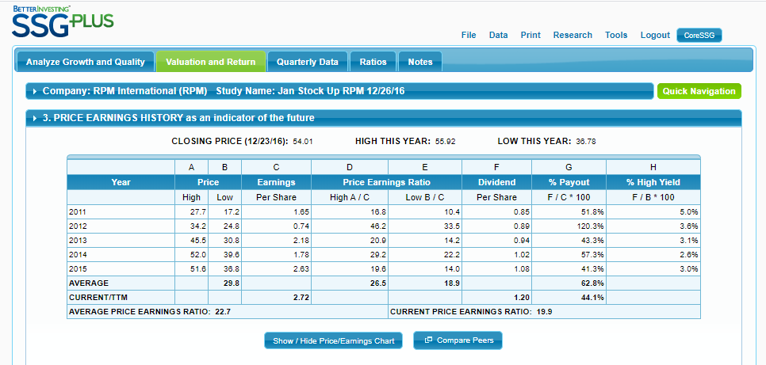


Is the Dividend Secure?
Notes:
Here is an example using BetterInvesting’s SSGPlus. You can simply scan the Dividend amounts to look for consistent growth. You may also want to look at % Payout, the percentage of Earnings Per Share the company used to pay the dividends and see whether that is somewhat stable.
Notice that in 2012, this company paid dividends of 89 center per share, but only had earnings per share of 74 cents. They actually paid more dividends per share than they earned per share. That is why the payout ratio is over 100%, 120.3%
Remember that the money for the dividends had to be found from sources other than the company’s current year earnings.

Slide 17
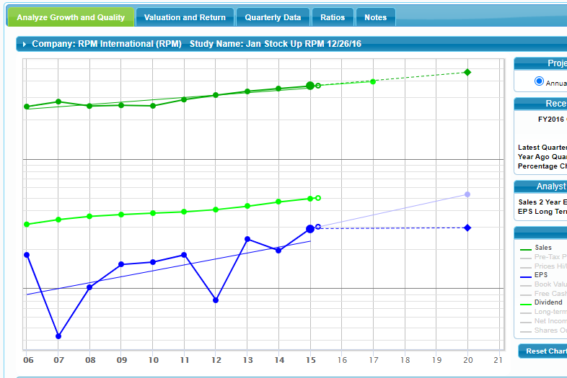
Is the Dividend Secure?
Notes:
You can also look at the Dividends on the graph of the SSG Plus under Analyze Growth and Quality. See how stable the dividends have been and how they are growing.

Slide 18
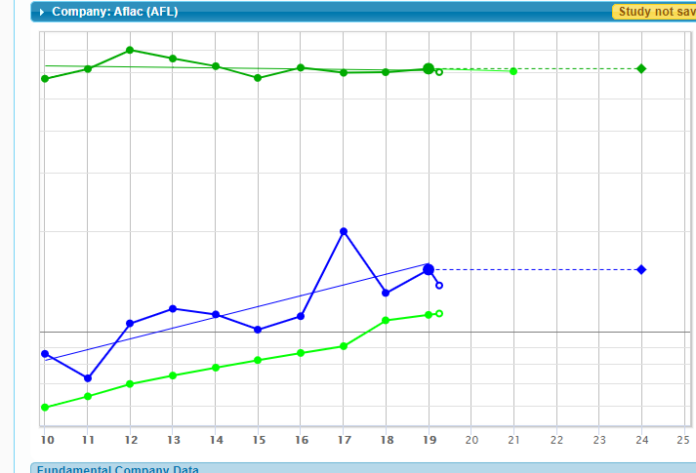
Is the Dividend Secure?
Notes:
Here is another example. Notice the dividend line has a steeper climb, meaning it is growing faster. It is still relatively stable.

Slide 19
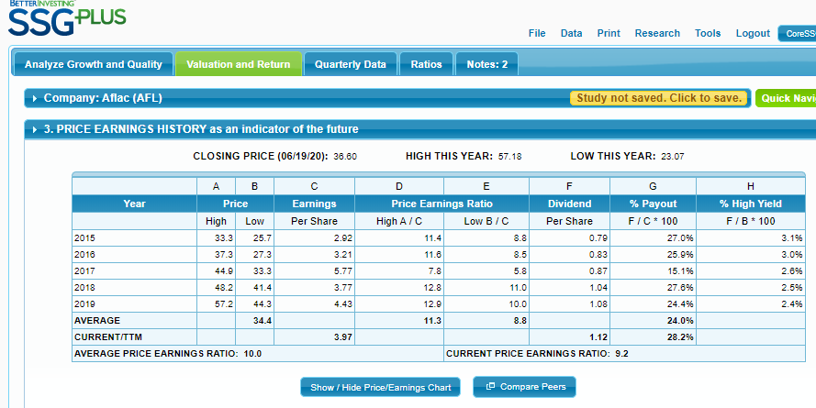




Is the Dividend Secure?
Notes:
Notice with this company the payout rate is a little more stable. Generally mid 20% - The exception is the one year they had a bump in earnings and keeping up the dividends took a smaller % of the earnings, but we noticed on the previous slide how steady the dividend growth has been.

Slide 20
Price Appreciation
Faster growing stocks can produce adequate
price appreciation from EPS growth alone
EPS
X
P/E
=
Price
Tortoises need help from P/E expansion
Notes:
[14:30] © © © With price appreciation, our formula for price is EPS times P/E. For price to grow, one or both must grow.
Note this is the same equation used for the calculation of future high and low price on the SSG.
© Companies with faster growing EPS can produce price appreciation equal to their EPS growth rate, and that rate may produce enough return on our investment
© Tortoises need a boost from P/E expansion because the EPS growth rate may not be sufficient by itself.

Slide 21
Price Appreciation
Potential for future P/E to be higher is critical for tortoises
  Stock price tends to follow earnings growth
  With a constant P/E ratio, slower growth produces less price appreciation
Especially important for tortoises
  Buy when P/E ratio is below average
Notes:
For any stock, we want there to be room for P/E Expansion. P/E expansion is the Price Earnings Ratio going up from the P/E at purchase.
While it is important with any stock, it becomes crucial with Tortoises because the EPS growth alone may not give us sufficient price appreciation, we need the boost from P/E expansion.
Our goal is to purchase these stocks when the P/E Ratio is below its historic average.

Slide 22

P/E Expansion
P/E expansion means …
… the Price-to-Earnings ratio moves higher than when you bought the stock
Buying when there is potential for P/E expansion is always important — even more so for tortoises
Notes:
Larger, slower growing stocks will hopefully have less surprises, better potential for a low PE to correct at some point (giving us PE expansion).
Of course you want to analyze the company to see why the PE ratio is currently below normal --- to minimize the chances that the PE is down for fundamental reasons (such that you should avoid the stock) !!

Slide 23
P/E Expansion is Limited
P/E expansion can’t continue forever!
After the P/E has moved up to ‘normal’, future Total Return is limited …
  … by the future EPS growth rate!
When you run out of potential for P/E expansion, you should consider selling
Notes:
Unlike EPS, P/E can’t be expected to keep getting larger and larger. Earnings can grow larger and larger for as long as a company exists. There is a limit to how high P/E can be expected to get. It’s normal for P/E to move up and down in cycles.
Since P/E expansion is critical for Slower Growers, selling when there is only limited potential for P/E expansion can be important to getting adequate Total Return. You want to think about getting out when there is little upside, or room for P/E Expansion.
ORIGINAL NOTES (IN ADDITION TO ABOVE)
The same amount of P/E expansion spread out over a longer period of time produces a lower compound annual return. If you continue to hold while P/E comes down and then back up, the boost to Total Return from P/E expansion will be less. If P/E expansion is the primary driver of price appreciation (i.e., EPS growth is low), this will have a significant impact on Total Return.

Slide 24
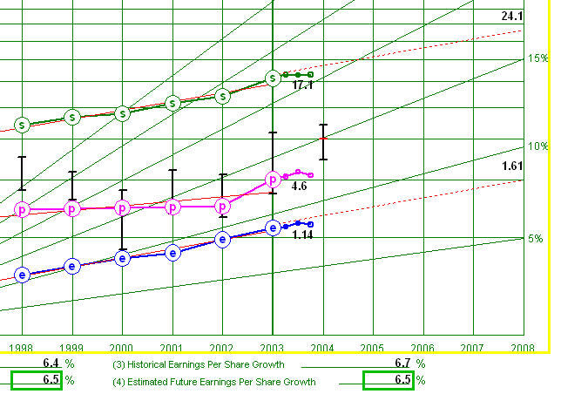
Example
Estimating future EPS growth
at 6.5%, to $1.61 EPS in 2008
Notes:
Doesn’t matter what this company is --- just that growth has been fairly consistent in the 6% - 7% range,
© and that we’re estimating a 6.5% ES growth rate going forward getting to $1.61 in 2008
Remember I talked about using older examples!
(connect those numbers to the following slide).

Slide 25
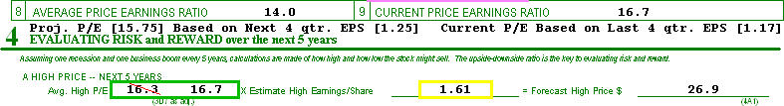

Example – 6.5% EPS Growth
Potential high P/E set to current P/E -
we assume no P/E expansion …
Price appreciation = EPS growth rate
Notes:
© We are going to set our future high P/E (in the box on the left side) to the current P/E (on the right side).
© © Note that ,when future High P/E is set to equal Current P/E the Annual Price Appreciation equals the future EPS growth rate that we saw on the last slide. Without any change in P/E, price grows at the same rate as EPS.
The 8.9% Total Return is the combination of annual EPS growth plus the average future yield from dividends.
Try this for yourself with any stock --- set the future high PE in section 4A to the current PE and you will see that the price appreciation part of Total Return matches their estimated EPS growth rate.

Slide 26

Let’s Review
Slower growing stocks can produce good returns
Total Return comes from:
  Price Appreciation + Dividends
For Tortoises (vs. faster growing Hares)
  Dividends are a bigger factor
  Potential for P/E expansion is even more important than usual
Notes:
[20:00] A quick review…..

Slide 27

Questions?

Slide 28
The Importance of Portfolio Management
For slower growing stocks, more active Portfolio Management can improve return
If you just buy and hold, what is the very long-term potential for Total Return?
  EPS growth rate + dividend yield
For slower growers that may be inadequate
Notes:
Here, more active Portfolio Management means selling when there is inadequate Total Return potential. For Slower Growers this will often be when there is little potential for P/E expansion.
“Very long term” means long enough that either PE expansion or contraction will be a negligible factor. The same amount of P/E expansion (or contraction) spread out over longer and longer periods of time will have less and less effect on compound annual Total Return. Over the very long term, the effect on Total Return of EPS growth and dividend yield dominate the effect of P/E expansion.

Slide 29

Portfolio Management
BetterInvesting thinking embraces the concept of Defensive/Offensive Portfolio Management
  Defense = Quality
  Offense = Value
Defense – don’t own poor quality stocks
  Maintain a good average level of quality
  Sell stocks that are clearly poor quality
Notes:
This isn’t a PM class, we’re not trying to completely cover either PM, nor various concepts about stock quality
There really are a lot of PM approaches within BetterInvesting, but what many call “offensive PM” is --- while not absolutely essential to success with slow growing stocks --- a highly recommended part of owning Tortoises.
Defensive Portfolio Management protects us by focusing on quality. We try to maintain quality stocks in our portfolio.
Offensive Portfolio management looks to increase our return by focusing on value.

Slide 30

Portfolio Management
Offense – monitor Total Return
  Maintain an adequate average Total Return level
  Replace low Total Return stocks as you identify significantly better opportunities
  Very important for slower growers!
Notes:
Slower growers tend to have a more consistent P/E history (on average, certainly not all do), so we can feel a little more confident that we’re in the ballpark when trying to assess whether and how much P/E expansion we might reasonably have ahead of us.
Also since they are generally a quality stock that most likely pays a dividend, it’s not a disaster if we take our time in replacing it --- unless it’s become significantly overvalued --- that would just mean we would anticipate a relatively low Total Return for the limited time while we are looking for a replacement.

Slide 31
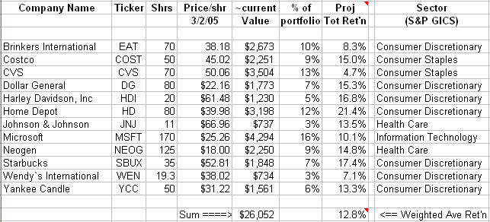
Offensive Portfolio Management
From Section 5 of your SSGs
Notes:
Here is a partial spreadsheet for a club portfolio. Let’s assume the SSG judgments are correct. We can get a Total Return for the portfolio. ©
As you can see our total projected return is 12.8%.
© © But let’s look closer at our 3 biggest holdings. You can see the % of portfolio column to the left of the Total Return column, We have 16% of our portfolio in Microsoft and we are expecting Total Return of 10.1%. 12% of our portfolio in Home Depot with return at 21.4%. Those are acceptable, although Microsoft is slightly below our average.
The bigger concern is CVS which is 13% of our portfolio with only 4.7% expected Total Return. It is weighing our average down.
So what if I were to search for a high-quality replacement candidate that at current price offered a much better return going forward. What might my overall portfolio potential return change to from our current 12.8%?
ORIGINAL NOTES
This is a subset of a simple spreadsheet for club visits to analyze a club portfolio.
Assuming data and judgment are both current for all stocks in my portfolio, I can get a weighted average return for my portfolio as a whole. If using my own judgment what if the potential return from a significant part of the portfolio is low (here, with 13% of the portfolio in CVS with only 4.7% TR potential). It’s dragging down the average return for the portfolio as a whole. So what if I were to search for a high quality replacement candidate that at current price offered a much better return going forward. What might my whole-portfolio potential return change to? (next slide)
Note that a helpful thing a person might add to this spreadsheet would be a column that gives estimated future sales and/or earnings growth for each stock, and gets a weighted average of that as well. And maybe the current yield as well. For slow growing stocks it would help put into context how much of our TR we’re expecting to get from PE expansion going forward.

Slide 32
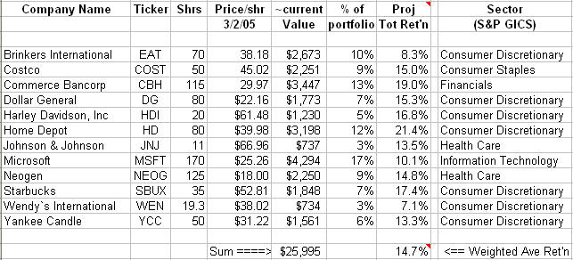
Offensive Portfolio Management
Notes:
If I were to replace CVS with Commerce Bankcorp the potential Total Return from that 13% of the portfolio is now 19% (vs. 4.7% before).
That improves the potential Total Return for the whole portfolio to 14.7% (from 12.8% before).
Incidentally, notice that making the replacement improved sector diversification too!

Slide 33
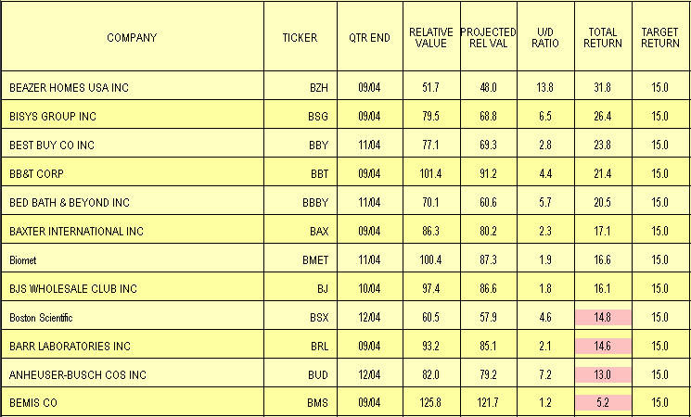
Toolkit 5 Offense Report
Notes:
[27:00] An easy way to track portfolio offense is with the Portfolio Offense Report built into Toolkit.
Shaded (pink) numbers are Total Return values below a user-set threshold (15% by default)
The above report is sorted by potential Total Return . ©

Slide 34
Let’s Review Again!
Total Return comes from:
Price Appreciation + Dividends
For tortoises:
  Dividends are a bigger factor
  Potential for P/E expansion is critical for adequate price appreciation
P/E expansion can’t continue forever!
Good Offensive Portfolio Management is key to success
Notes:
You can get okay results even without good Offensive Portfolio Management, but you’re locking yourself into a modest Total Return going forward. If you have excellent process, you can do better!
So to review once again,……

Slide 35

Questions?

Slide 36
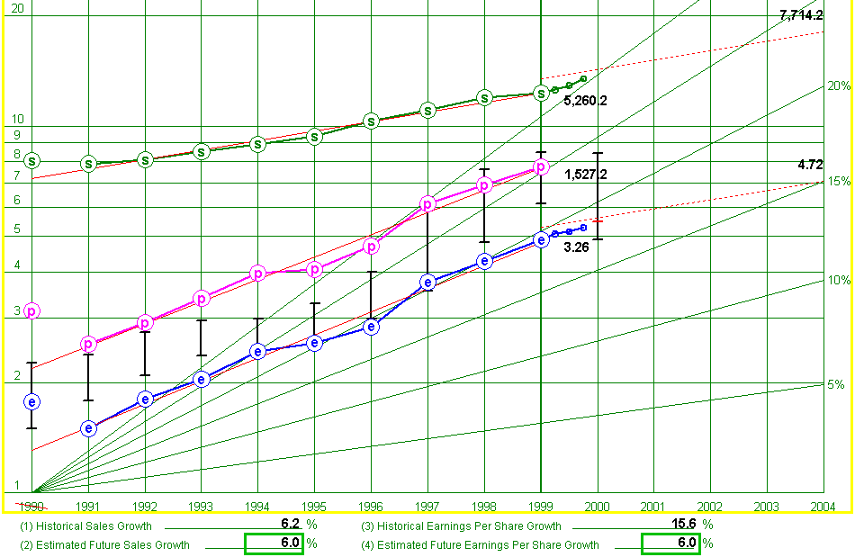
Example: Gannett Co.
As of late
November 2000
Historic Sales Growth: 6.2%
Estimated EPS Growth: 6.0%
Notes:
Lets look at an example. Imagine we bought Gannett Corp in late November 2000, using the Nov 24th 2000 Value Line data report.
This is what the visual analysis graph of the SSG looks like using that data. A slower growing company. ©
We were estimating future EPS growth at only 6.0% © ©
Can this investment provide us with a good Total Return?

Slide 37
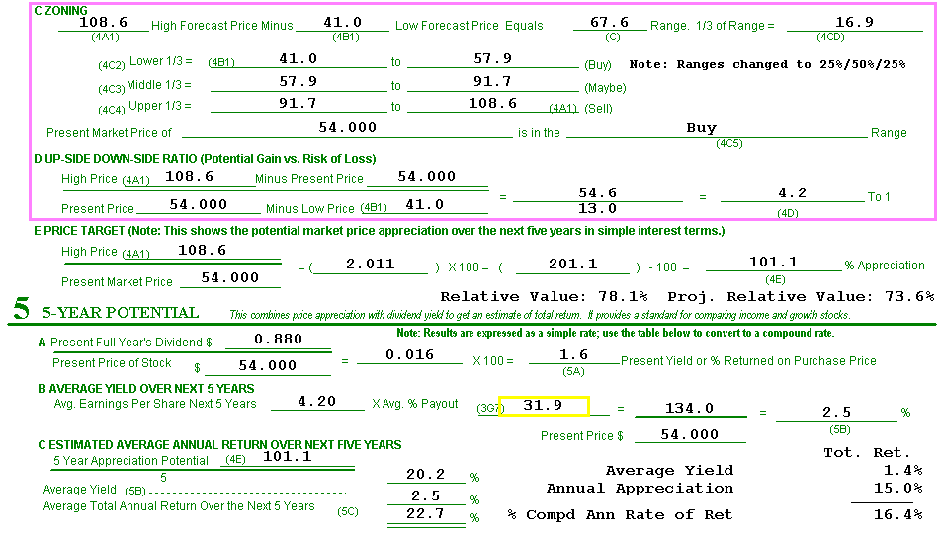
16.4% potential Total Return
Mostly from EPS growth and P/E expansion
Notes:
Of the 16.4% potential Total Return, © only 1.4% comes from expected dividend yield, © the rest was from price appreciation.
You will recall that on the previous slide we determined that we expected the company to grow EPS at 6%. We can only get price appreciation of 6% annually (on average) without PE expansion.
So we were expecting to get 9% of the 15% of that annual price appreciation from P/E expansion. The P/E ratio going up while we hold the stock.
Note that while it isn’t shown on this graphic, the Price Earnings Ratio at the time was 15, near the normal low P/E for Gannett

Slide 38
Example: Gannett Co.
Fast-Forward 15 months, to Feb 2002
Stock price rose from $54 to $74
From EPS growth?
  No
EPS for 2001 was disappointing, below estimate on original SSG
There was significant P/E expansion
Notes:
Let’s get into our DeLorean and go back to the future to Feb 2002, 15 months after we purchased Gannett.
Our stock price rose $20 per share from $54 to $74, It wasn’t from Earnings per Share growth, EPS were disappointing.
So if our Price Appreciation didn’t really come from EPS, it had to come from somewhere?
P/E expansions! The P/E ratio went up, likely based on the expectation that things would improve significantly, and the EPS would bounce back.

Slide 39
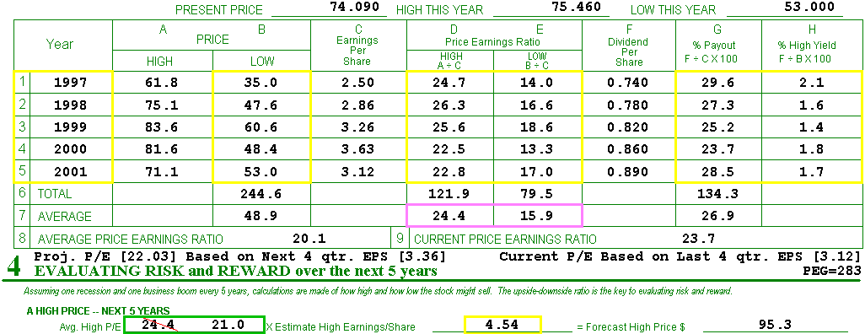
Current PE has grown:
  from 15 (in late 2000)
  to close to the historic average high P/E
Not much room for further expansion
Notes:
In late 2000 when we did our study, remember our P/E ratio was 15.
Well by February 2002, it had grown to 23.7. In fact it went from near the normal low in 2000, to near the normal high in 2002 which was 24.4.
There likely isn’t much room for P/E to continue going up at that point. At that P/E Ratio Gannett was expensive, and there was little upside. It was time to replace it.

Slide 40
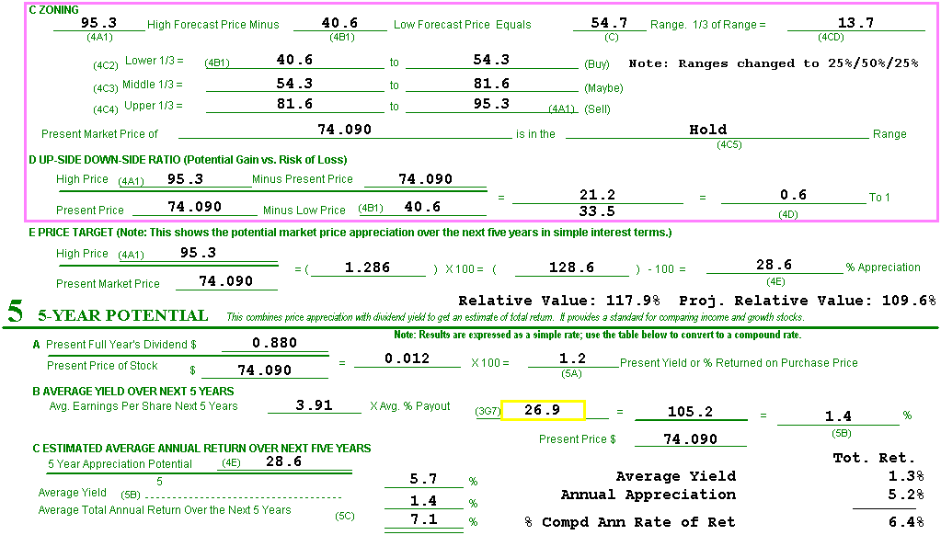
Time to Replace
Expected Annual Price Appreciation was
close to the expected EPS growth rate
Notes:
Going forward from here, what you could expect was a compound average annual Total Return © in line with your low growth rate. ©
If you’re happy to own a low-returning stock, fine. Keep it. Otherwise, you’ve made money on Gannett but it was time to start looking for a replacement candidate.

Slide 41

Gannett --- Result?
Stock held for 15 months
What return did we get on our money?
  30% compound annualized return
    (a 39% increase in 15 months)
This sometimes happens with Offensive Portfolio Management and tortoises:
  There is a bit more portfolio activity
Notes:
So how would Gannett have worked out?
We didn’t hold 5 years, only 15 months, but our return worked out to 30% compound annual return on our investment.
There is a little more work involved. With slow growing Tortoises you end up doing more work --- you periodically have to seek out and analyze replacement candidates, potentially more often than with high growth Hares.
Why do a little extra work? You decide if a little extra work is worth doing if you can find quality companies where you can get a 30% compound annualize return on your investment.
Also remember you are selling more often and if it is in a taxable account you may pay a little more in taxes and a little sooner than with fast growing hares which generally are held longer. Likewise, Tortoises tend to pay more in dividends, so if they are in a taxable account, there may be more taxes.
ORIGINAL NOTES
“A little more portfolio activity”: Could note that this approach with slower growing stocks generates more taxes along the way, rather than deferring them as you can do if you buy and hold a higher growth stock --- because you pay taxes on probably more dividends along the way, and you tend to buy and sell a little more often (which also has an impact from two brokerage commissions each time you replace a slow grower).
And in fact another downside (full disclosure) with slow growing stocks is that you end up doing more work --- you periodically have to seek out and analyze replacement candidates, potentially more often than with high growth quality stocks.

Slide 42

Gannett – Hypothetical?
Was this a real-world case?
Yes:
  Based on real data, using this approach
No:
  I didn’t personally buy and sell shares of Gannett and actually make this return
Notes:
Was Gannett a real case? Yes, it was based on real data and it used our approach of looking for Tortoises on sale and selling when there is little remaining upside.
But…this was just based on data, not an actual purchase.
We have another example showing how this works, and that example is a real world example from Brian Lewis’s actual personal portfolio history.
ORIGINAL NOTES
There’s no better way to impart credibility than to talk about a real world case where the presenter personally succeeded with the suggested approach. The next slides show an example from Brian Lewis’ personal portfolio history

Slide 43
LaFarge (LAF)
Purchased LAF shares on 4/26/2000 at $24.94 per share (P/E 6.5)
Sold all shares on 3/4/2002 at $41.30 per share (P/E 14.3)
Collected $1.20 per share in dividends
33% compound annualized return
  (69% increase over 22 months)
Notes:
These aren’t hypothetical results, but actual results obtained investing in LAF, LaFarge, using exactly this methodology. Brian’s investment club bought shares at about the same time and obtained comparable results.
LaFarge was bought in April 2000 at a price of $24.94 per share, It had a P/E of 6.5.
It was sold in March 2002 at $41.30 per share. At that point the P/E had expanded to 14.3.
There was also $1.20 in dividends while LaFarge was held.
The end result was a 33% compound annualized return on the investment
The market doesn’t offer us high quality, consistent slow growth stocks at an excellent price on a regular basis. So at the time you go to replace your stock, you might well not be able to find another slow growth opportunity to purchase. You just have to have your eyes open while looking at stocks in general, not toss out slower growth opportunities, and pounce when the price is right.
ORIGINAL NOTES
These aren’t hypothetical results, but actual results obtained investing in LAF using exactly this methodology. His investment club bought shares at about the same time and obtained a similar gain.
One point to make here is that the market doesn’t offer us high quality, consistent slow growth stocks at an excellent price on a regular basis. So at the time you go to replace your stock, you might well not be able to find another slow growth opportunity to purchase. You just have to have your eyes open while looking at stocks in general, not toss out slower growth opportunities, and pounce when the price is right.
33.49% = IRR based on purchase price, sale price and eight $0.15/sh dividends from 4/26/00 to 3/04/02. 100 shares with two $10 commissions.
70.4% = total of sale proceeds and dividends vs. purchase cost.

Slide 44
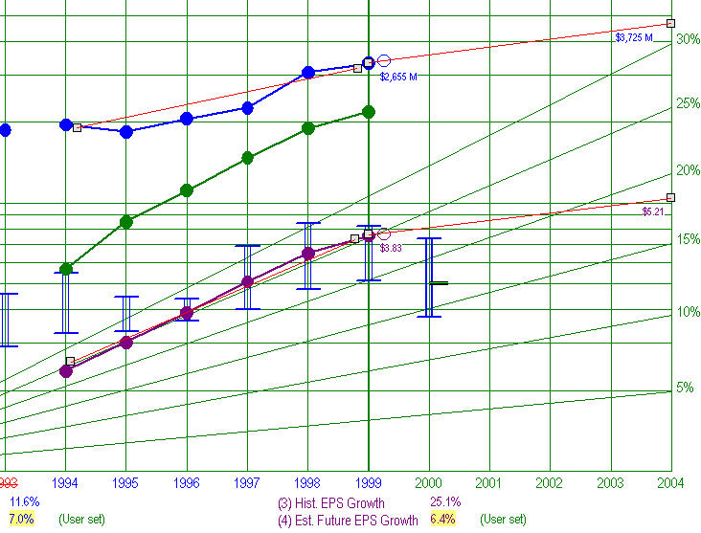
LAF SSG as of 4/26/2000
Est. EPS growth at 6.4%
Notes:
This is an example using a different software.
This is the SSG for LaFarge as of April 26, 2000.
Notice we expect Earnings Per Share to grow at only 6.4% going forward. © ©

Slide 45
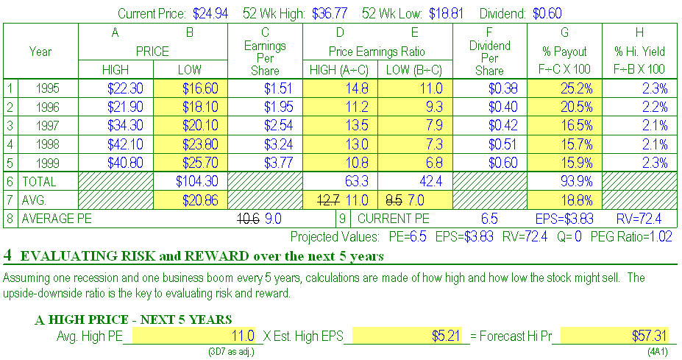
LAF on 4/26/2000
Notes:
If you look at our SSG you can see that the current P/E is 6.5. ©
Our historic average P/E as adjusted, we will just accept the adjusted amount for our purposes, is 9.0 ©
Our current P/E of 6.5 is well below our historic average as adjusted of 9.0. It looks like LaFarge is on sale, the P/E is well below the historic average.
You may also notice that the current P/E of 6.5 is actually below our historic average Low P/E as adjusted of 7.0 © This really looks like a fire sale. When the P/E is in fire sale range, I would revisit my research to make sure that there isn’t a reason the company is at fire sale prices.
ORIGINAL NOTES
Current PE well below historic average PE, and in fact a little lower than average low P/E --- i.e., room for P/E expansion
One bad thing about using NSA here is that when you change the estimated future P/E values in section 4, NSA actually goes back to section 3 and changes the historic average P/E ratios in lines 7 & 8. I consider that barbaric, but do understand the tradeoff (they’re trying to make RV come out more logically). Anyway, bottom line is that however you slice it, whether the historic average P/E ratio is 10.6 or 9.0, the current P/E of 6.5 when bought was well below the high and even the historic low P/E. Assuming it wasn’t a deal that’s “too good to be true”, it was a bargain.

Slide 46
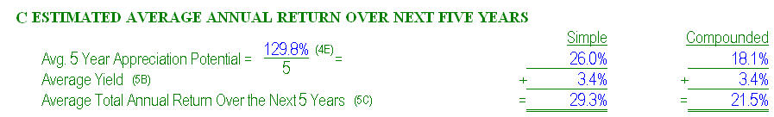
LAF on 4/26/2000
Potential Total Return: 21.5%
18.1% of that is potential price appreciation
What part of the 18.1% is from EPS growth?
6.4% (SSG page 1)
  Expecting lots of P/E expansion
Notes:
[36:30] This is section 5 showing our expected Compounded Average Annual return.
The expected potential return on our investment is 21.5%. © Our expected average yield is 3.4% © And, we expect price to appreciate 18.1% ©
Of our 18.1% stock price appreciation, how much can we expect will contributed by EPS growth? That is right, 6.4% - remember two slide ago we showed the estimated future EPS growth? It was 6.4%
If our stock price is expected to appreciate 18.1%, and we can attribute 6.4% of that appreciation to growth in Earnings Per Share, how much of our Stock Price appreciation is expected to come from buying at a Fire Sale? 18.1 – 6.4 leaves 11.7. We expect to get a return on our investment of 11.7% simply due to the fact that we bought the stock at a great price. In other words, we expect P/E expansion to contribute 11.7% growth in our stock price

Slide 47
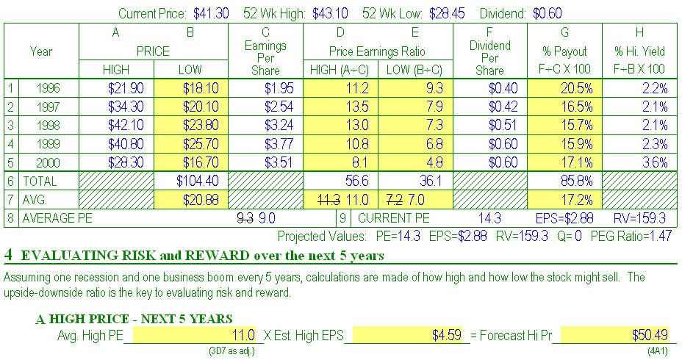
LAF on 3/4/2002
Notes:
[38:00] This is the updated SSG for LaFarge on the day it was sold, again using Value Line data current at that time.
Notice © that the Current P/E of 14.3 is well above the historic average PE of 9.0, and in fact above the average high PE of 11. This seems to indicate that there is no room for PE expansion.
The stock is very expensive at this point. It is selling for 14.3 times its Earnings Per Share, when on average it only sells for 9.0 times its EPS. In fact, on average, the highest the P/E normally goes is 11 times its EPS.
ORIGINAL NOTES
Per the slide title, this is from a different (updated) SSG created for LAF on the day sold, again using Value Line data current at that time.
Current PE is now well above the historic average PE, and in fact above the average high PE --- i.e., no room for PE expansion

Slide 48
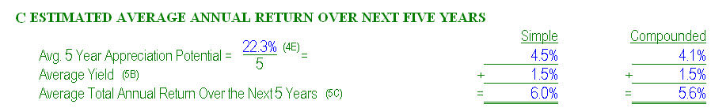
LAF on 3/4/2002
Potential Total Return: now just 5.6%
4.1% of that is potential price appreciation
Current P/E is so high that we actually expect P/E contraction from here
  Time to replace
Notes:
Right now, Price Appreciation makes up 4.1% © of our Total Return ©. That is well below the 6.4% Earnings per Share growth rate we had originally projected for LaFarge.
If the Price Appreciation is less than the EPS Growth Rate, P/E is costing us return, it is reducing our Total Return because we expect it go to lower than it is at the moment. This is P/E Contraction.
So what do you do?
Replace, or in this case maybe just sell even if no replacement candidate is available. If we really expect we could get P/E contraction, then selling even without a replacement might make sense.
Of course it’s better to replace than “just sell”, that way we remain fully invested.

Slide 49

Summary
Slower growing stocks can make sense
One approach to investing in tortoises:
  Buy quality stocks when P/E is below average.
  Consider selling when future Total Return is inadequate (P/E is above average)
  Or, if you’re satisfied with a lower return, continue to hold; it’s up to you!
Notes:
…

Slide 50

Summary
Does it always work out as easily and nicely as in the examples?
Of course not!
But the approach can work well
And, it expands your investment possibilities
Notes:
…

Slide 51


A big thank you to
BRIAN LEWIS and JIM THOMAS
who both taught this material before me and contributed so much to the class material.

Slide 52


Make A Difference In
Someone’s Life
If you have benefited from
BETTERINVESTING,
please pick up some
BETTERINVESTING
materials
and introduce others to this dynamic investment education opportunity!

Slide 53

Questions or Comments?
ah@cpabe.com
Avi Horwitz

